Slide 1
Decolonization
The End of Empire in the late 20th century

Slide 2
In the aftermath of World War II…
Decolonization began in earnest.
Many of the independence movements that had boiled up in the 1920s and 1930s reignited.
Popular opinion shifted from supporting imperialism to supporting decolonization.

Slide 3
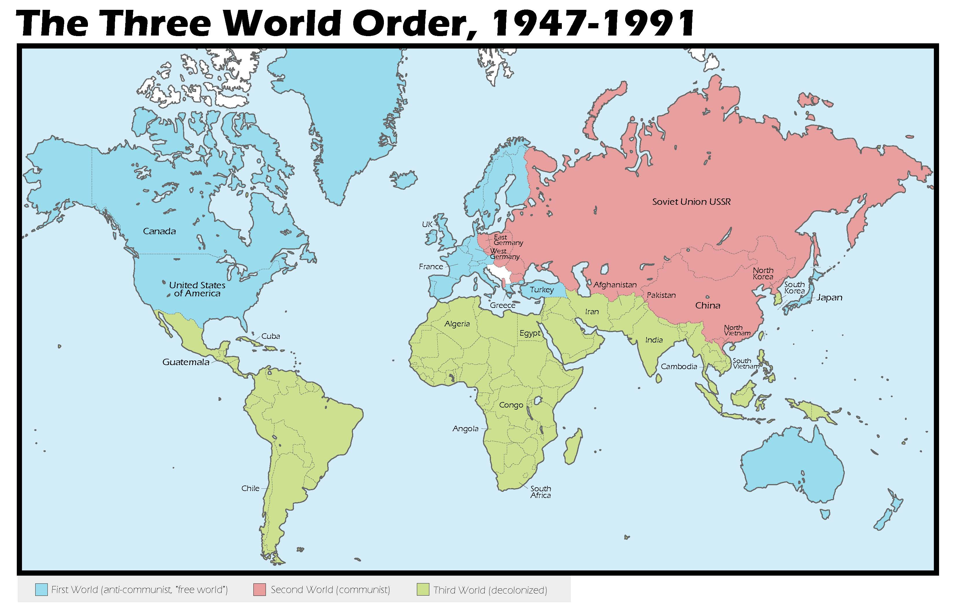

Slide 4
Decolonization in the Middle East

Slide 6
French in the Middle East
After the partition of the Ottoman Empire, France received a mandate to control modern-day Syria and Lebanon.
During World War II, when France was conquered by the Germans, they lost control of Syria temporarily reignite a Syrian independence movement.
In May 1945, French troops occupied the Syrian parliament and cut off Damascus’s electricity to try to subvert independence. France finally withdrew troops under international pressure in 1946.

Slide 7
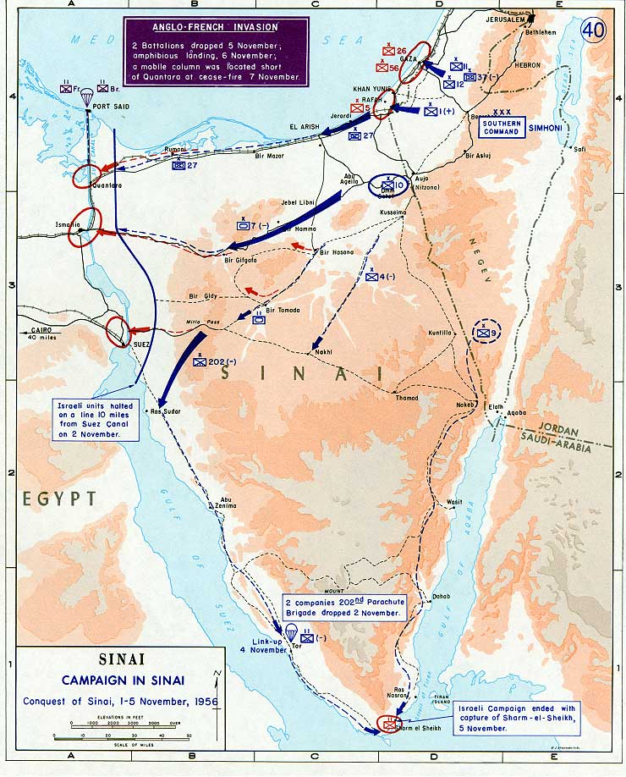
Britain in the Middle East
In the 1930s, British troops were granted permission to occupy portion of the Suez Canal zone.
In the 1950s, Egyptian President Nasser nationalized the Suez Canal and requested the removal of British troops → this led to the 1956 Suez Crisis
The crisis made Nasser a leader in the growing Arab and Egyptian nationalist movements.

Slide 8
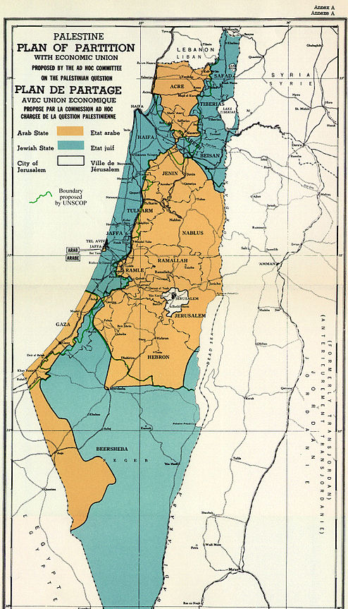
The Problem of Palestine
British proclaimed support for Jewish “homeland” in Palestine (Balfour Declaration, 1917) but at the same time attempted to limit Jewish migration.
Pan-Arab nationalism generally opposed the Jewish state
Jewish, Arab pressure drove British to hand Palestine over to United Nations for a resolution
Partition plan of 1947 divided Palestine into two distinct states → Arab leaders contested this as a violation of the concept of self-determination

Slide 9
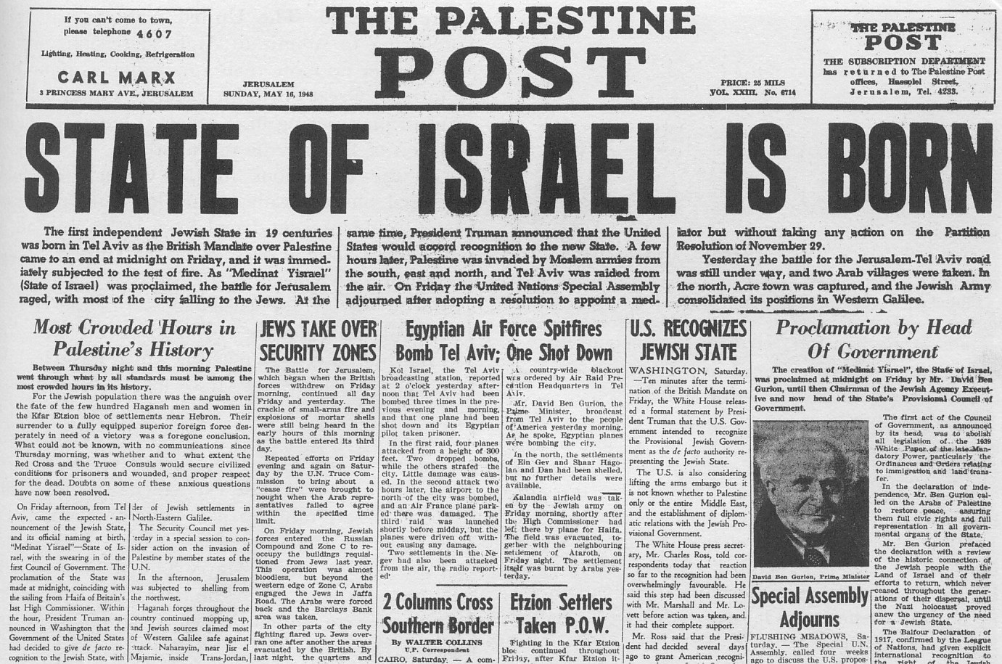
The Creation of Israel
May 1948, Jewish state declared independence of state of Israel
Sparked series of conflicts spanning five decades
Israel greatly expanded territory
Intifada (1987-1991 Palestinian uprising)
The US and United Nations both recognized the legitimacy of the independent nation of Israel.

Slide 10
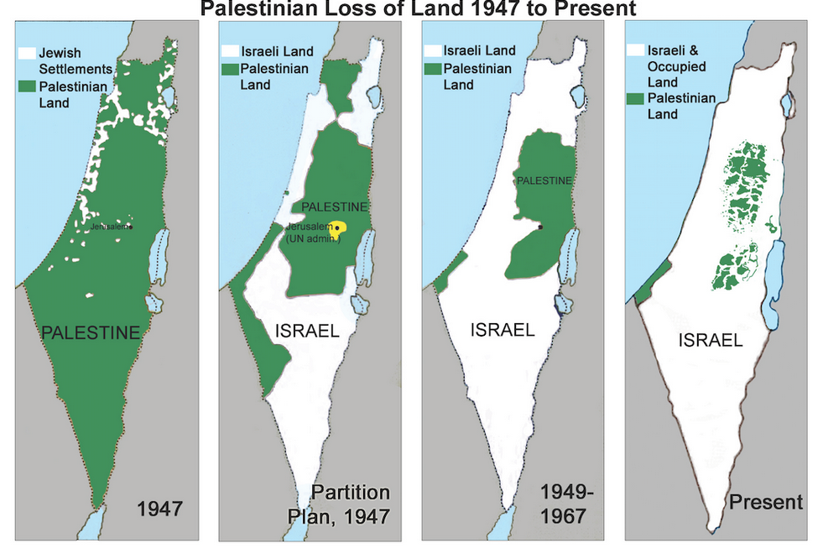

Slide 11
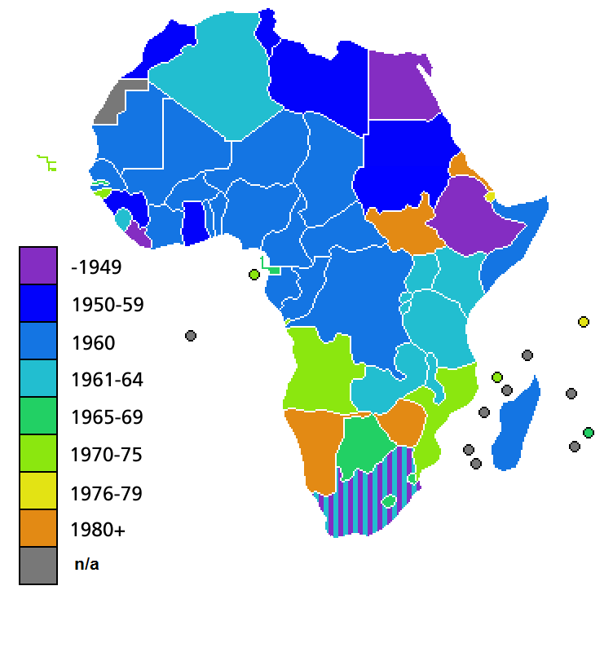
Decolonization of Africa

Slide 12
Négritude
Négritude movement
Influence of “black is beautiful” from U.S.
Revolt against white colonial values, reaffirmation of African civilization
Connection with socialism, communism
Geopolitical implications of the Cold War meant that the connection of decolonization movements with communism limited support from many Western nations.

Slide 13
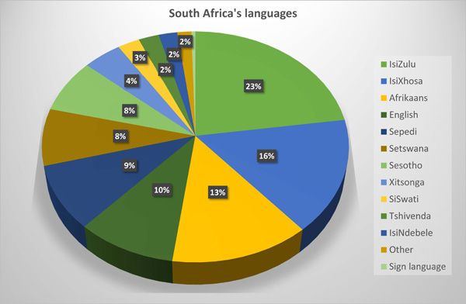
Decolonization in Africa
Legacy of colonial rule, arbitrary borders led to extensive issues.
Internal divisions among nations:
Different tribes,
Different ethnicities,
Different languages,
Different religious traditions
For example, in South Africa, 10+ languages were spoken as native languages.

Slide 14
The French in Africa
In the 1950s France began the process of relinquish control over its African colonies.
But French determined to retain Algeria
Longer period of French colonization (began in 1834, before the “Scramble of Africa”)
Two million French citizens born or settled in Algeria by WWII

Slide 15
War in Algeria
1954 Front de Libération Nationale (FLN) began guerilla warfare against France
Simmering conflict since French massacre in Sétif, 1945
500,000 French soldiers involved in the war by 1958
Like the Vietnam War for Americans, the War in Algeria became increasingly volatile at home. Frantz Fanon, The Wretched of the Earth (1961), manifesto against colonial rule.
War ended with Algerian independence in 1962

Slide 16
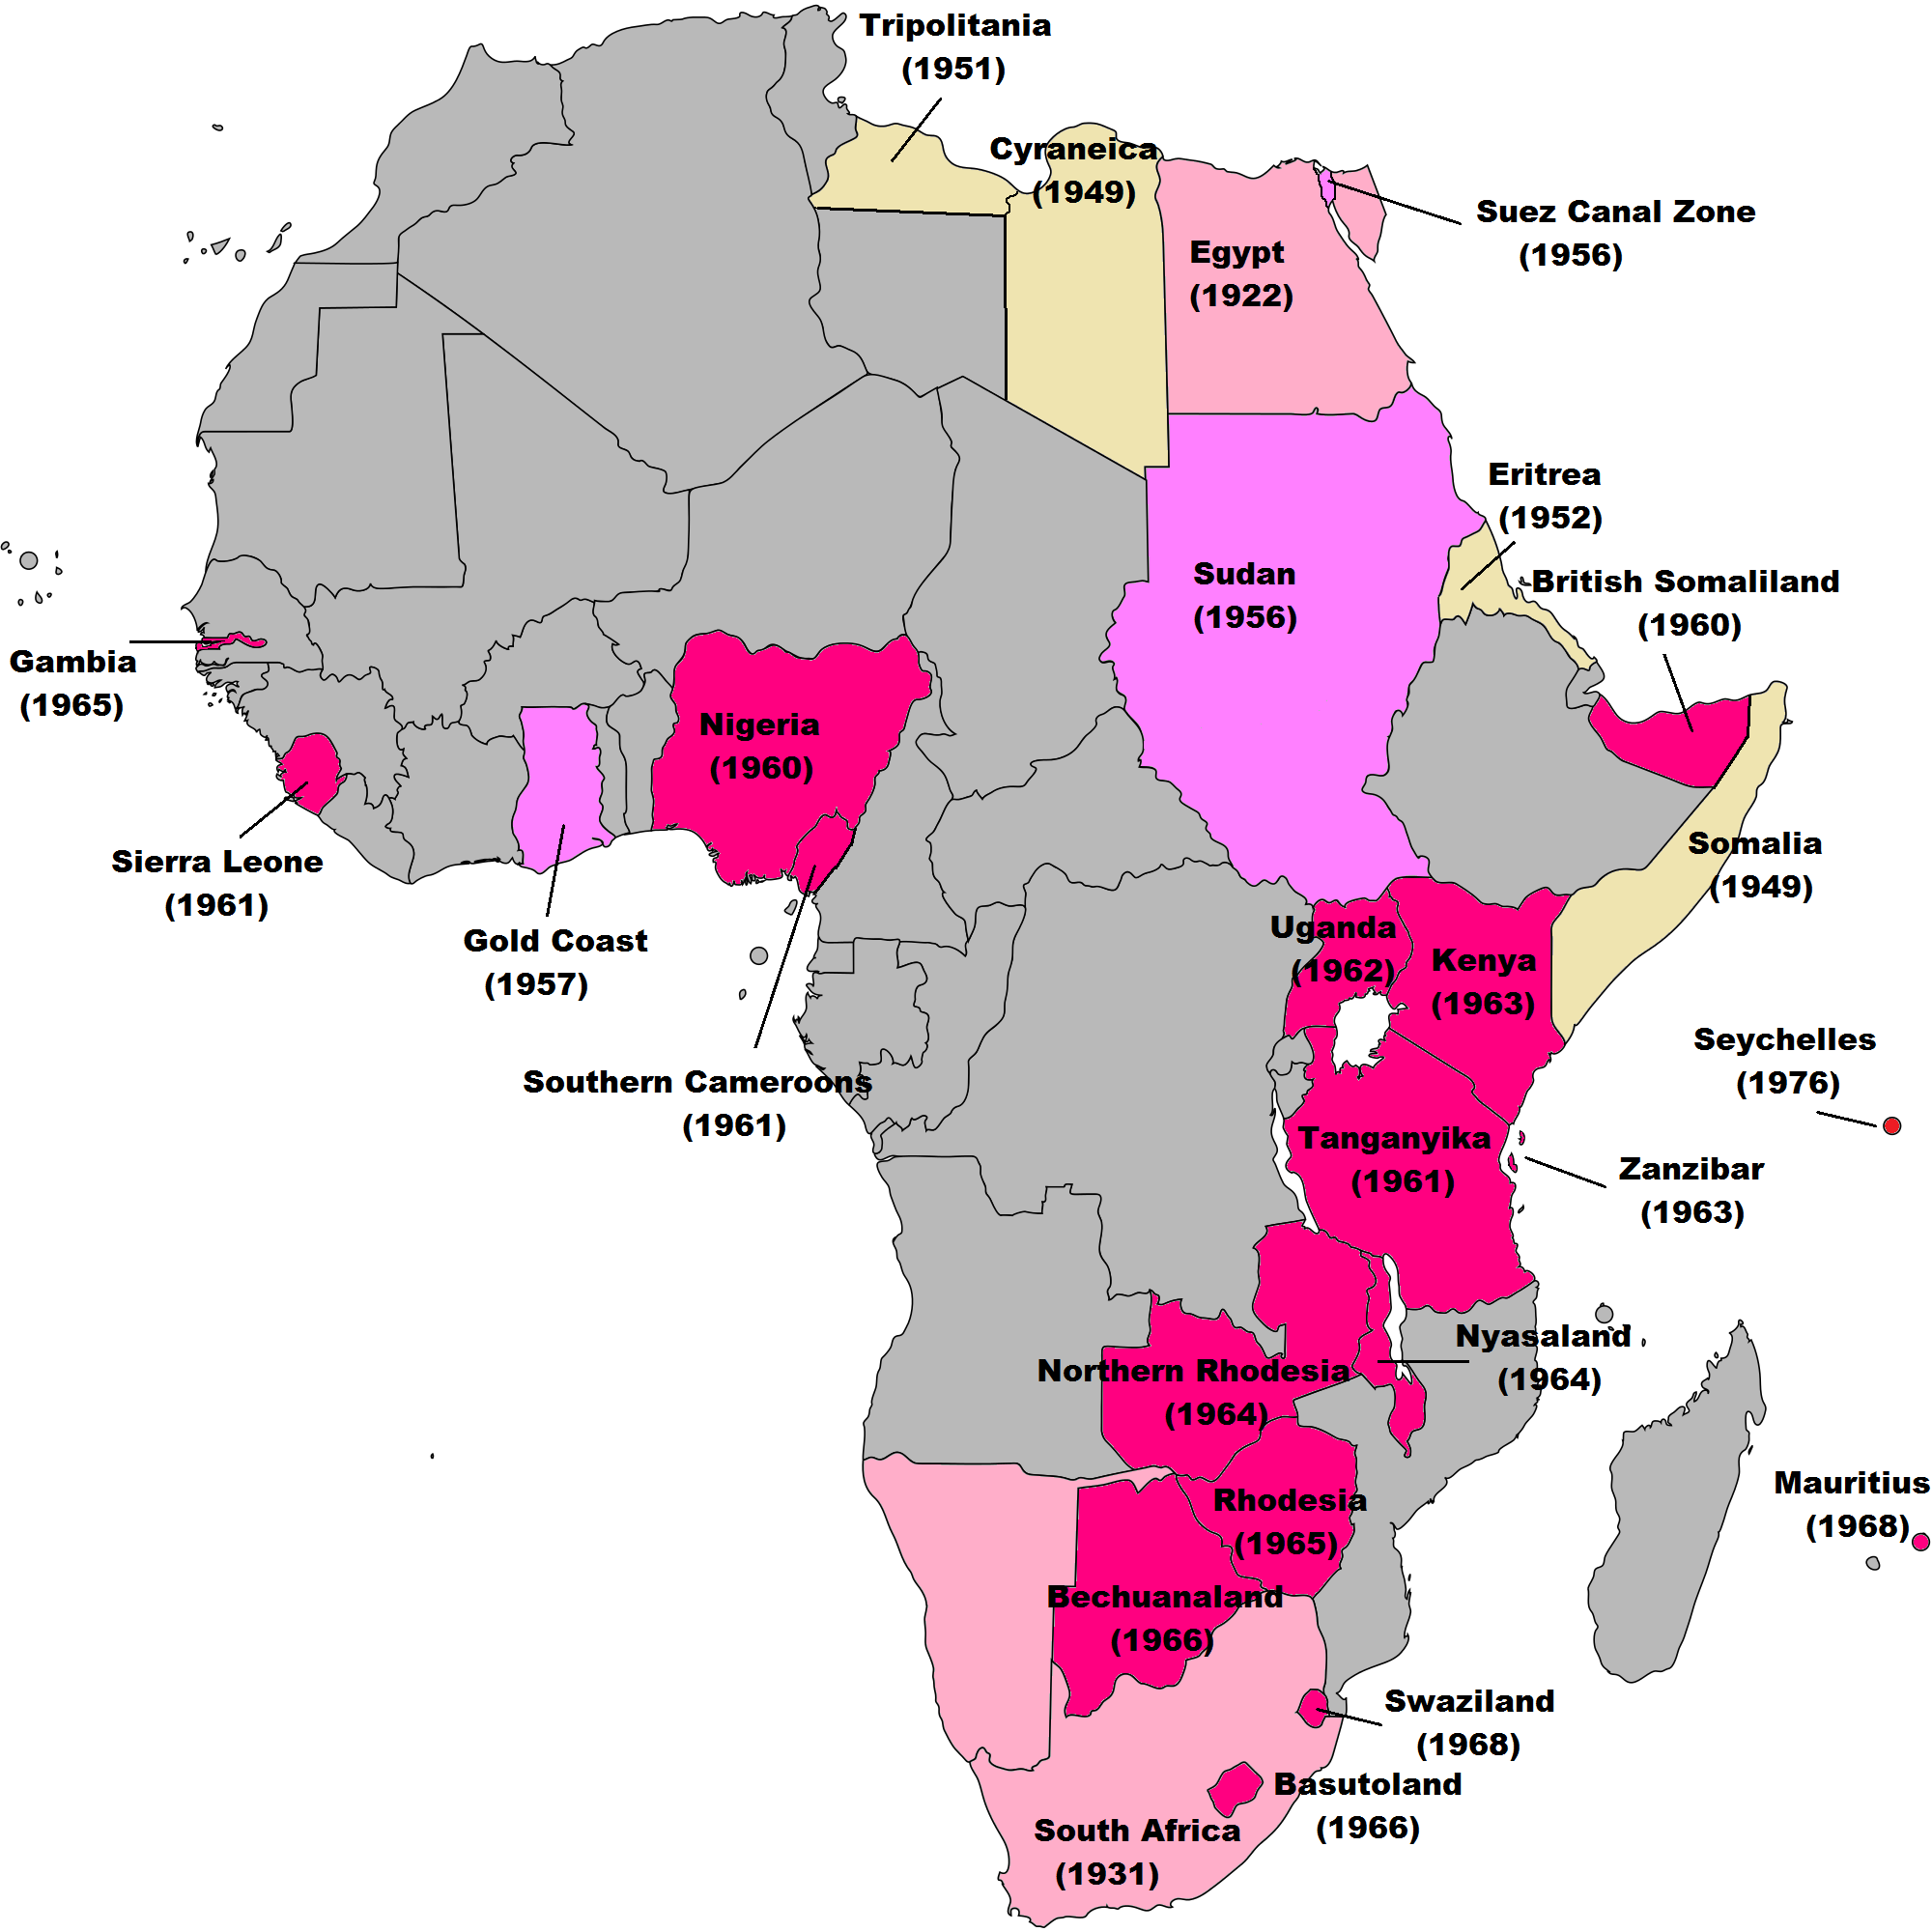
The British in Africa

Slide 17
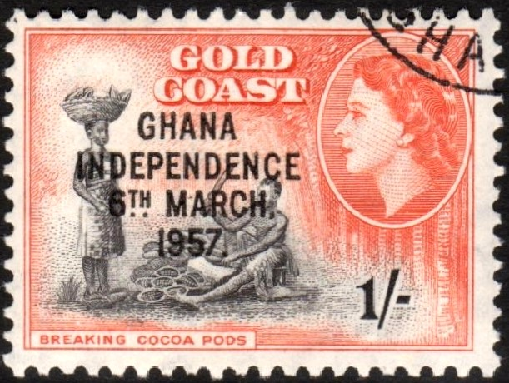
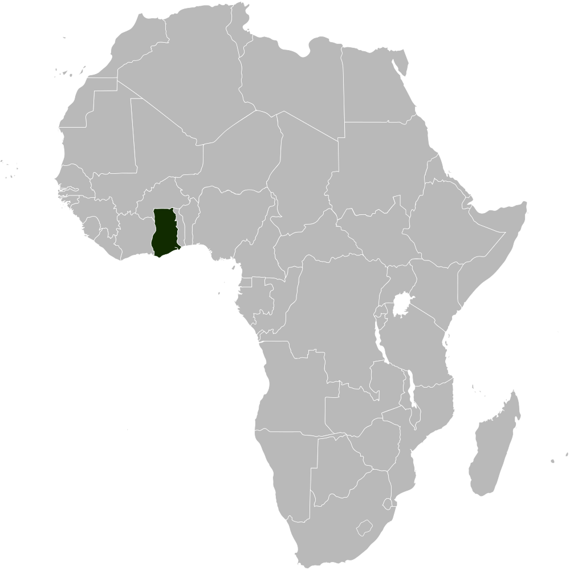
Ghana aka “The Gold Coast”
In 1957, the Gold Coast became the first sub-Saharan colony to achieve independence and renamed itself Ghana.
Celebrated Queen Elizabeth II’s visit in 1961 as an affirmation of Ghana’s independence and equality with the former colonizer

Slide 18
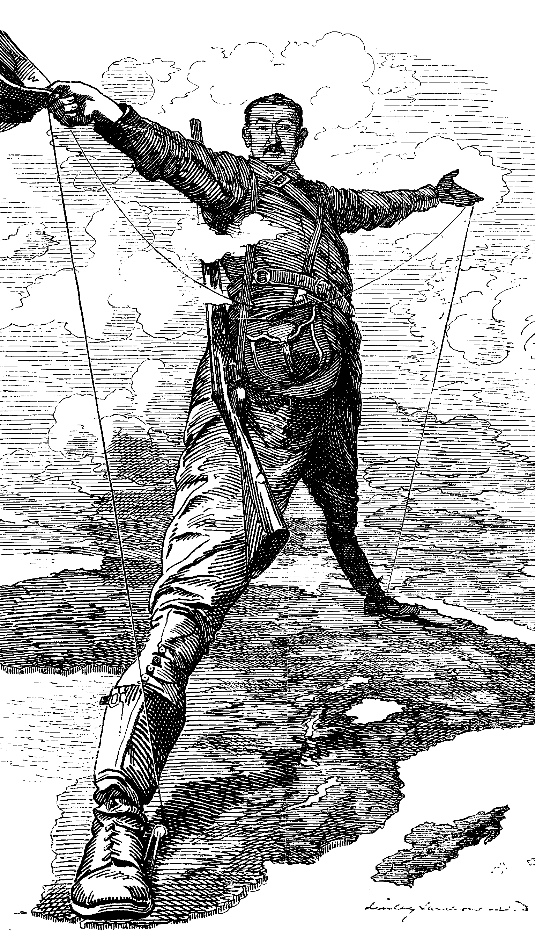
Anticolonial Rebellion in Kenya
In 1952 Britain declared a state of emergency in response to the Mau Mau, a group which advocated violent resistance to British domination in Kenya
After more than a decade of conflict, Britain recognized Kenyan independence in 1963.

Slide 19
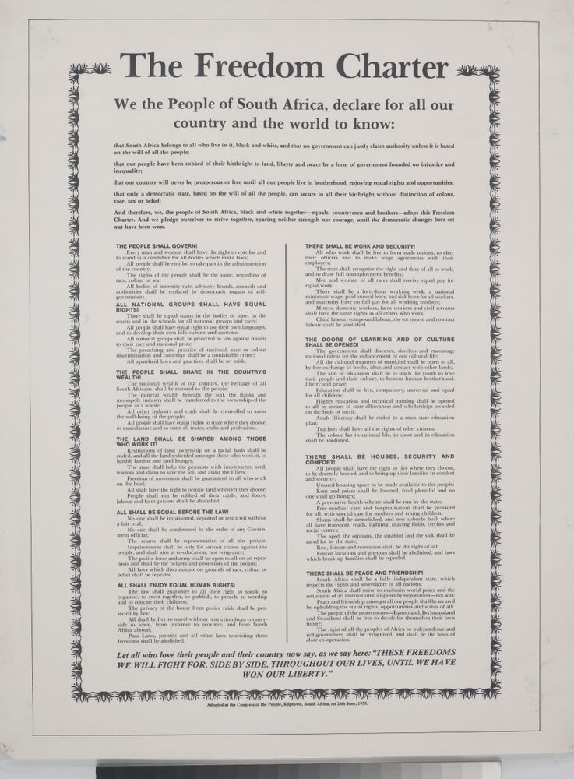
Legacies of colonialism: Apartheid
Apartheid legalized segregation that was instituted in 1948.
African National Congress (ANC) published Freedom Charter, 1955
Repression of ANC caused worldwide ostracism of South Africa
In 1970, the South African government stripped black South Africans of their citizenship.

Slide 20
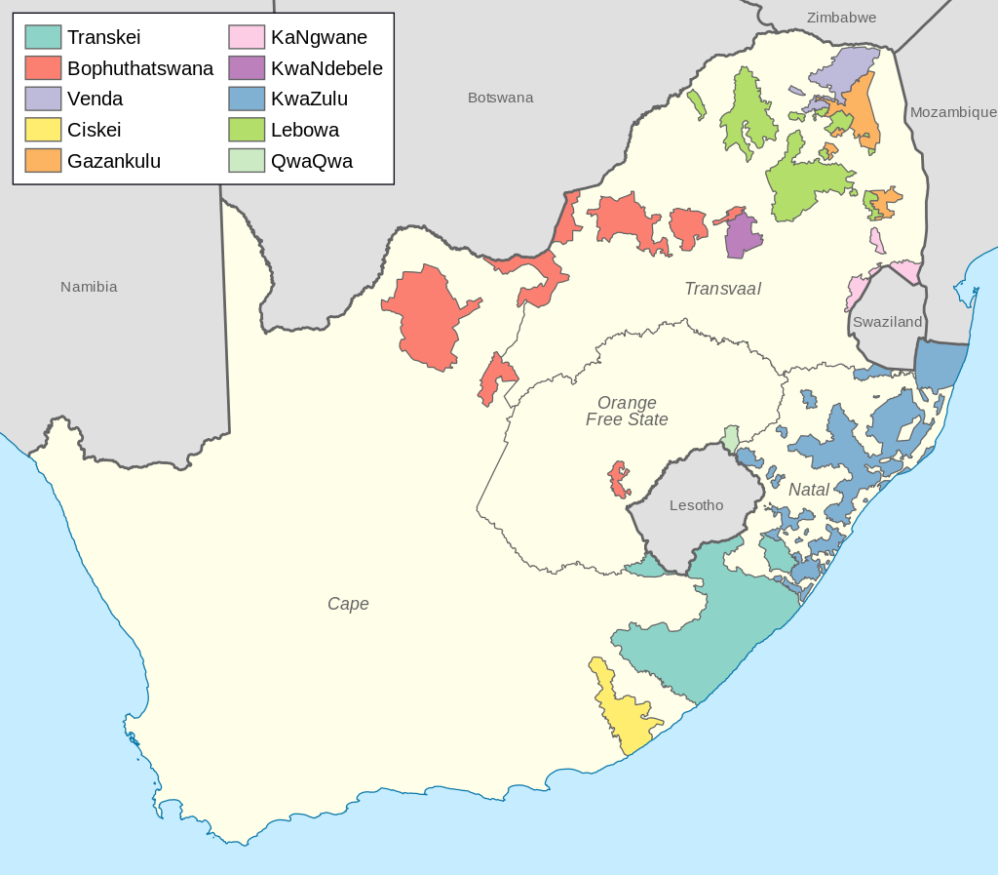
South Africa: Under apartheid almost 90% of territory was reserved for whites. Division of Africans into tribal “Bantustan” or homelands.

Slide 21
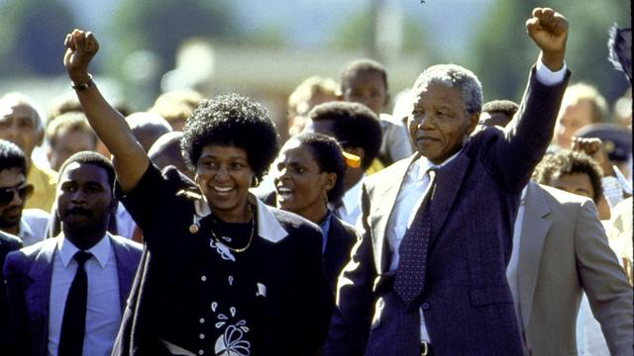
The End of Apartheid
Release of Nelson Mandela, 1990
Negotiation of end of white minority rule
1994 elections brought African National Congress (ANC) to power
Relatively calm transition to democratic society

Slide 22
Colonial Legacies in Sub-Saharan Africa
Boundaries declared permanent regardless of ethnic disputes which has led to many civil wars
--Rwandan Civil War (1990s) and Tutsi genocide
--Sudanese Civil War and Darfur genocide
Falling commodity prices; continued poverty →New International Economic Order, 1970s
--Sought to improve terms of trade and provide tariff reductions for Third World countries.

Slide 23
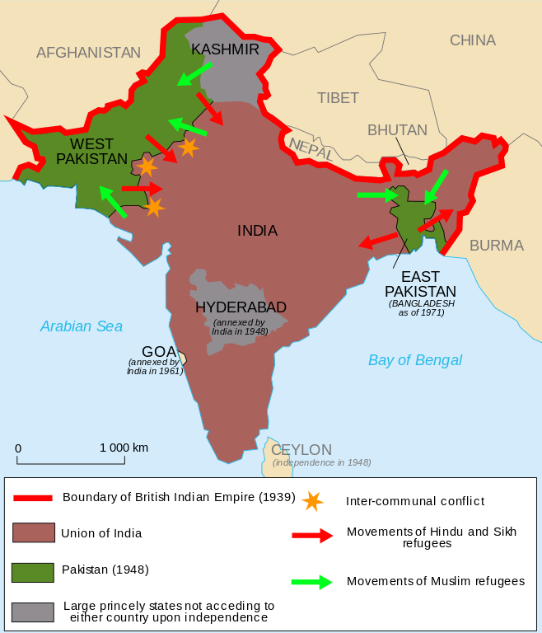
India

Slide 24
Home Rule for India
Since the 1930s non-cooperation movement, India had been arguing for “home” or self rule.
A Major debate about whether Muslims would be treated equitable under a Hindu majority government.
Muslim separatism versus. communalism
Direct Action Day, August 16, 1946
A political action day suggested by the Muslim League which deteriorated in intense violence.
→Great Calcutta Killing

Slide 25
Partition and Violence
1947 partition and the Great Migration:
Around, 6.5 million Muslims moved from East Punjab to West Punjab and 4.7 million Hindus and Sikhs moved from West Punjab to East Punjab.
Estimates of tens of thousands of deaths as refugees sought to migrate to either Pakistan (West Punjab) or India (East Punjab).
1947, photograph of a train with a massive number of political refugees →

Slide 26
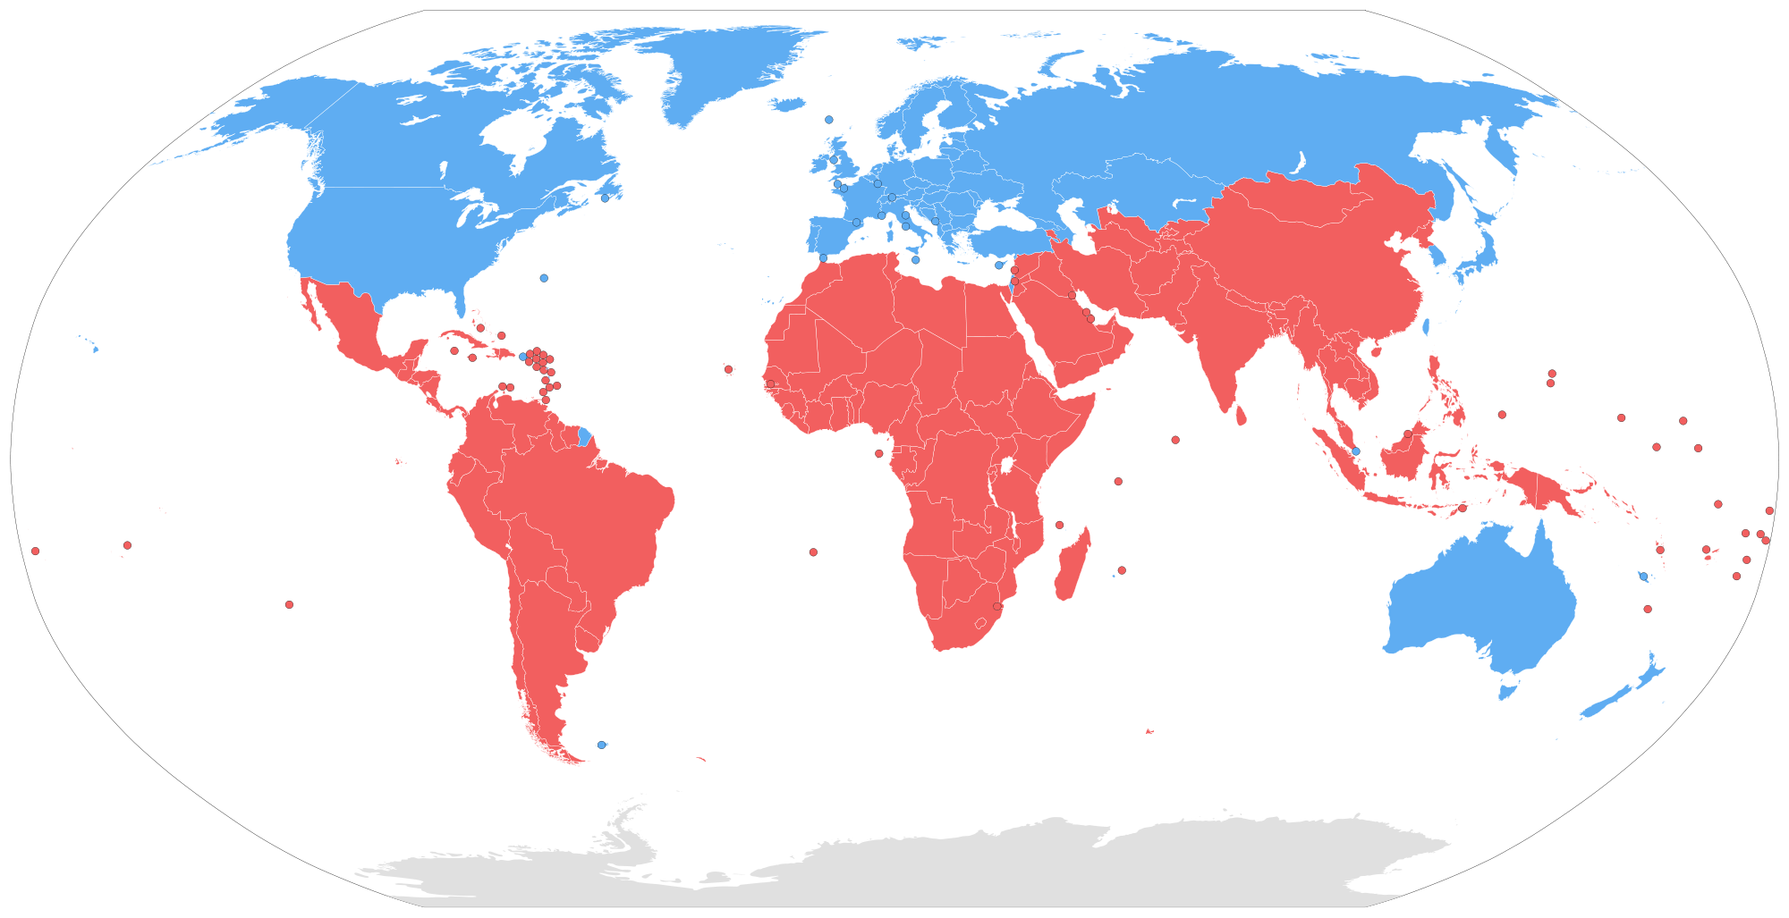
The Global South
The legacies of exploitation continue to impact much of the Global South in the modern day.
From the early modern era colonization of the Americas and South East Asia to the 19th century neo-imperialism of Africa, the past fifty years represents the first time since the rise of the nation-state that a majority of the globe’s population has had rights of self government.

