Slide 1
World War II

Slide 2
World War II
Allies vs. Axis powers
Italy, Germany and Japan formed Axis
Great Britain, France, Russia (and later the United States) were the major Allied powers
Allies initially followed policy of appeasement
Asian conflict began in 1930s, European war erupted 1939
Global by 1941; over in 1945

Slide 3
World War II in East Asia

Slide 4
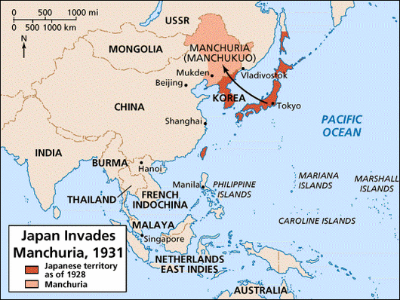
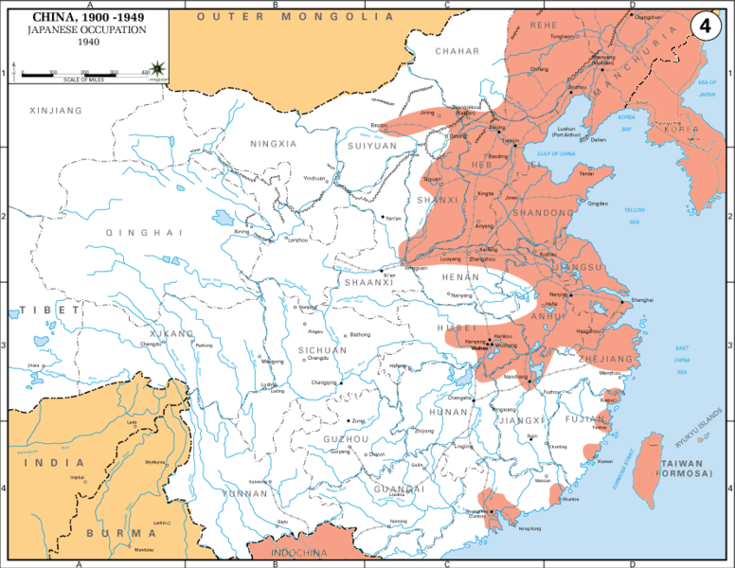
Japan’s imperialist ambitions
Conquest of Chinese Manchuria 1931–1932
Japan signed Tripartite Pact with Germany, Italy (1940); neutrality pact with Soviet Union (1941)
Full-scale invasion of China in 1937
Incredibly brutal treatment of Chinese citizens
Japan believed they were ethnically superior to Chinese
Please be advised, the next slide contains graphic imagery.

Slide 5
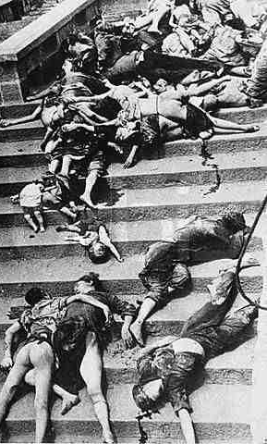
Rape of NanKing
In December 1937, the Japanese Imperial Army entered the city of Nanking.
Ariel bombing of urban center
Massive amount of the city destroyed
The brutality was horrifying:
400,000 Chinese were massacred as “bayonet practice”
Estimates that over 7,000 women were raped

Slide 6
New York Times Reports
BUTCHERY MARKED CAPTURE OF NANKING
All CAPTIVES SLAIN
Civilians Also Killed as the Japanese Spread Terror in Nanking
U. S. EMBASSY IS RAIDED
Capital’s Fall Laid to Poor Tactics of Chiang Kai-shek and Leaders’ Fight
By F. Tillman Durdin
ABOARD THE U. S. S. OAHU at Shanghai, Dec. 17 – Through wholesale atrocities and vandalism at Nanking the Japanese Army has thrown away a rare opportunity to gain the respect and confidence of the Chinese inhabitants and of foreign opinion there.
Demonstrates that Western nations both knew about the horrific events and did little to reprimand the Japanese.
The failure of Chiang Kai-shek and the Kuomintang
party to protect Chinese citizens contributed to growing support for the Communist Party.

Slide 7
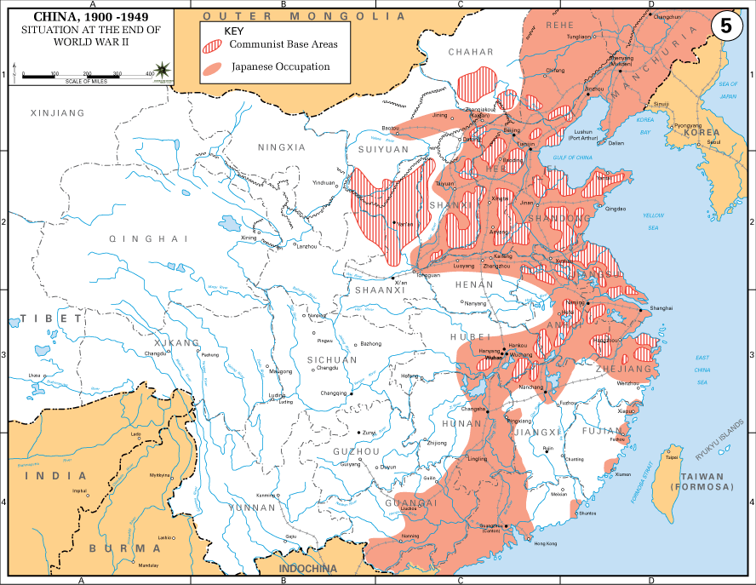
Chinese Resistance
Japanese aggression spurred a temporary “united front” policy between Chinese Communists and Nationalists, or Kuomintang party
Guerilla warfare tied down half of the Japanese army
Ultimately, continued clashes between Chinese Communists and Nationalists limited Chinese defense:
By the end of World War II the Chinese Communist Party had gained popular support.

Slide 8
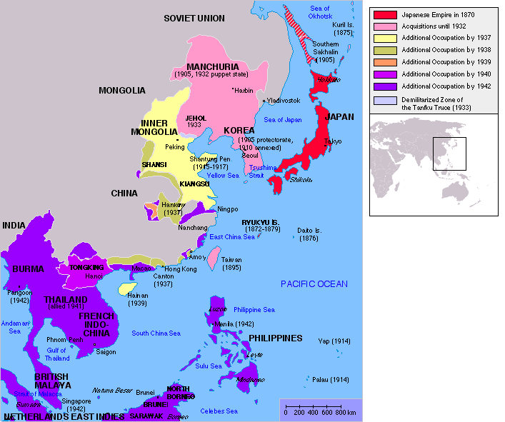
Japanese army and navy was incredibly successful at conquering western imperial territories including French Indochina, Burma, Malaysia, the Philippines, and Indonesia.
After the US entered the war in December 1941, the process of “Island Hopping” to retake territory and ultimately attack Japan began in earnest.

Slide 9
World War II in Europe

Slide 10
Expanding Axis: Italy & Germany
Italy in the 1930s
Germany in 1930s
Italy invades Ethiopia 1935
2,000 Italian troops killed; 275,000 Ethiopians killed
Italy invades Albania in 1939
1935 Germany announces remilitarization
1936 Germany invades Rhineland
1938 invade Austria & Czechoslovakia
1939 invade Poland & Lithuania

Slide 11
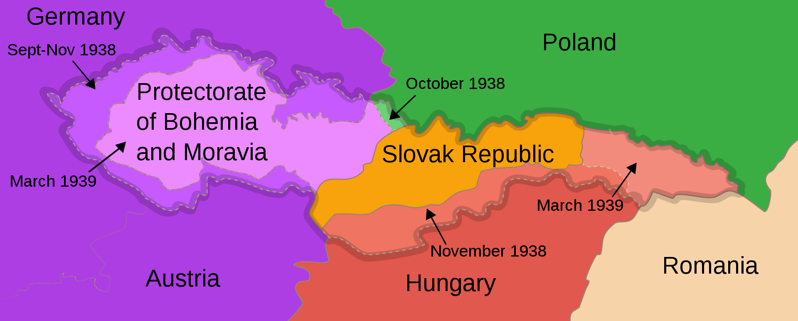
Appeasement
France and Britain appeased Germany repeatedly in the 1930s in an effort to avoid war
Munich Pact of 1938→ control of the Sudetenland in CZ (Hitler “promised” it would be his furthest advancement fall 1988)
Four months later, March 1939, Hitler invaded the rest of Czechoslovakia

Slide 12
An American Experience, 1938

Slide 13
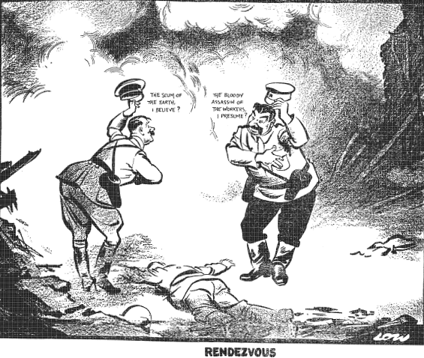
Non-Aggression Pact
Neither country would attack the other.
Hitler saw it as a way to keep the USSR from attacking Germany,
Stalin saw it as a way to provide the USSR with time to prepare for Germany’s inevitable invasion.

Slide 14
Escalating Anti-Semitism
Throughout the 1930s in a process known as “Nazification” Hitler and the fascist Nazi party normalized anti-Semitism.
Kristallnacht: major country-wide pogrom against Jewish businesses and synagogues, November 9–10, 1938
“Night of broken glass”
Nazis initially encouraged Jewish emigration
Few countries willing to accept Jewish refugees

Slide 15
The St. Louis
In 1939, a ship carrying 900+ Jewish refugees planned to land in Cuba while refugees waited US visas.
Ultimately, the ship is denied entry and crew spreads lies that the ship will be permitted in an attempt to avert suicides. Ship is sent back to Germany
Of the passengers on the St. Louis, 254 died as a result of the Holocaust

Slide 16
The Holocaust & The Final Solution
Ethnic Jews primary target of Nazi genocidal efforts
Other groups also slated for destruction, including political dissidents (Communists), religious dissidents (Jehovah’s Witnesses), people with disabilities, and other ethnicities such as Roma.
Einsatzgruppen (mobile killing squads) followed German army into Soviet Union with Operation Barbarossa
Round up of Jews and others; mass shootings and mass graves
Later in 1941 decided on “final solution”: deportation of all European Jews to extermination camps

Slide 17
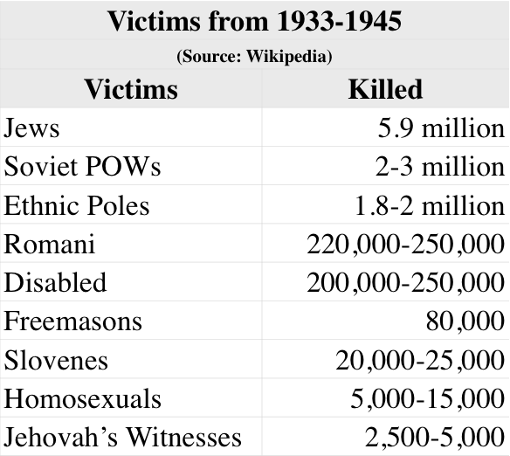
Hitler’s Final Solution
Jews forced to live in ghettos or concentration camps, then in the spring of 1942 were systematically deported to extermination camps.
Through bureaucratic assembly-line style of organization, many Germans were involved in the Final Solution (rail conductors, factory managers, etc.)
People who were deemed to not be of value in production, were murdered through poison gas (Zyklon B) in rooms designed to look like showers.
Corpses destroyed in crematoria

Slide 18
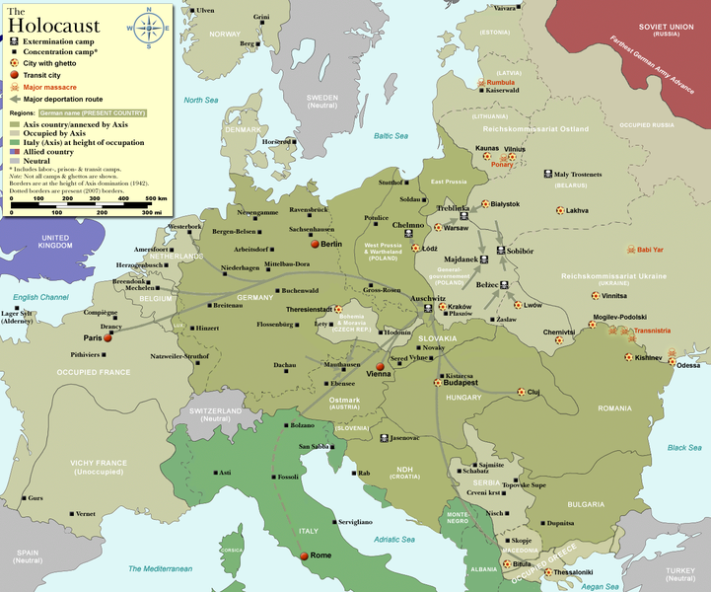
The Holocaust in Europe, 1933–1945

Slide 19
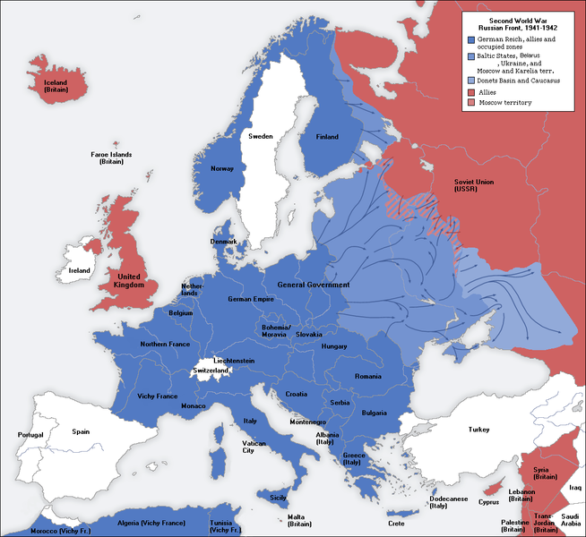
Axis Success
For the first few years of the war, Hitler’s fascist war machine seemed to be unstoppable.
Blitzkrieg meaning 'Lightning War', was the method of offensive warfare which utilized tanks and aircraft.
Nazi Germany expanded their influence throughout most of mainland Europe from 1939-1944.

Slide 20
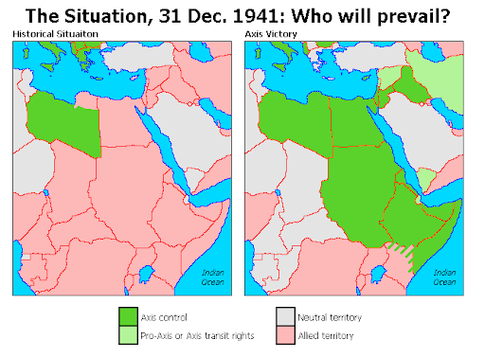
Africa: Strategic Competition
Italy and Germany invested a significant effort into controlling North Africa and the Suez Canal.
Pushing into West Asia would allow them to control important oil fields.
Britain and the United States concentrated their efforts against the Axis in Africa before creating a “Second front” in Europe.
Allies victorious by summer 1943.

Slide 21
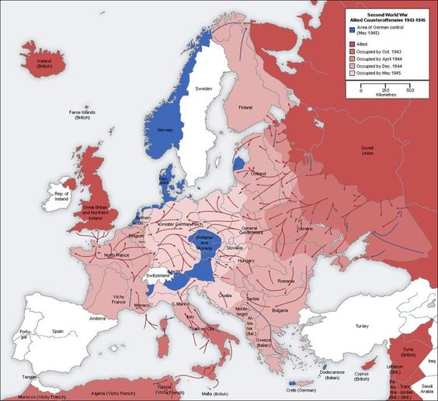
Turning Tide in Europe
Red Army (Soviet Union) gained offensive after Stalingrad (February 1943)
D-Day: June 6, 1944, British, French, and U.S. forces landed in France
Aerial bombing of Germany cities and industrial sites by Allies
30 April 1945, Hitler committed suicide;
8 May, “V-E” Victory in Europe Day when Germany surrendered

Slide 22
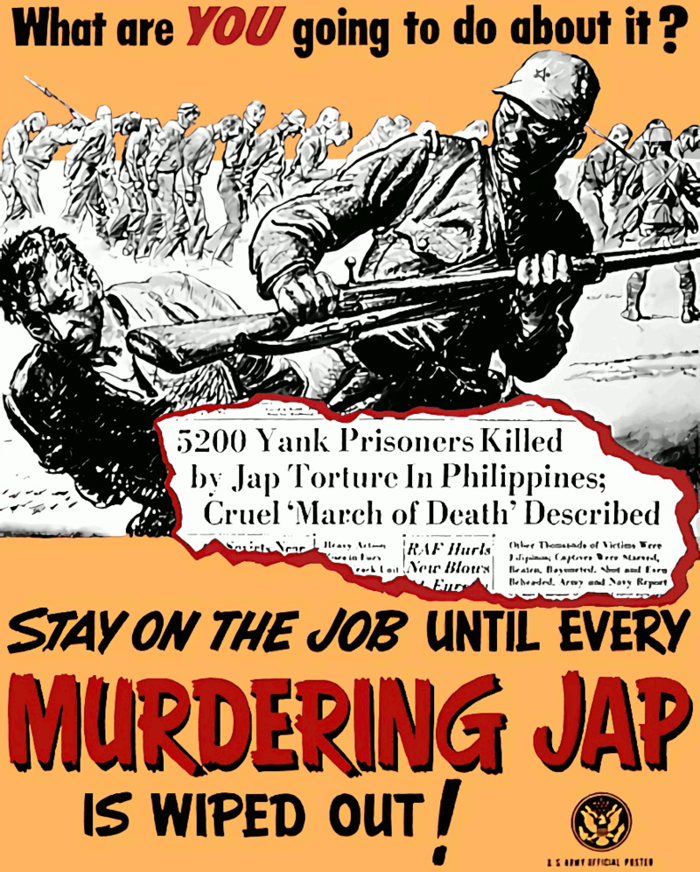
Turning the Tide in the Pacific
Battle of Midway consider turning point in the Pacific, June 1942
US took the offensive, engaged in island-hopping strategy
Racialized War:
Both the Japanese and the US believed they were ethnically superior
Dehumanizing the enemy became a common element of the war in the Pacific
Iwo Jima and Okinawa
Japanese were instructed never to surrender which lead to incredibly aggressive fighting
Savage two-month battle for Okinawa

Slide 23
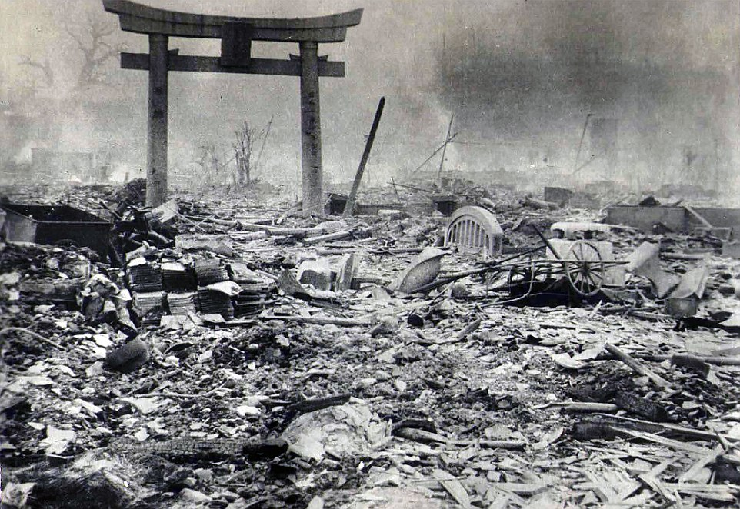
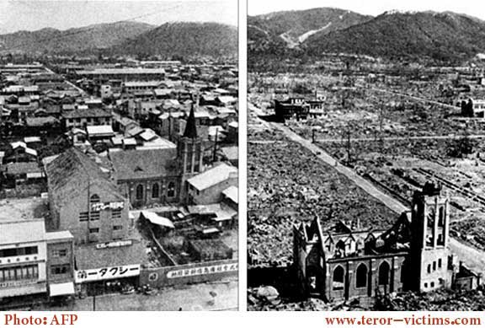
Japanese Surrender
U.S. firebombing of Tokyo, March 1945
100,000 killed
One-quarter of buildings destroyed
Atomic bombs dropped on Hiroshima and Nagasaki, August 1945
Emperor Hirohito (1901–1989) surrendered unconditionally September 2, 1945
8/6/45 Hiroshima: death toll 133,000
8/9/45 Nagasaki: death toll 50,000

Slide 24
Co$t of war ?
Financial Cost of World War II
1 | U.S. | $341 billion in 1945 | would cost | $3,582,143,803,399.78 in 2005.
2 | Germany | $272 billion in 1945 | would cost | $2,857,311,186,289.56 in 2005.
3 | Soviet Union | $192 billion in 1945 | would cost | $2,016,925,543,263.22 in 2005.
4 | Britain | $120 billion in 1945 | would cost | $1,260,578,464,539.51 in 2005.
5 | Italy | $94 billion in 1945 | would cost | $987,453,130,555.95 in 2005.
6 | Japan | $56 billion in 1945 | would cost | $588,269,950,118.44 in 2005.
 | Total | $1.075 trillion in 1945 | would cost | $11,292,682,078,166.46 in 2005.

Slide 25
Cost of the War

