Slide 1
The Interwar Years

Slide 2
Outline
Role of WWI in Anti-Colonial Movements
India
Africa
The Great Depression
Rise of Totalitarian Regimes
Russian Revolution and Rise of USSR
Fascism and the Nazi Party
Chinese Nationalism

Slide 3
Anti-Colonialism
Post World War I peace talks incorporated an ideological challenge to colonial rule embodied through Wilson’s Fourteen Points.
Despite this, both Britain and France maintained their imperial rule, often violently suppressing anti-colonial nationalist challenges.
While many of these independence movements failed to achieve success prior to World War II, the 1920s and 1930s movements were the impetus for change which was to come in the 1950s and 1960s.

Slide 4
India’s Quest for Home Rule
Indian National Congress founded 1885, to promote self-rule
→Initial support from both Hindus and Muslims
British encouraged development of Muslim League (1906) to blunt Congress
Original position in favor of collaboration with British; after World War I, moved to opposition

Slide 5
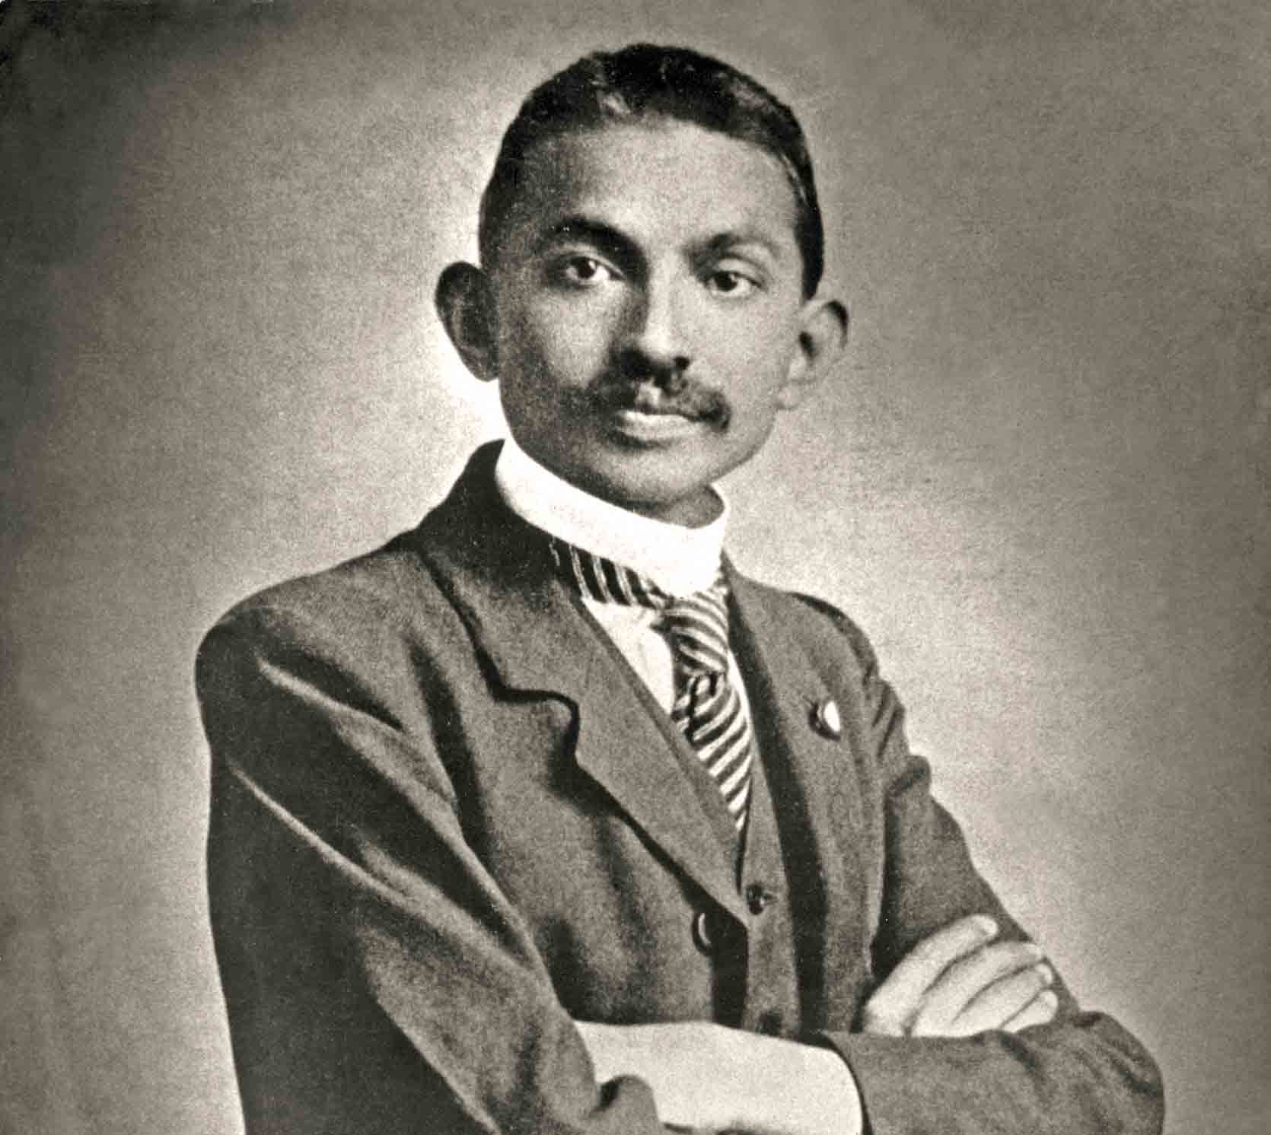
“Mohatma” Gandhi (1869–1948)
Hindu, studied law in London, practiced in South Africa
Opposed racial segregation
Returned to India 1915; made Indian National Congress into a mass movement
Titled Mahatma: “great soul”
Opposed caste system

Slide 6
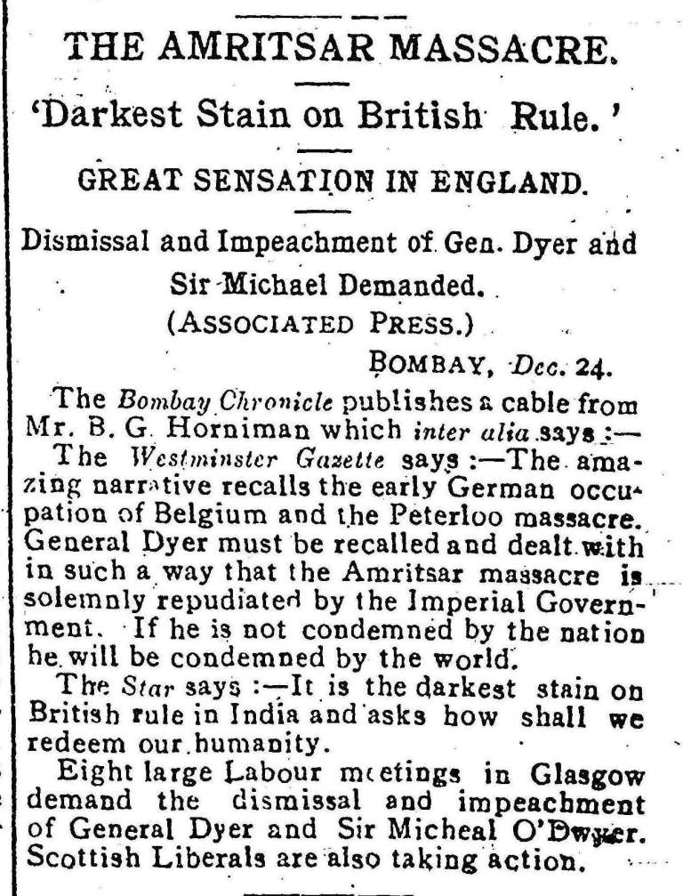
Massacre of Amritsar
April 13, 1919 in Punjab, India (northern India)
British troops fire into a crowd of thousands killing nearly 400 unarmed civilians and wounding over a thousand.
*marked a turning point in India’s modern history, deteriorated Indo-British relations and was the prelude to Indian nationalism and independence.

Slide 7
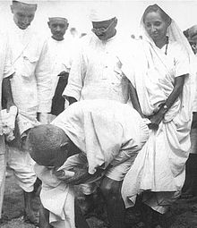
Salt March 1930
In March 1930, Gandhi set out with several dozen followers on a trek of 240 miles to the coastal town of Dandi on the Arabian Sea.
Goal was to intentionally break British policy of distilling salt from salt water
Gandhi arrested setting off a wave of massive protests against imperial control.

Slide 8
A force more powerful
https://vimeo.com/112189700
00:00-26:30
--What techniques does Gandhi use to challenge British authority?
--How does the British imperial government respond?
--Does civil disobedience work?

Slide 9
Africa

Slide 10
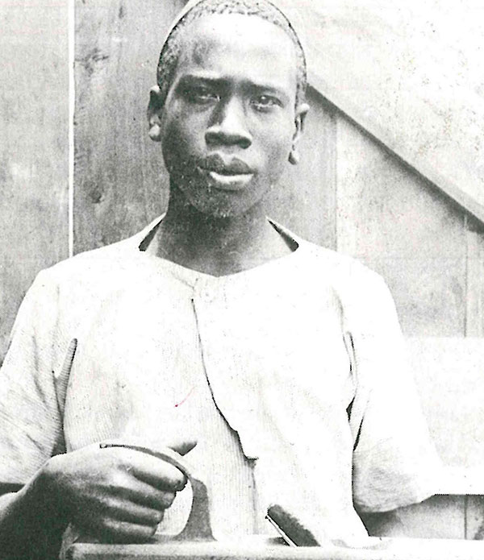
Fighting for Independence
Often influenced by education, experiences abroad during the War
Moved to create modern nation-states in Africa
Resistance to independence movements from European colonizers.
One exception to this was Egypt which was granted Independence in the inter-war years
Jomo Kenyatta (1895–1978), Kenyan nationalist
Became a vocal supporter of independence and pan-Africanism. Compared imperialism to fascism.

Slide 11
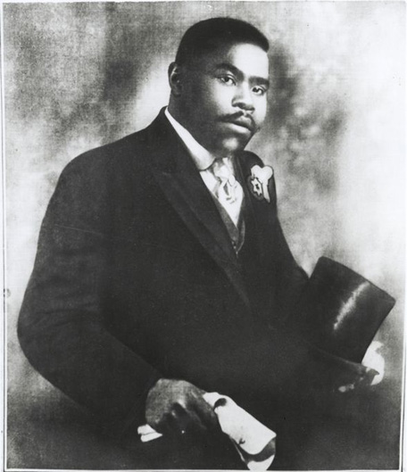
Pan-Africanism
Marcus Garvey (Jamaica, 1887–1940)
“Back to Africa”
→ Universal Negro Improvement Association, 1914
Millions of members around the world:
--promoted race pride,
--economic self-sufficiency in the black community,
--and pan-Africanism more broadly
Garvey linked Pan-Africanism with industrialization and modernization

Slide 12
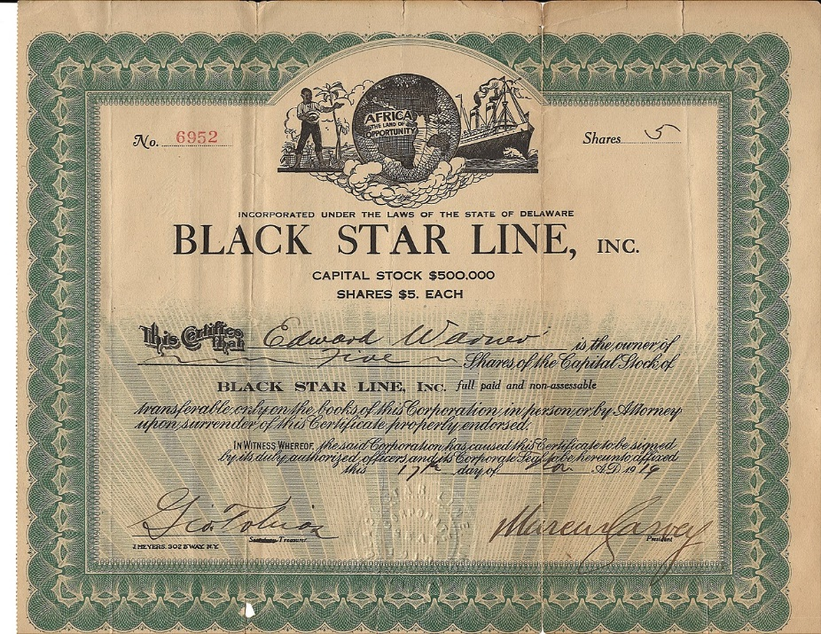
Industrialization in Africa
“In countries like Liberia railroads must be built. Industrial plants must go up if the race is to rise in greatness. Are you prepared to do your part? Men, can you be a commercial power by bowing at the footstools of other races? Can you become and industrial power by giving all energy and wealth to other races? The answer is No. But you can become a great commercial and industrial power by amassing and pooling your own industries and forming your own commercial enterprises...” -Garvey, 1920

Slide 13
Foreign interventions and imperialist attitudes remained high throughout much of the inter-war years. Despite this, growing challenges to capitalistic imperialism increased and challenged the standing world order which was dominated by Euro-American interests. Nationalism spurred independence movements around the globe and the failures of capitalism (Great Depression and colonialism) caused many to seek out alternative forms of government.

Slide 14
The Great Depression
Economics in the inter-war years

Slide 15
War debts
In the aftermath of World War I, the world’s economies were disrupted
Austria and Germany borrowed money from US to pay war debts to France and England
France, England dependent on those payments to pay debts owed to U.S. for WWI
System dependent on flow of cash from U.S.
US investors began to pull out in 1928

Slide 16
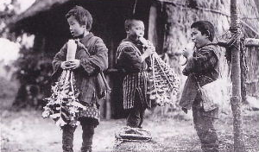
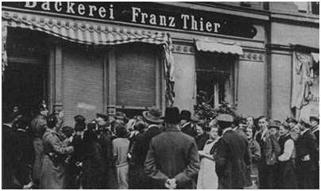
Agricultural surpluses, Stock Market crash
Agricultural surpluses in the 1920s contributed to extremely low prices on staples such as wheat causing farms to go into foreclosure.
In 1929 the stock market crashed in the US, causing a wave of bank closures around the globe.
U.S. restrictive tariff policies worsened the depression→Across the industrialized world, economies collapsed.
Subsequent inventory surpluses led to layoffs; layoffs meant less demand for products because fewer consumers.

Slide 17
 | United States | Great Britain | France | Germany
Industrial production | –46% | –23% | –24% | –41%
Wholesale prices | –32% | –33% | –34% | –29%
Foreign trade | –70% | –60% | –54% | –61%
Unemployment | +607% | +129% | +214% | +232%
Change in economic indicators
1929–1932

Slide 18
As economies plummeted and unemployment rose, many people turned to powerful leaders and governments who promised success through military buildup, the conquest of territory, and new economic systems.

Slide 19
Rise of Totalitarian Regimes
USSR, Germany, and Italy

Slide 21
Russia in Transition, the rise of the USSR

Slide 22
Communism in Russia
Bolshevik Revolution, October/November 1917
Soviets took over
Civil war, 1918–1920
Red terror campaign
Execution of tsar
→Red Army takes power 1920

Slide 23
War Communism, 1918–1922
Rapid collectivization
Confiscations of private property
Massively unpopular, Lenin backtracked in 1921
New Economic Policy (NEP), partial privatization of the economy to appease opposition

Slide 24
The New Economic Policy
Temporarily restored market economy; some private enterprise
Allowed peasants to sell surplus at free market prices
Electrification
Establishment of technical schools
Lenin dies in 1924→Bitter power struggle among Bolshevik leaders ensued

Slide 25
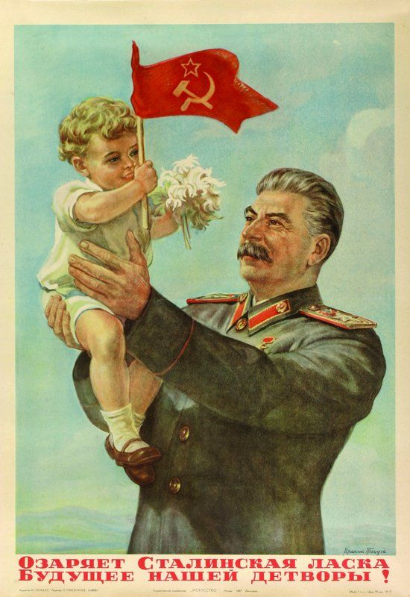
Joseph Stalin (1879–1953)
Georgian
Mother’s influence led to Orthodox seminary education
Stalin triumphed over party rivals
“Man of steel”
Leader of Soviet Union by 1928

Slide 26
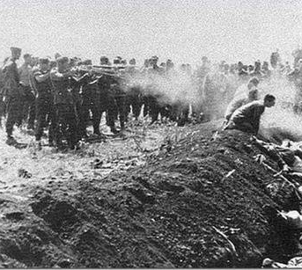
The Great Purge
Intra-party civil war
Stalin removed all people suspected of opposition, 1935–1938
Two-thirds of Central Committee
Half of army’s high-ranking officers
Executed or sent to labor camps
1937–1938, more than 1.5 million detained; 681,692 shot in mass executions

Slide 27
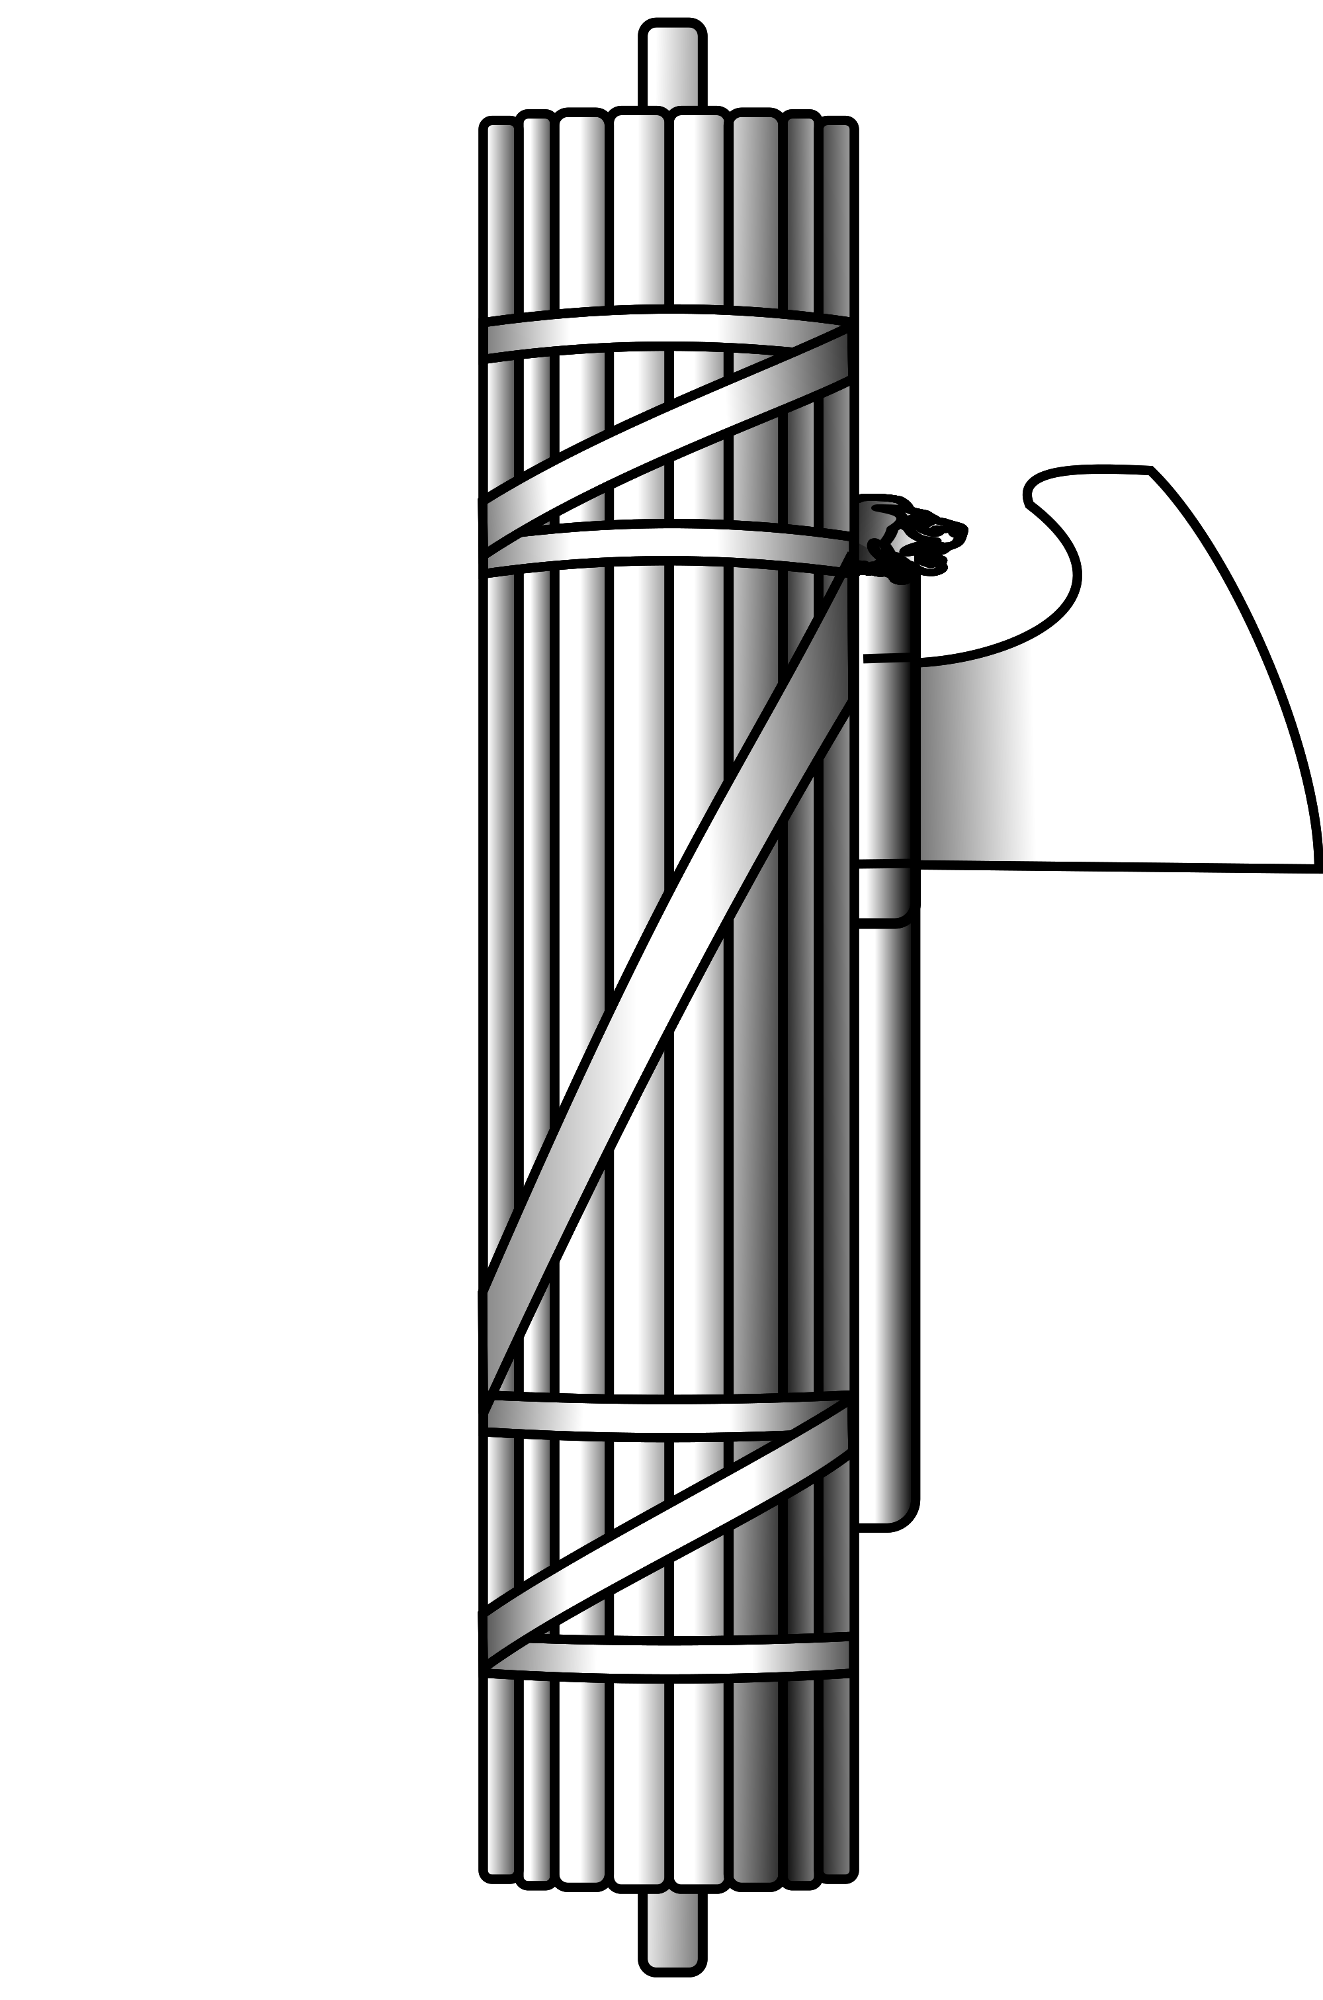
The Fascist Alternative
From fasces, Roman symbol of authority
Axe surrounded by wooden rods
Originated with Benito Mussolini
Influenced Europe, Asia, Latin America

Slide 28
Common Elements of Fascism
Primacy of state over individual
Devotion to a strong leader
Ethnocentrism
Militaristic
Anti-communist
Xenophobic

Slide 29
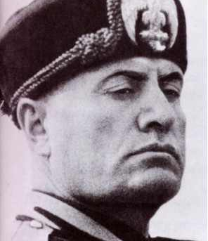
Italian Fascism
Mussolini, former newspaper editor, saw electoral successes in 1921
Offered an alternative to feelings of resentment many Italians felt following World War I
March on Rome, October 1921; King Emmanuel III offered him office of prime minister
Blackshirts
1926, seized power as Il Duce, “the leader”

Slide 30
Adolf Hitler and the Nazi Party
1921, became chairman of the National Socialist German Workers’ Party (Nazis)
Attempted to overthrow government in 1923
Wrote popular autobiography Mein Kampf in jail
Capitalized on public discontent with postwar era
War guilt clause
Reparation payments
Inability of major parties to come to consensus
Anti-Semitism

Slide 31
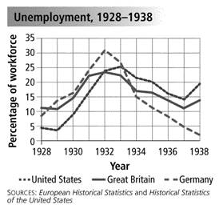
In Germany, depression, unemployment, and hard times led to a dramatic increase in votes for Hitler and the Nazi Party.
Election date | Votes in millions | Share
May 20, 1928 | 0.81 | 2.6%
September 14, 1930 | 6.41 | 18.3%
July 31, 1932 | 13.75 | 37.3%
November 6, 1932 | 11.74 | 33.1%
March 5, 1933 | 17.28 | 43.9%
Worldwide Great Depression meant slower production of goods, led to higher rates of unemployment.

Slide 32
Consolidation of Power
Nazis became single largest party in parliament, 1930–1932
Weak president Paul von Hindenburg (1847–1934) appointed Hitler as chancellor
Suppressed opposition, abrogated constitutional and civil rights
Made Nazis the sole legal party
Destroyed trade unions
Purged judiciary, civil service of perceived enemies

Slide 33
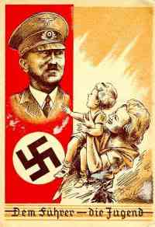
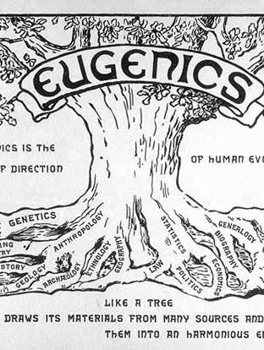
The Racialized State
Theories of racial superiority, racial purity
Pronatalist propaganda
Policies of eugenics
Compulsory sterilization of 30,000 Germans
Abortions illegal for healthy Germans, mandatory for “hereditary ill” and “racial aliens”
Euthanasia program killed 200,000 people with physical or mental handicaps between 1939 and 1945
Precursor to massacres of Jews, gypsies

Slide 34
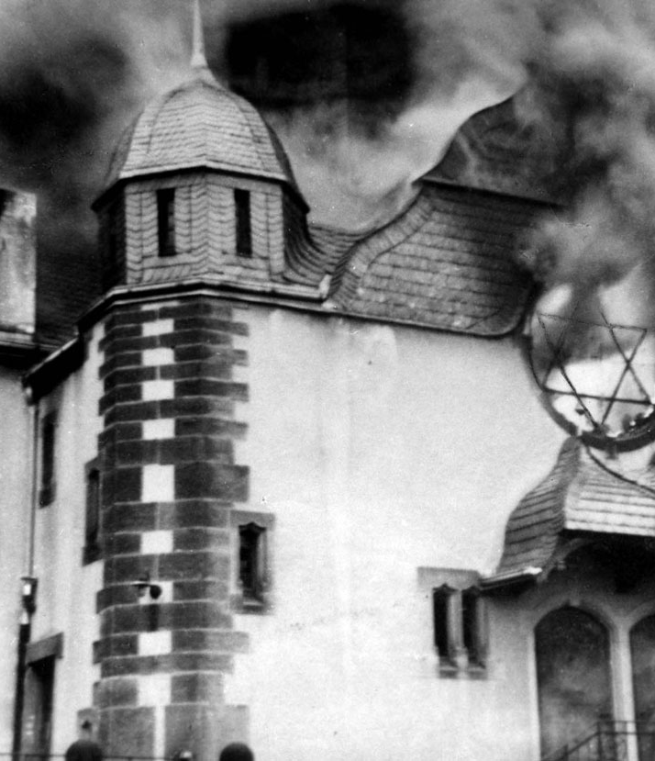
Anti-Semitism Grows
Biological racial theories and religious descent
1935 Nuremburg Laws
Prohibited marriages between Jews and non-Jews
Removal of Jews from civil service, schools
Liquidation of Jewish-owned businesses or purchase by non-Jews
Kristallnacht: major country-wide pogrom on Jews, November 9–10, 1938
“Night of broken glass”

Slide 35
China in transistion

Slide 36
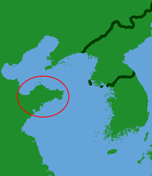
Chinese Nationalism: Reverberations of World War I
China resented increasing Japanese influence in mainland Asia. Especially that the Treaty of Versailles had recognized Japanese rights to the Shandong Peninsula.
New Culture Movement/May Fourth Movement
Students, urban intellectuals protested foreign interference
-Democratic and egalitarian values
-Vernacular literature as opposed to neo-Confucianism
-In favor of individual freedom and women’s liberation

Slide 37
Sun Yatsen: Republic or One-Party State?
Declared Republic of China in 1912
Created Nationalist People’s Party (Kuomintang or Guomindang) in 1919
Accepted support from Soviet Union
Members of the Chinese Communist Party also joined Kuomintang until the Civil War.

Slide 38
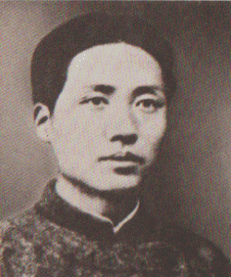
Marxism in China
Marxism increased in popularity (counter to the New Culture Movement, but initially worked with one another)
Chinese Communist Part, CPC founded in Shanghai (1921)
Leader: Mao Zedong
led a Chinese communist movement (Maoism)

Slide 39
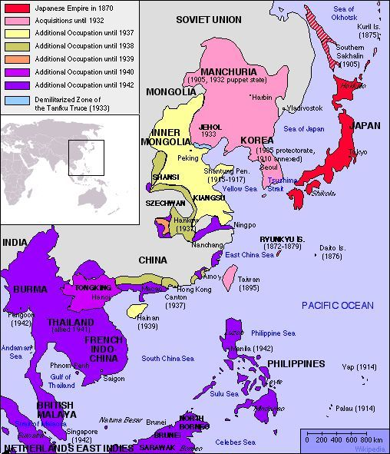
Internal Divisions, External Threats
The Chinese Civil War was a civil war in China fought between the Kuomintang-led government of the Republic of China and the Communist Party of China (CPC).
The war intermittently lasted between 1927 and 1949 → Weakened Chinese resistance to the Japanese in the 1930s contributing to the Japanese conquest of China.

Slide 40
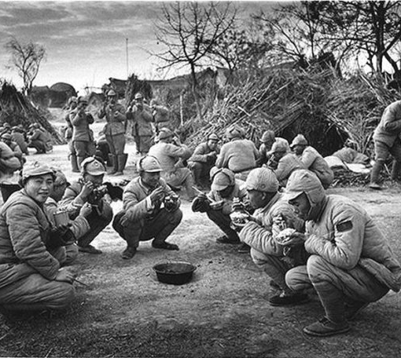
Chinese Civil War
Chiang Kai-Shek took over after death of Sun Yatsen
Launched military expedition to unify China; turned against communist allies
Communists fled over 6,000 on foot in retreat: the Long March
Chinese citizens suffered extensively during the 1930s as the Civil War was exacerbated by the famine of the Great Depression

Slide 41
Conclusion
World War I left the world quite unsettled:
Poor economic recovery plans which contributed to the Great Depression and rise of fascism
Destabilization of empires and resurgence of ethnonationalism
Building anti-colonial movements across the globe
Civil Wars in Russia and in China which triggered pro-communist uprisings
Many of these factors would ultimately contribute to the Second World War.

