Slide 1
The Great War
i.e. World War One before World War II

Slide 2
M.A.I.N. Causes of World War I
Militarism
Alliances
Imperialism
Nationalism

Slide 3
Militarism
European nation’s building up armies
U.S. Standing military in 1914 was only 200,000
 | 1880 | 1914
Germany | 1,300,000 | 4,500,000
France | 730,000 | 4,000,000
Russia | 400,000 | 5,900,000

Slide 4
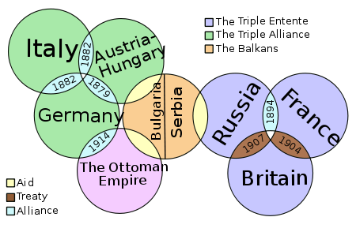
Alliances
By 1914 all the major powers were linked by a system of alliances.
Increased likelihood war would spread
“the enemy of my friend is my enemy”
“the enemy of my enemy is my friend”

Slide 5
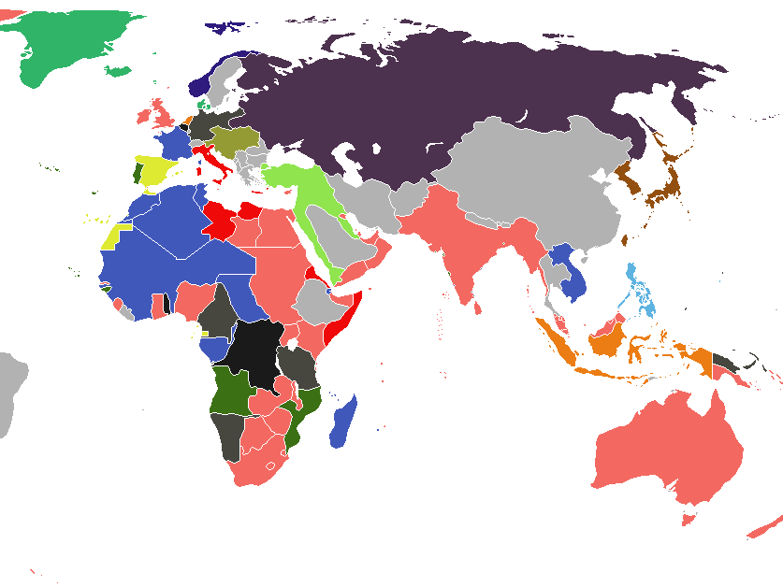
Imperialism
All the great powers were competing for colonies/territory.
The British feared Germany in Africa.
The Austrians feared Serbia/Russia in the Balkans

Slide 6
Nationalism
Rise in jingoism-- extreme patriotism, especially in the form of aggressive or warlike foreign policy.
Self-determination and independence movements
Belgium, 1830
Unification of Italy, 1861
Unification of Germany, 1871
Sought to create a shared language, cultural traditions, etc. often through public schooling

Slide 7
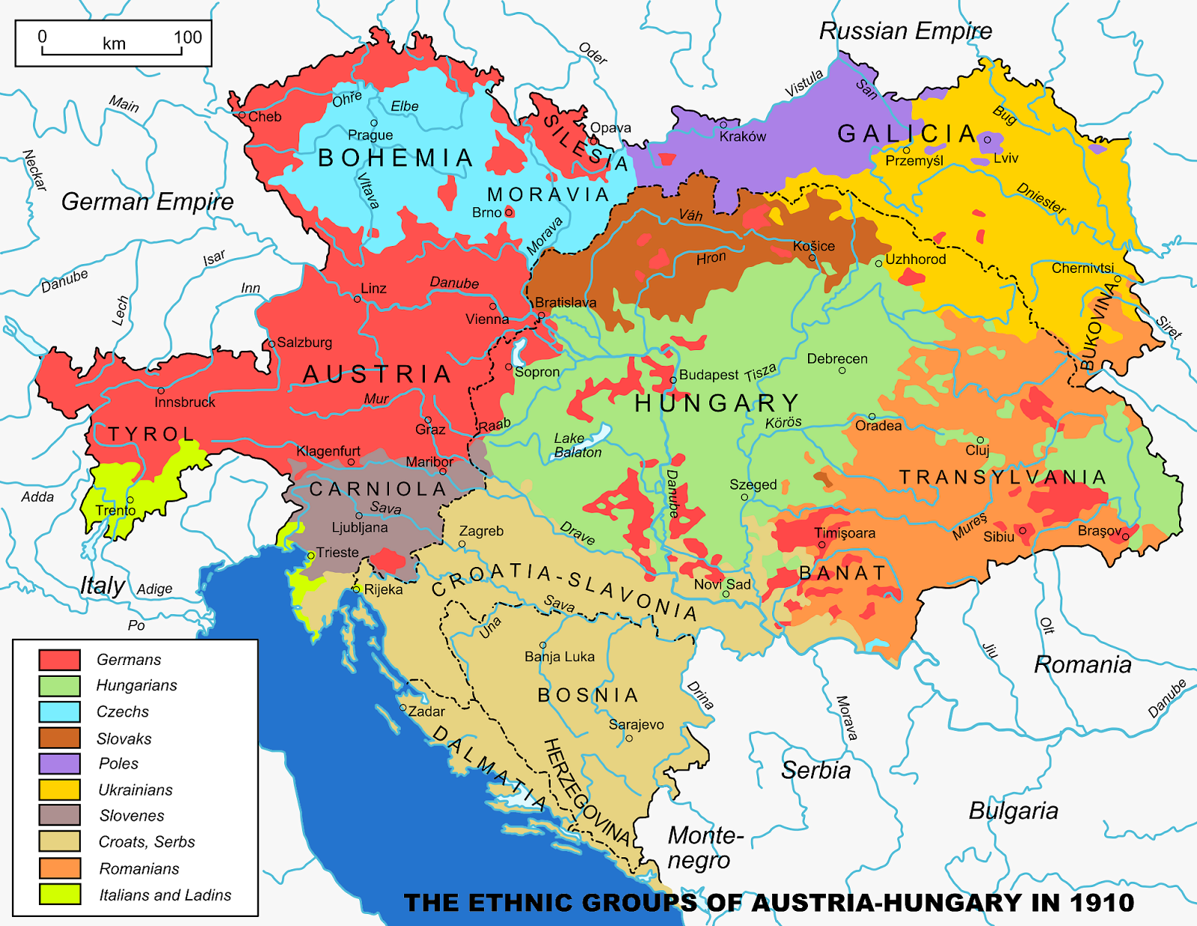
Ethnonationalism
Large nations tended to act considering only their own interests
Ethnic groups wanted to form independent nations
Austria governed Czechs, Poles, Slovaks, etc
Poles throughout Germany, Russia, and Austria-Hungary
Ottoman empire governed Greeks, Serbians, Romanians, Armenians and Bulgarians

Slide 8
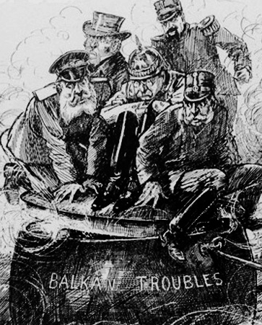
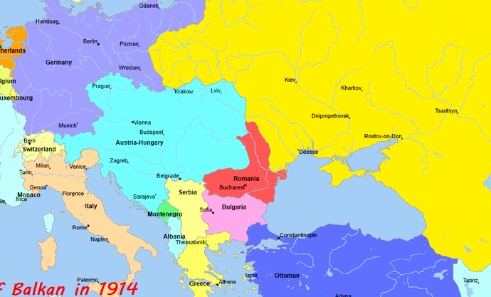
Powder Keg
Bosnia was annexed by Austria-Hungary in 1908
Serbian nationalists in Bosnia wanted to be incorporated into Serbia NOT ruled by Austria-Hungary

Slide 9
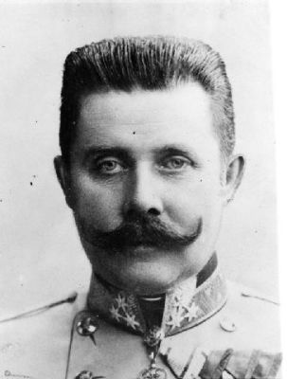
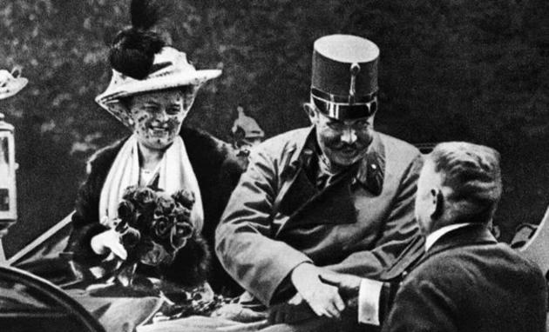
Archduke Francis Ferdinand (Royal Prince of Austria) is assassinated by Serbian nationalist while driving through Sarajevo

Slide 10
July 28 Austria declares war on Serbia
July 29 Russia mobilizes in support of Serbia
August 1 Germany declares war on Russia
August 4 Britain declares war on Germany for invasion of Belgium

Slide 11
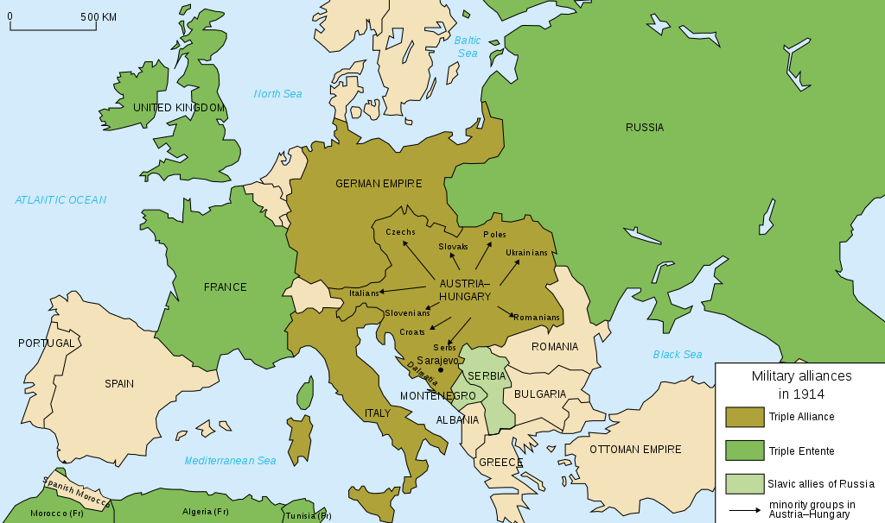

Slide 12
War of Attrition
West: three years of stalemate
Trenches from English channel to Switzerland
East: more movement
Treaty of Brest-Litovsk in March 1918 placed much in Entente control

Slide 13
Fighting—Trenches
Almost stand still with adoption of trench warfare

Slide 14
Stalemate
Neither side able to gain a clear advantage →“Dig in,” literally, with trench warfare.
West: three years of stalemate
Trenches from English channel to Switzerland
East: more movement
Treaty of Brest-Litovsk in March 1918 placed much in Entente control

Slide 15
New Weapons
Barbed wire and machine guns used to deadly results
Mustard gas first used by German troops, 1915
Tanks, airplanes, and submarines were used but not quite sophisticated enough to make a practical difference in the war.

Slide 16
Massive Destruction
Unprecedented casualties
At the battle of Ypres, 1914, British lost 13,000 men gained 100 yards
Verdun, 1916
315,000 French killed
280,000 German casualties
At the Somme, 1916, British gained few thousand yards
420,000 casualties
No significant strategic advantage

Slide 17
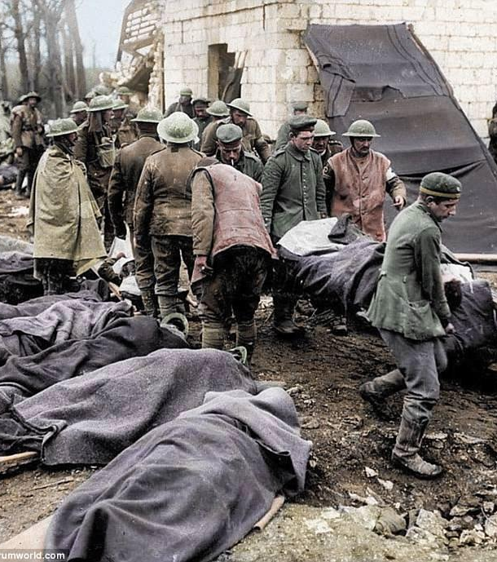
Fighting—Total War
Everyone considered a combatant
Attempt to starve enemy into submission and surrender
Use chemical weapons on civilians.
More than 5 million civilians killed

Slide 18
Minorities and the War

Slide 19
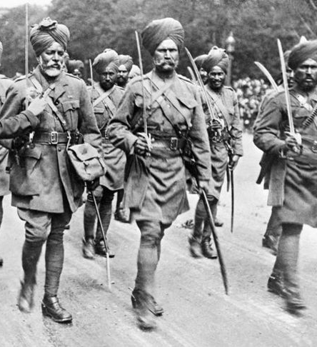
Global Involvement
Importation of troops from colonies
Great Britain: Australia, New Zealand, Canada, India, Africa
Gallipoli a majority minority battle
France utilized more than 90,000 Vietnamese from French Indochina
Active fighting in colonies such as Africa
Indian Sikhs (pictured) fought for the British

Slide 20
Impact of World War I on India
Recruitment of young men into the British army was extensive. Roughly 1.3 million Indians served in the British military of which 75,000 gave their lives.
The war operations in Europe sucked huge quantities of necessary commodities from India (wheat, rice, sugar, tea, coffee etc.) The accelerated export of the items from India caused scarcity, food insecurity in the domestic market.
Britain increased taxes and duties to fund the war.

Slide 21
Africa and the Great War
African colonies were coerced into participated in World War I
Germany used African troops to expand territory (photo at left)
Allies then invaded German-controlled colonies
For the first time in modern history, Africans were encouraged to fight white soldiers and supplied with modern weapons.
→Encouraged local rebellions and challenges to European domination

Slide 22
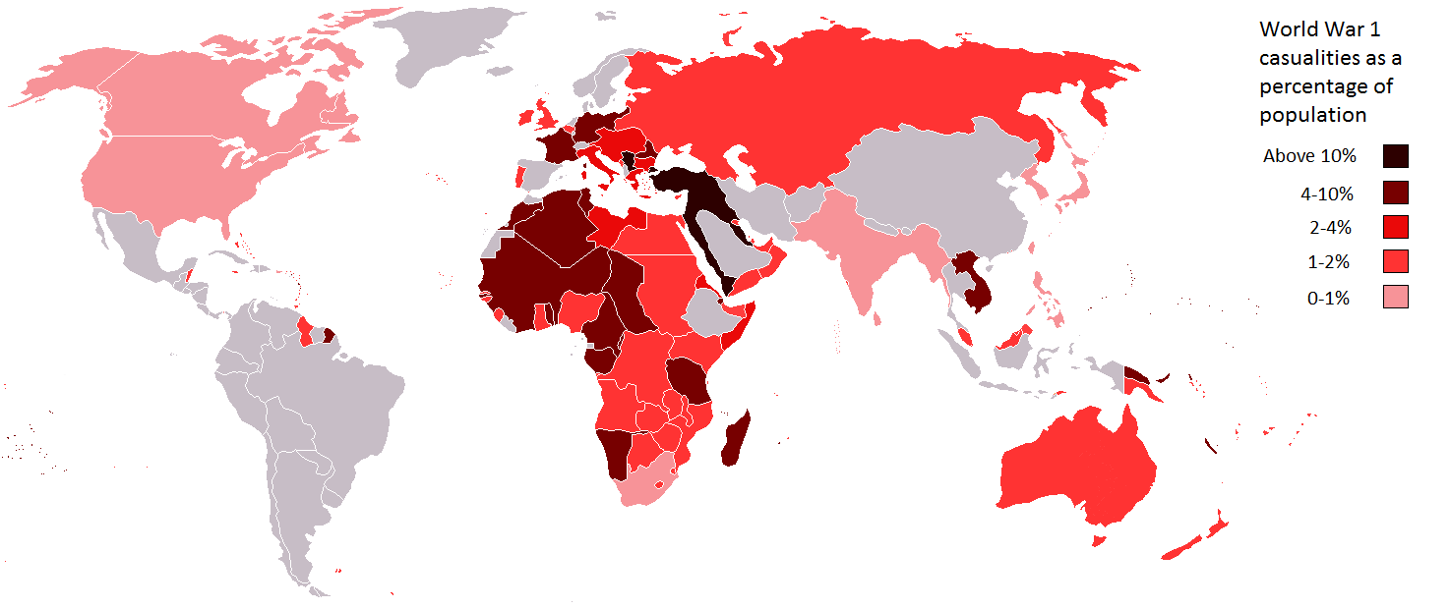
World War I Causalities:
Shows the significant role of colonial soldiers In Conflict

Slide 23
Pandemic
“Spanish” Flu

Slide 24
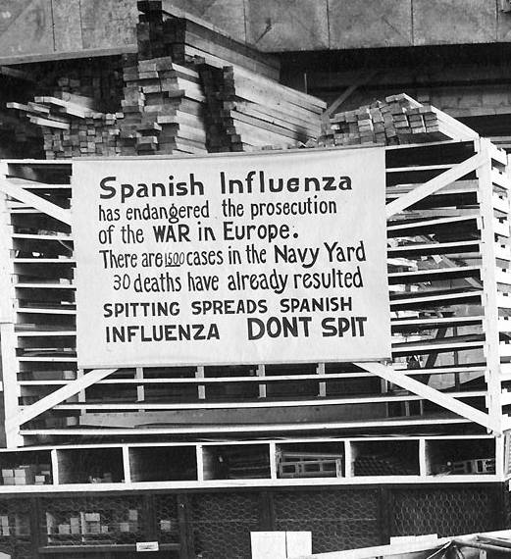
1918, Kansas
In 1918, a new strain of flu surfaced in middle America. Called the “Spanish Flu” because the Spanish press reported on the virus and American ethnic bias against Spain, the flu had deadly consequences.
Between 1918-1920 roughly 50 million people around the globe died from the so-called Spanish Flu.
Photograph from a US Navy Yard.

Slide 25
CDC video from 2018 looking back at the flu 100 years later.
This largely optimistic film from the CDC recalls the impact of the 1918-1920 pandemic and explores the CDC’s role in trying to prevent another such event.

Slide 26
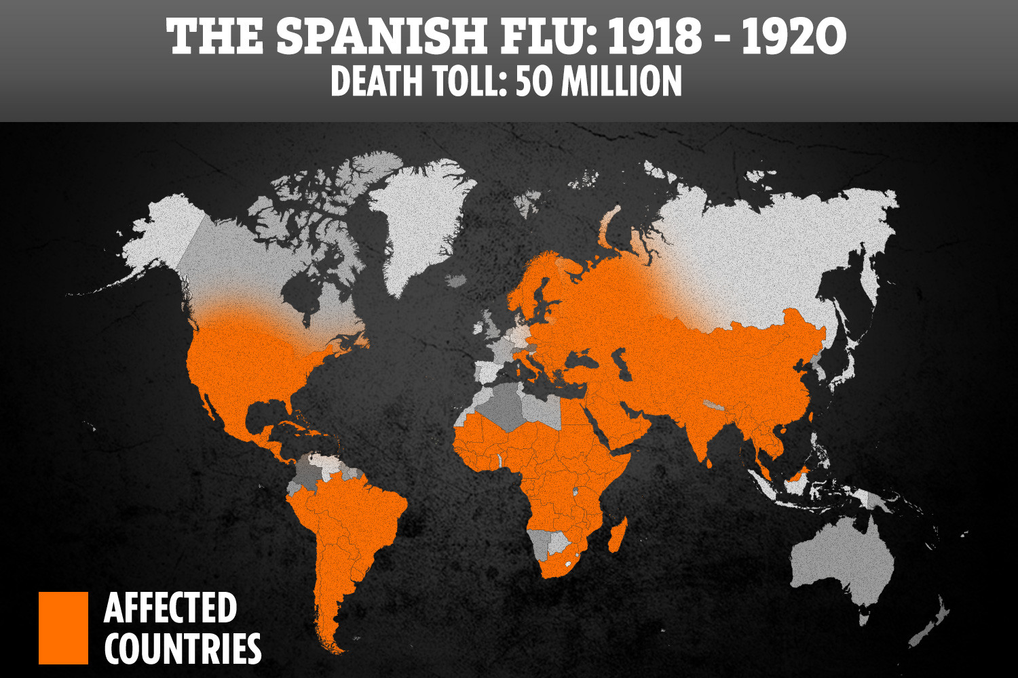
Global troop movements because World War I
contributed to the spread of the Spanish Flu.

Slide 27
Give Peace a Chance

Slide 28
Paris Peace Conference
Versailles Treaty signed June 28, 1919
Reparations- Germany owed the Allies $33 billion for economy injury suffered throughout the War.
Wilson’s Fourteen Points were an important feature of post-War Europe.

Slide 29
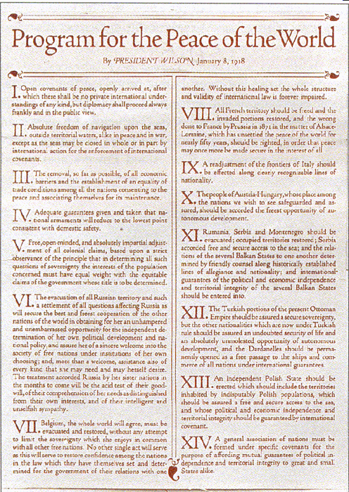
Fourteen Points
Open Diplomacy (no secret treaties)
Freedom of the seas
Reduction of armaments
Territorial changes
Association of Nations “League of Nations”

Slide 30
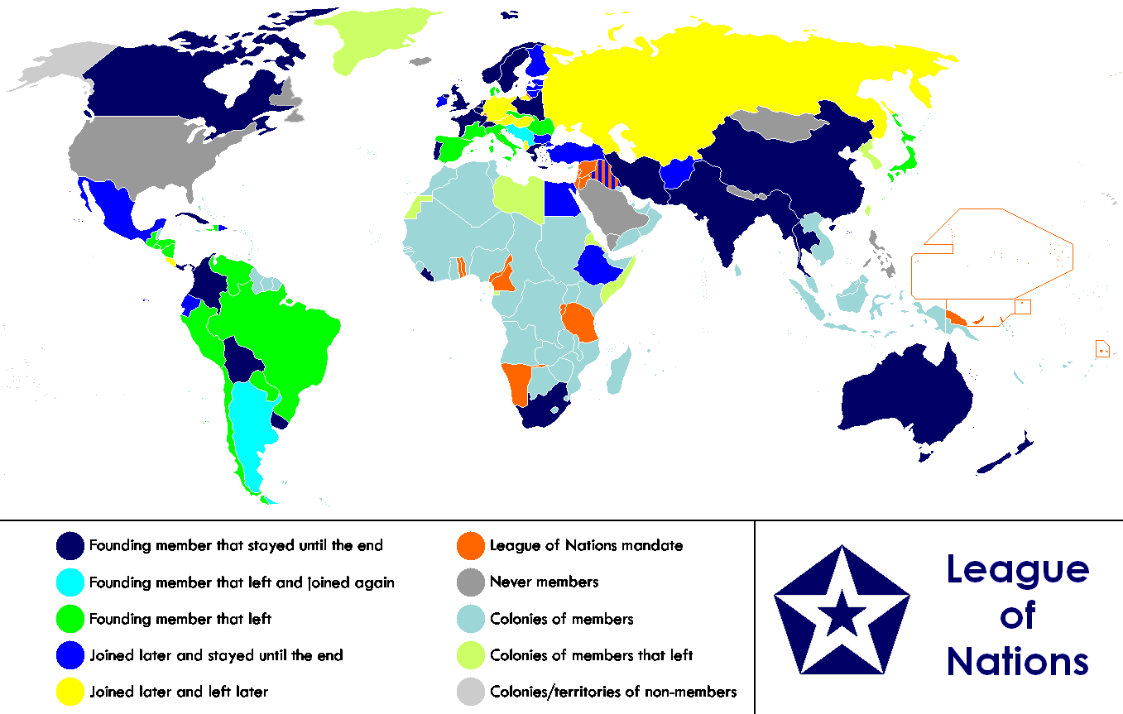
League of Nations
Member nations would consider an attack on one country as an attack on all.

Slide 31
World War I Outcomes
Massive death count: Conservative estimates of 15 million dead (5 million noncombatants), 20 million injured
End of four empires, rise of nine new countries
-Russia, Austria-Hungary, Germany, Ottoman Empires fall
-New ethnonational states rise (i.e. Poland, Czechoslovakia, etc.)
Beginning of the end of Europe’s domination of globe

Slide 32
Dissolution of empires, rise of ethnonationalist states. Map © BBC

Slide 33
Dissolution of the Ottoman Empire
Treaty of Sèvres (1920) removed Balkan and Arab provinces, allowed for European occupation of Middle East
Mustafa Kemal (Atatürk) led uprising against sultanate, created Republic of Turkey
Republic recognized by Allies in Treaty of Lausanne (1923)
Intensely secular government
Emancipation of women

Slide 34
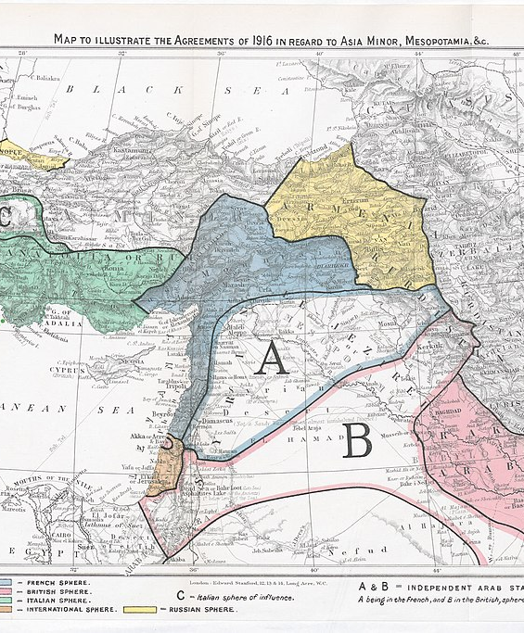
Territorial Changes in the Middle East after the Great War

Slide 35
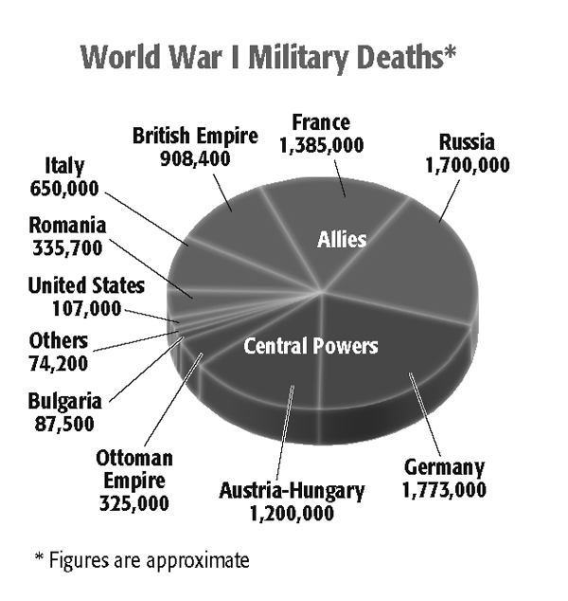
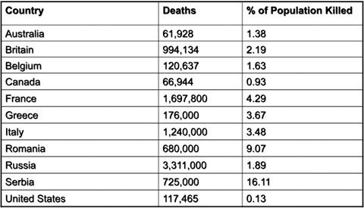
The Toll of the Great War

