Slide 1
Africa and Islamic Empires
In the Early Modern World

Slide 2
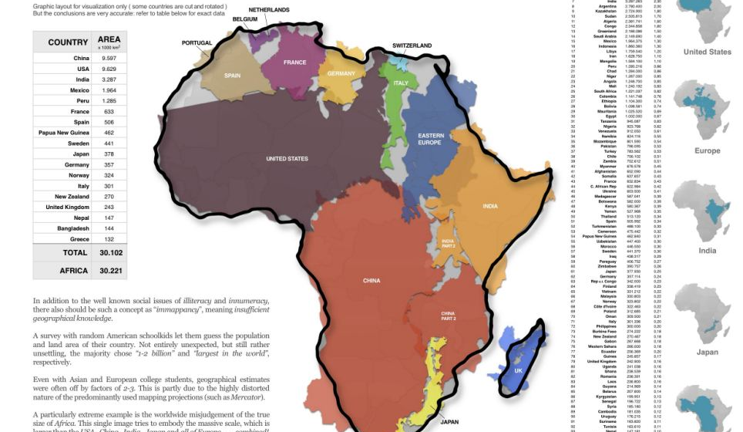
Africa in the early modern period
In the Early Modern Period, Africa consisted of an immense amount of cultural diversity.
The peoples of Africa differed in their religious beliefs, social stratifications, foods and dress, and other customs.

Slide 3
Watch from c. 1400-c. 1800

Slide 4
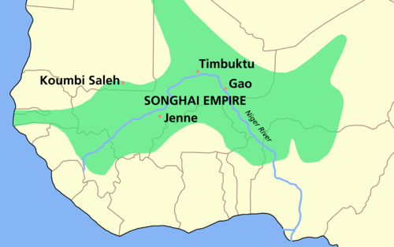
Songhai Empire
The Shongai (Songhay) Empire, 1460-1591 CE, replaced Mali as the most dominant state in West Africa in the late 15th century.
The Songhai people controlled Niger river transport which made them poised to gain power and influence.
By 1469 CE the Songhai gained control over Timbuktu.

Slide 5
Rulers of the Songhai
Sunni Ali
(r. 1464-1492 CE)
The leader during Songhai Expansion.
Military tactics earned him the nickname “Sunni the Merciless.”
Improved irrigation and agricultural yields.
Anti-Muslim influence, supported animistic traditions
King Mohammad I
(r. 1494-1528 CE)
Converted to Islam
Encouraged education and study of Islam as well as science
Given honorary title of ”Caliph of the Sudan”

Slide 6
Islam in Sub-Saharan Africa
Pre-Islamic paganism, ancestor worship featured animistic traditions
Islam developed in commercial centers
Timbuktu, major center of Islamic scholarship by sixteenth century
African traditions and beliefs blended into Islam to create a syncretic religion
Gender relations, standards of female modesty incorporated as Islam spreads

Slide 7
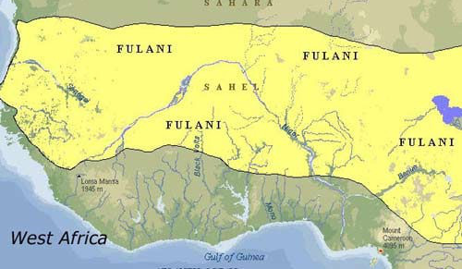
The Fulani and Islam
Fulani are a traditionally nomadic people who were early converts to Islam.
1680, military campaigns to enforce sharia (law based on the Qur’an) began in West Africa *same time that the Spanish Inquisition is ongoing.*
Considerable influence extended to south as well

Slide 8
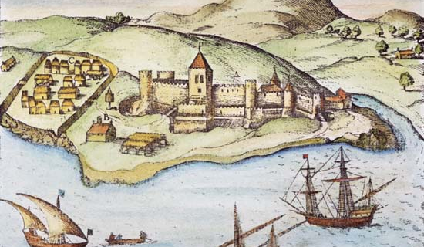
Trading Post Empires
For most of the early modern period, European nations did not establish formal colonies in Africa to conquer territory, but rather established trading posts.
The Portuguese and Spanish exerted increasing control over trade which destabilized many African societies.
→Portuguese came to control the gold fields of southern West Africa in the early 16th century which limited wealth of the Songhai

Slide 9
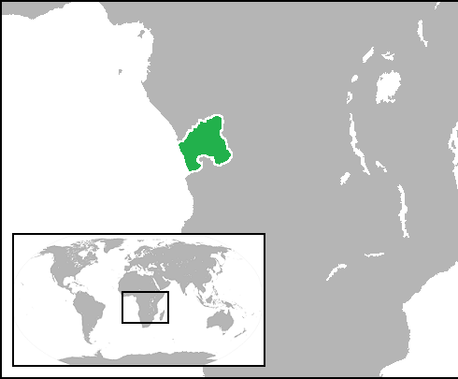
Kingdom of the Kongo

Slide 10
Kingdom of Kongo (14-19th century CE)
Consolidated power through regional trade of ivory, copper, and slaves along the Congo River.
Initially friendly with Portuguese traders and slavers. Leadership even converted to Christianity to enhance trade relations and social standing.
Relations with the Europeans deteriorated as each side attempted to dominate the other.

Slide 11
Enslaving the Kongolese
Kongo kings appealed without success to slow, but not eliminate, slave trade and control who was being enslaved (not Kongolese people).
Relations deteriorated; Portuguese began engaging in slave raiding, taking Kongolese people.
Due to friction, Portuguese relocated their main slave market further south to Angola in the late 17th century.

Slide 12
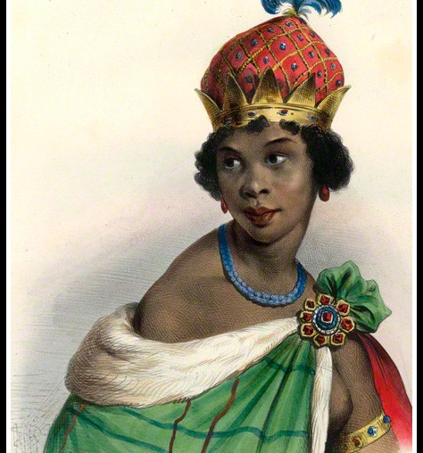
Queen Nzinga
Ruled Angola, 1623-1663
-Fiercely resisted the Portuguese presence and enslavement of her people
-Actively fought in battles
-Fairly successful at disrupting the Portuguese trading post
Died in 1663, her death marked the end of effective resistance of Portuguese slave trade in Angola.

Slide 13
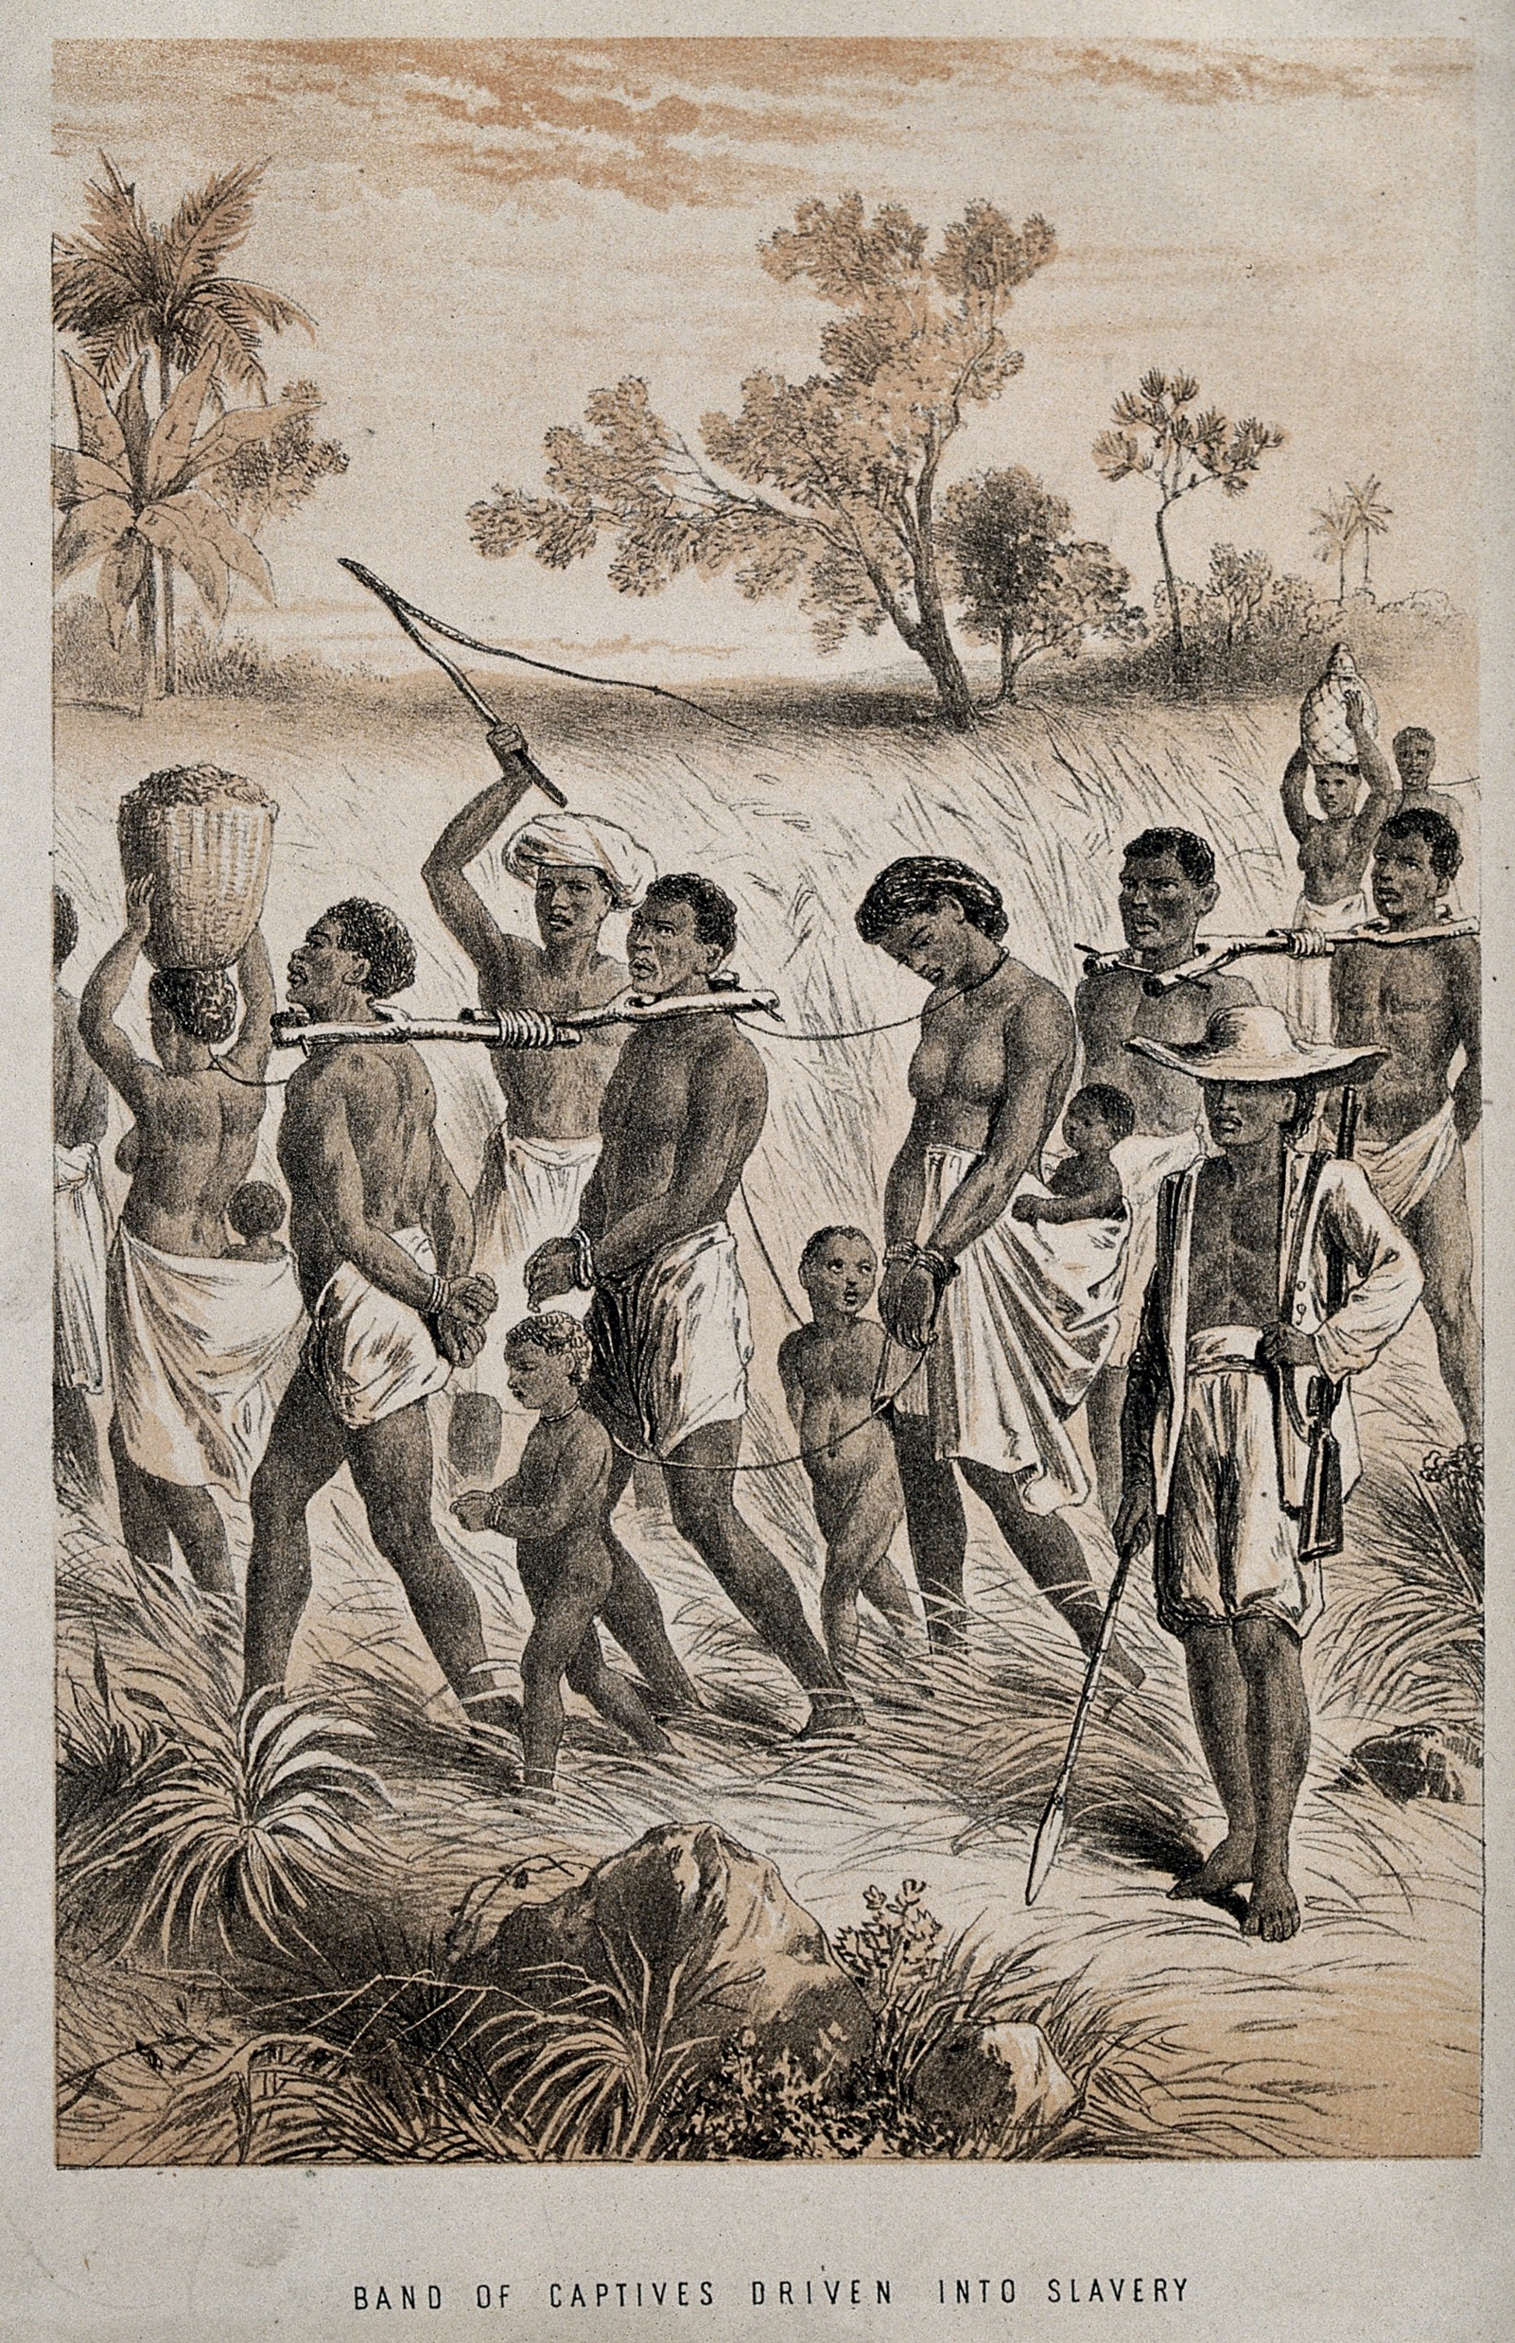
The Transatlantic Slave Trade
c. 1500-1800

Slide 14
Depopulating Western Africa
Best modern estimates suggest that more than 12 million Africans were enslaved as part of the Transatlantic slave trade.
Distorted sex ratios resulted
Two-thirds of slaves were male, 14–35 years of age
Polygyny encouraged because so few men
Traditional gender division of tasks shifted
(Map at left shows areas of collection, Africa, and destination, the Americas.)

Slide 15
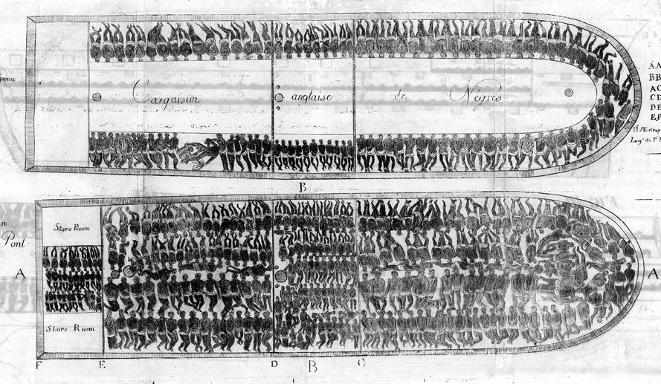
Africa to the Americas
African slaves captured by raiding parties, force-marched to holding pens at coast (coffle)
Middle passage under horrific conditions
4–6 weeks
Mortality initially high, often over 50% in 16th century; eventually declined to 5% c. 19th century
Approximately 4 million died before arrival

Slide 16
Islamic Empires
Ottoman, Safavid, and Mughal Empires

Slide 17
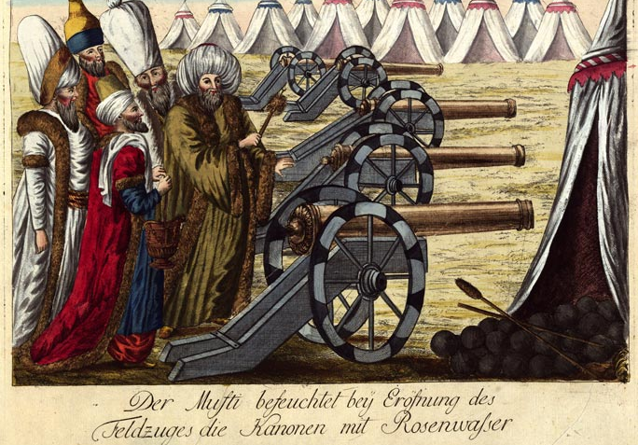
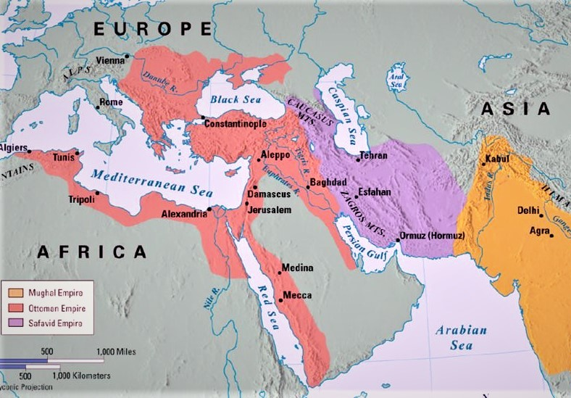
“Gunpowder” Empires
Nickname given to the major Islamic Empires of the Early Modern world for the use of weaponized gunpowder.

Slide 18
The Dynastic State
What is a dynasty?
Ottoman, Safavid, Mughal dynastic empires all based on military conquest
Prestige of dynasty dependent on piety and military prowess of ruler
Techniques for maintaining the bloodline and strong leadership included sibling rivalries and serving as regional governors

Slide 19
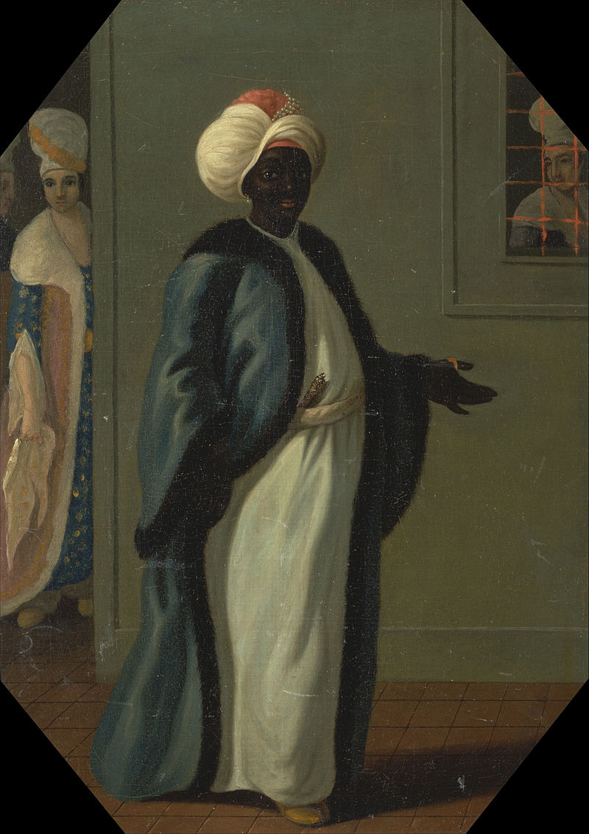
The Ottoman Empire (1289–1923)
Osman led bands of semi-nomadic Turks to become ghazi: Muslim religious warriors
Relied heavily on enslaved laborers in the harem (palace) and throughout the empire.
In Balkans, forced Christian families to surrender young boys to military service: devshirme (blood tax)→ Often grew up to be exceptionally loyal enslaved fighters: Janissaries
Most women in the harem were enslaved. Served as concubines to the royal family. Women could gain significant power through children.
Kizlar Agha, The Chief Eunuch, exercised great power over policy within the harem. (painting at left)

Slide 20
Millet System
provided minority groups (Jews and Orthodox Christians) semi-autonomy while still under Ottoman rule
→seen as lower-class citizens but could retain their religious and political systems.
→paid tributes or taxes, jizya
Allowed the Ottoman state to conquer vastly diverse populations and maintain control while having some religious tolerance.

Slide 21
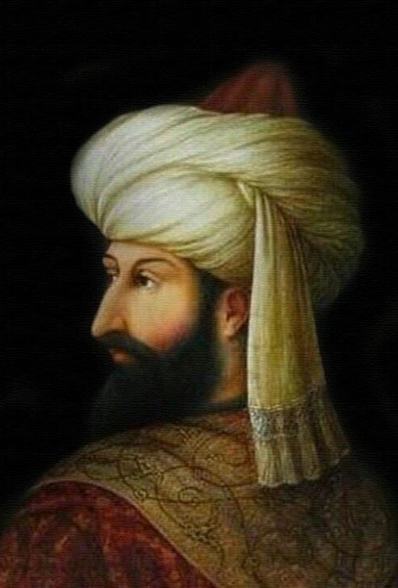
Mehmed the Conqueror
Mehmed II (r. 1451–1481)
Capture of Constantinople, 1453
Renamed the city Istanbul
Transformation from warrior sultan to emperor of “two lands” (Europe, Asia) and “two seas” (Black Sea, Mediterranean)

Slide 22
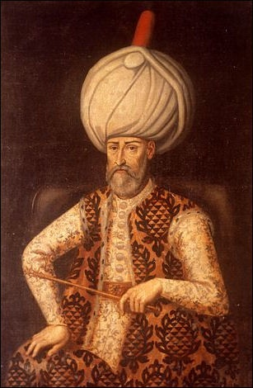
Süleyman the Magnificent (r. 1520–1566)
Expanded further into Asia and Europe
-Besieged Vienna, 1529
-expanded Ottoman control of Medina and Mecca
Developed Ottoman naval capabilities
Ottoman–Venetian War (1537–1540)
Partnership between France and Süleyman against Holy Roman Empire
Ottomans overtook Venetian possessions in the Adriatic
Battle of Lepanto, 1571
European forces (Venetian and Spanish) defeat Ottoman navy. Seen as a battle between Christianity (Catholicism) and Islam.

Slide 23
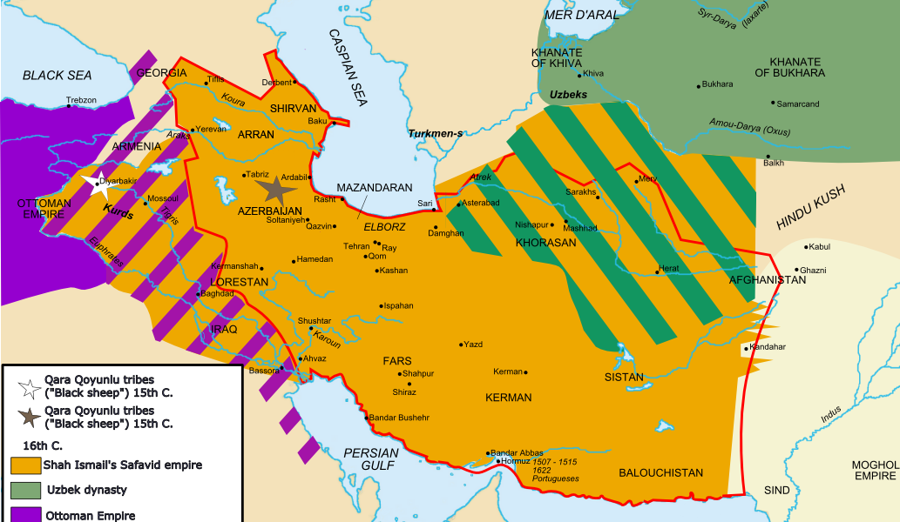
The Safavid Empire
Young military leader, Ismail, r. 1501–1524 founded the Safavid Empire
→Became shah, proclaimed shiism official religion of realm (modern day Iran)
Empire called Safavid after Safi al-Din (1252–1334), a philosopher
→Fight with Ottomans over the Sunni-Shi’ite divide and political influence. Ultimately, Ottomans are victorious in the Ottoman–Safavid War (1623–1639).

Slide 24
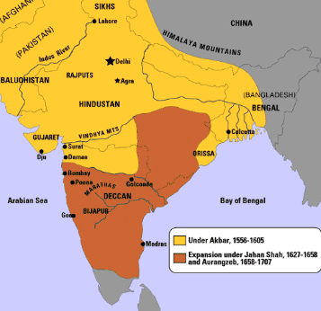
The Mughal Empire
Mughal (Persian for Mongol) dynasty
Expanded through most of Indian subcontinent
Dominant in the 16th and 17th centuries
Trade with Portuguese vessels and ultimately loose power and authority as European influence grows in the region.

Slide 25
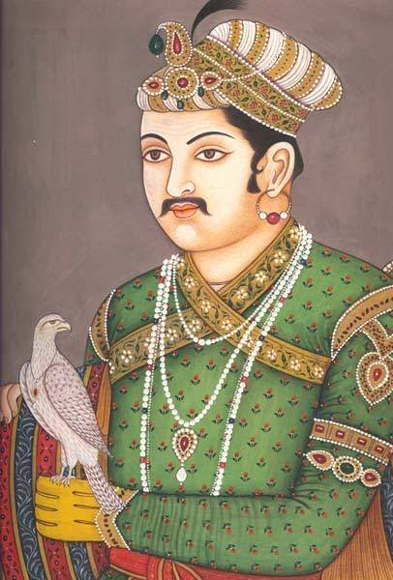
Akbar (r. 1556–1605)
Created centralized government (through taxation of produce and tariffs).
-Created an equitable system of taxation based on the production potential of different regions
Encouraged intermarriages between Mughal and Rajput aristocracy
Religiously tolerant, promoted a “divine faith” for India
→Syncretic form of Islam and Hinduism

Slide 26
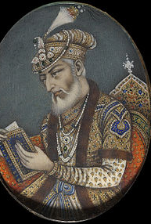
Aurangzeb (r. 1659–1707)
Expanded Mughal empire into southern India
Fought and defeated expanding British interests in India
Hostile to Hinduism
Demolished Hindu temples, replaced with mosques
Expanded tax on Hindus to encourage conversion

Slide 27
English East India Company: Growing Influence
The British built forts and trading stations in Calcutta, Madras and Bombay beginning in the late 17th century
In 1717, Mughal nobles granted the British a firman (royal dictate) exempting them from customs duties.
The treaty of 1765 gave them the right to collect taxes on behalf of the emperor.
These conciliatory moves showed waning Mughal influence thought the empire did not cease to exist until 1858.

