Slide 1
Colonization of the Americas

Slide 2
Outline
America prior to 1500
Types of Native Societies
Native Cultures
European colonization of the Americas
Geography
Economics
Religion
Race and Ethnicity

Slide 3
America prior to 1500

Slide 4
The “New” World, America
Population estimates 70-100 million people in the Americas
*Not a unified group*
Different tribes varied in:
Dress
Food
Settlement

Slide 5
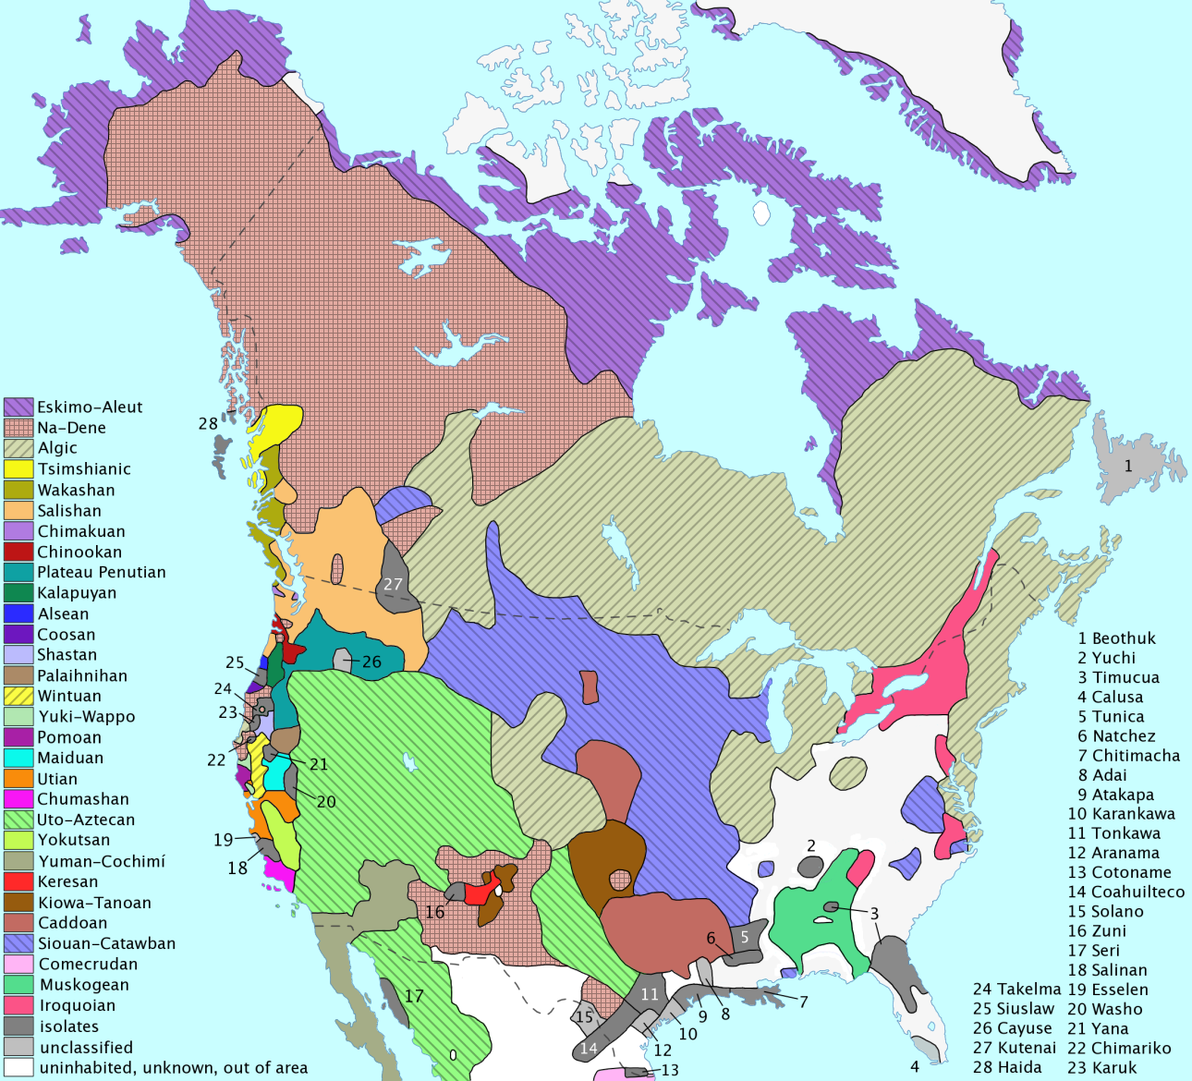

Slide 6
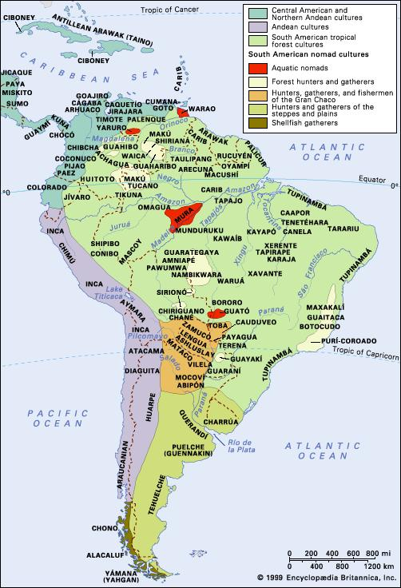
Population Estimates and Diversity:
5-10 million in North America
60-90 million in Latin America
300-400 different languages spoken across the continents
© Encyclopedia Britannica

Slide 8
Types of Indigenous Civilizations
Nomadic
Sedentary or non-nomadic
Hunter-gatherers, little to no crop cultivation
Move semi-annually following food supplies
Agricultural societies, cultivated the land
Moved infrequently dependent on safety or environmental conditions

Slide 9
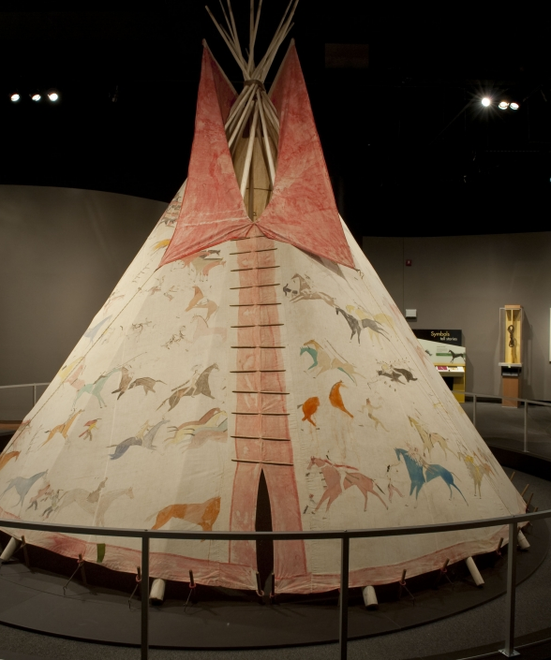
Nomadic-Lakota
"There were 50 tents made of tanned hides, very bright red and white in color and bell-shaped, with flaps and openings, and built as skillfully as those of Italy, and so large that in the most ordinary ones four different mattresses and beds were easily accommodated. The Indians . . . are as well sheltered in their tents as they could be in any house."
"The tanning is so fine that although it should rain bucketfuls, it will not pass through nor stiffen the hide, but rather upon drying it remains as soft and pliable as before.“
From Don Juan de Oñate’s account of a 1599 Great Plains expedition
?
--How can we tell the tent above
was made in post-Columbian America?
--Does de Oñate seem impressed? Condescending?

Slide 10
Sedentary- Aztec
The basis of Aztec success was their remarkable system of agriculture, which featured intensive cultivation and reclamation of swampland.
The Mexica capital city of Tenochtitlán, founded around 1325 CE
Tenochtitlán was an impressive city which included wetland gardens and used raised causeways to separate the gardens and move around the city
Roughly 200,000 people lived within Tenochtitlan and another 10 million were part of the broader Aztec Empire.

Slide 11
Conquering the Aztecs
In August 1519, Cortés marched to Tenochtitlan.
Over the next two years, the Spanish forged alliances with other indigenous groups.
In 1521, Tenochtitlan was sacked, and its monuments destroyed.
The Tlaxcalans were instrumental in helping the Spanish conquer the Aztecs.
With the leadership dismantled, the Spanish easily conquered the remain Aztec peoples.

Slide 12
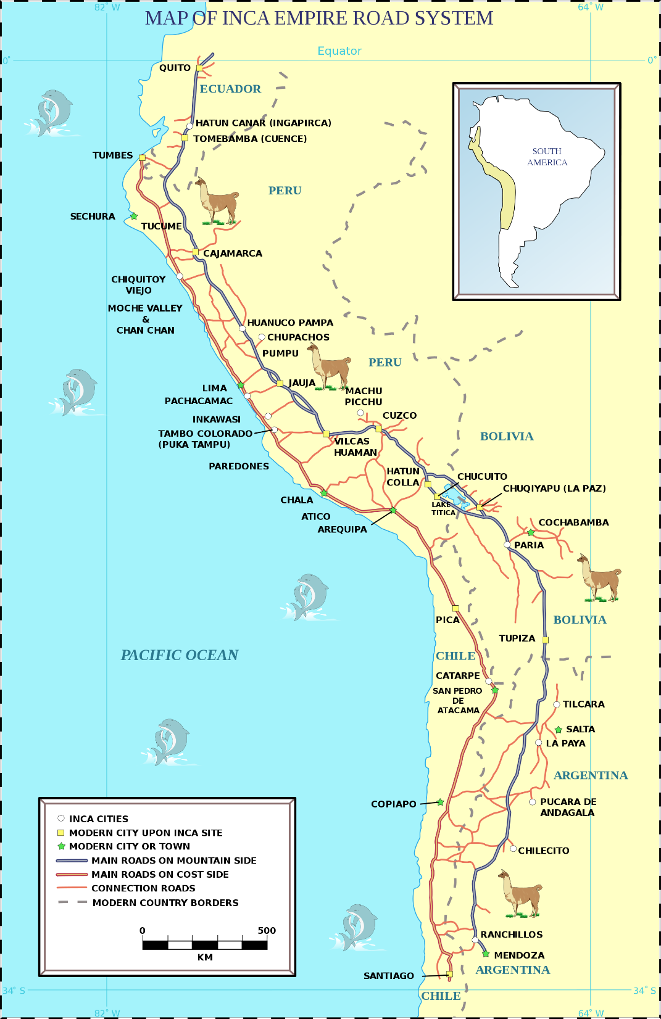
Sedentary-Inca
At its height, Inca empire consisted of 10-12 million inhabitants and included 100 different ethnic groups
Encompassed large scale agricultural networks and roads as well as a cohesive language and faith throughout their expansive empire

Slide 13
Conquering the Inca
In the 1530s, Atahualpa controlled an army that was 80,000 strong. Pizzaro had under 300 men at his disposal.
On the initial day of attack, Pizzaro’s men ambushed the Inca killing 7,000 Incas were and sustaining zero Spanish losses.
Pizzaro kidnapped and held Atahualpa before executing him and taking the capital city.
Ultimately, the Spanish capitalized on internal fractions and built alliances with Native Americans who resented the Inca.

Slide 14
Native Culture

Slide 15
Native Economies
Gender divisions of tasks
Self sufficiency among tribes
Vast communication and luxury trade networks
Public/communal property

Slide 16
Native Attitudes towards Slavery
Different in North American than in Mesoamerica and South America
Slavery was a often product of war or debt
In North America, captives could become full members of society
In Meso and South America slaves were at times used as part of religious offerings
Was not race based, but often tribal or ethnically based
Slavery was NOT hereditary!

Slide 17
Religions
Very diverse
Common factors:
Link between spiritual and natural world (Animism)
Spiritual world was part of daily life:
Crop ceremonies
Shamen (revered members of society not witches)
Religious Cross Fertilization
Willingness to experiment with new ideas
Few attempts at conversion

Slide 18
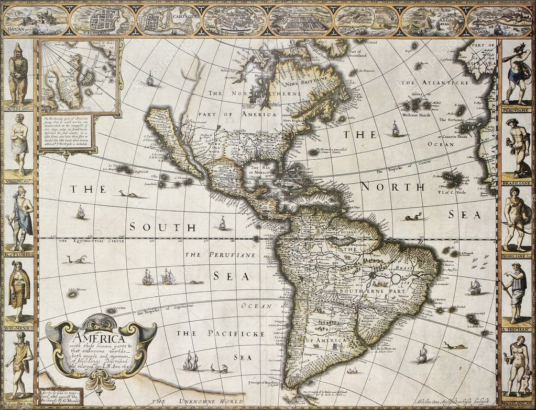
European Conquest

Slide 19
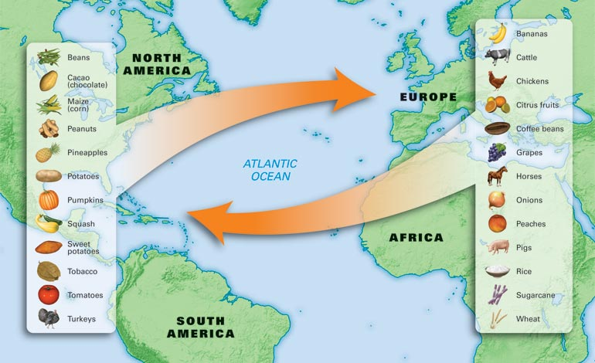
The Columbian Exchange
Biological consequences of contact

Slide 20
Importance of Geography in Colonization
The relative isolation of the Americas and connectivity of the Eurasian and African continents was an important factor which enabled European conquest.
European access to agricultural and technological advancements from Asia, and even diseases, ultimately provided an advantage against indigenous Americans.

Slide 21
Virginia Soil Epidemic
“the populations at risk have had no previous contact with the diseases that strike them and are therefore immunologically almost defenseless”
Population of Mexico
1400 5 Million
1800 600,000
Some modern estimates believe that nearly 90% of the native population was wiped out due to diseases.

Slide 22
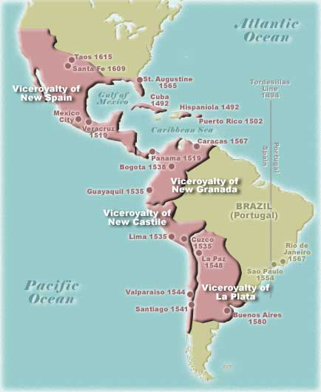
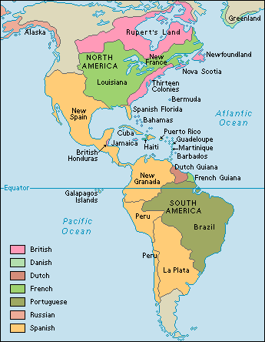
c. 1600 c. 1700

Slide 23
Economics
Recall, economic motivations were crucial to exploration.
To exploit the New World, European colonizers:
Implemented mercantilist policies
Expanded agricultural pursuits
Extracted natural resources

Slide 24
Mercantilism
Mercantilism→ belief that in order to build economic strength a Nation had to export more than it imported
Could use colonies to increase exports and decrease imports
Quinto real (royal fifth) tax a mercantilist policy which greatly enriched Spain’s monarchs
The 17th century Navigation Acts were an example of British mercantilist policies.

Slide 25
Agriculture in Latin America
Spanish territory
Portuguese territory
The Hacienda (plantation)
Grow primarily foodstuffs: Wheat, grapes, meat
Encomienda system of utilizing native labor force (essentially indentured servants without an end)
Due to uprisings, ultimately replaced by debt peonage (similar to share cropping)
Primarily used enslaved Africans
Grow Sugar cane
Large-scale importing of slaves began in 1580s
Working conditions poor: 5–10% died annually
Approximately one human life per ton of sugar

Slide 26
Extraction of Resources in North America
English
French
Use a combination of indentured servants (typically of European descent) and African enslaved laborers
Southern colonies grow crops (tobacco, indigo, rice)
Mid-Atlantic colonies grow tobacco and diversified grains
Northern colonies subsistence farming (fewer slaves)
Focus on fur as opposed to agriculture “Company of New France”
Limit immigration through late 17th century to limit competition

Slide 27
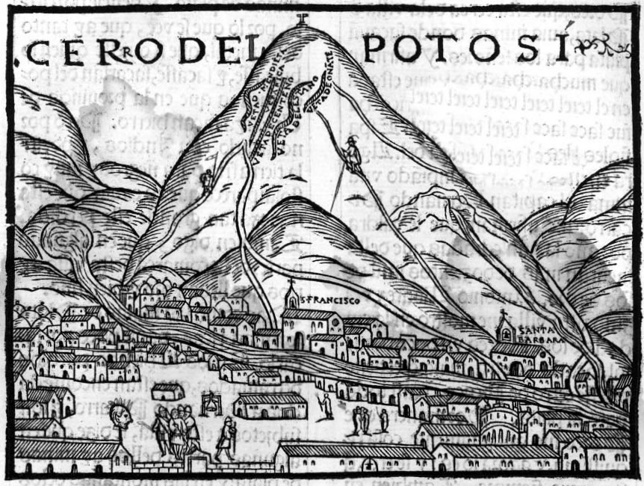
Hunt for gold and silver
Conquistadores looted Aztec, Inca treasures and melted them down for their value as raw precious metals
Extensive use of natives in mining → Potosí, Bolivia
American silver and gold became an important part of Asian trade in the 16th-17th centuries

Slide 28
Religion/Conversion

Slide 29
The Rise of Spain’s Golden Empire
The Spanish Requerimiento, 1512:
Included explanation of Christianity
An order to accept Christ
Statement provided Spanish ability to wage war upon refusal of Requerimiento
Due to conquest and plague, many natives felt gods had abandoned; converted to Catholicism
Often retained elements of pagan religion

Slide 30
Conversion attempts in New France
A French Jesuit missionary, 1642:
To make a Christian out of a Barbarian is not the work of a day. . . . A great step is gained when one has learned to know those with whom he has to deal; has penetrated their thoughts; has adapted himself to their language, their customs, and their manner of living; and when necessary, has been a Barbarian with them, in order to win them over to Jesus Christ.

Slide 31
Race and Ethnicity

Slide 32
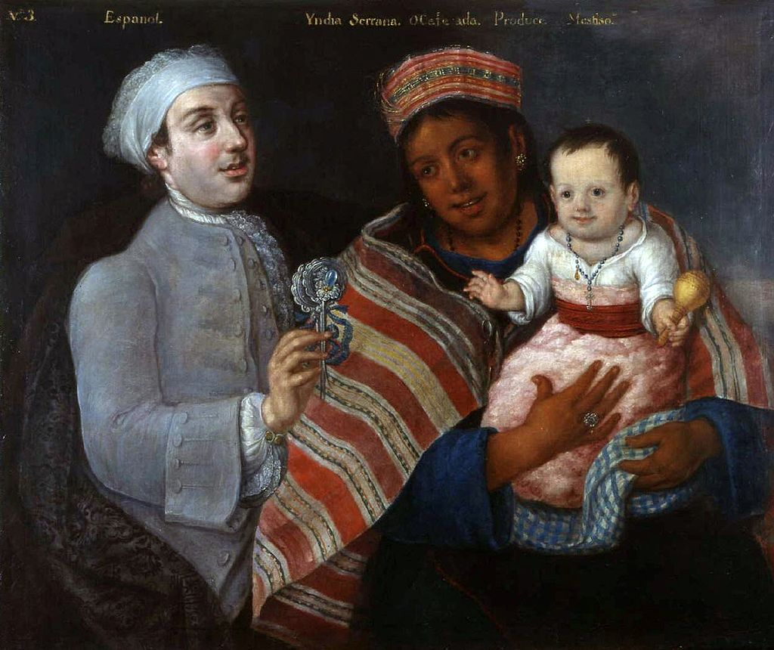
Mestizo Society
Over 85% of Spanish and Portuguese migrants were male.
results in a mestizo or mixed society
Europeans marrying indigenous women was common in Latin America
Indigenous people were still held to a lower social status and used as enslaved laborers and indentured servants.
Los cuadros del mestizaje del Virrey Amat c. 1770

Slide 33
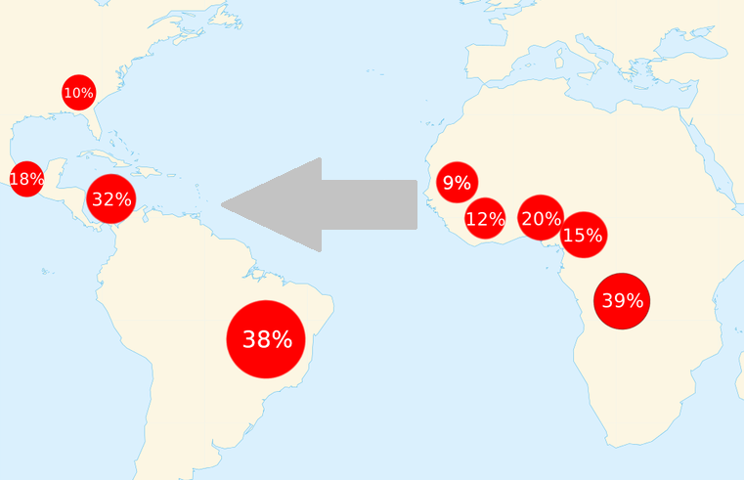
Enslaved Africans
In addition to enslaving Native Americans, Europeans came to increasingly rely on enslaved Africans.
To maintain enslaved laborers, race became an increasingly important factor in determining social status in the Americas.
Map showing geographic points of origin (Africa) and destination (the Americas) for enslaved people in the transatlantic slave trade.

Slide 35
French and Indians
Trade with Natives
Live among natives→ do not disrupt Native lifestyles
Learn Native languages
Intermingle and intermarry
Marriage between French and Natives was encouraged and accepted
“Our young men will marry your daughters, and we shall be one people.” -Champlain

