Slide 1
Age of Imperialism

Slide 2
Motivations for imperialism
Asian Imperialism
African Imperialism
US Imperialism

Slide 3
Motivations for Imperialism
Military/Defense
Political
Cecil Rhodes: imperialism alternative to civil war
Economic
Industrial capitalism
Exporting goods
Religious
Geopolitical
Controlling important waterways, etc.

Slide 4
Primary Source Tie In: Motivations
When I next realized that the Philippines had dropped into our laps I confess I did not know what to do with them. . . And one night late it came to me this way:
That we could not give them back to Spain- that would be cowardly and dishonorable;
that we could not turn them over to France and Germany-our commercial rivals in the Orient-that would be bad business and discreditable;
that we not leave them to themselves-they are unfit for self-government-and they would soon have anarchy and misrule over there worse than Spain's wars; and
that there was nothing left for us to do but to take them all, and to educate the Filipinos, and uplift and civilize and Christianize them, and by God's grace do the very best we could by them, as our fellow-men for whom Christ also died.
-William McKinley, US President, 1903

Slide 5
Theories that drive Imperialism
Social Darwinism
Herbert Spencer, English Sociologist
“Survival of the Fittest”
Sea power = Success
Alfred Mahan, American military historian
Powerful navy, and geographically dispersed naval bases are key to national success (protects trade interests, etc.)

Slide 6
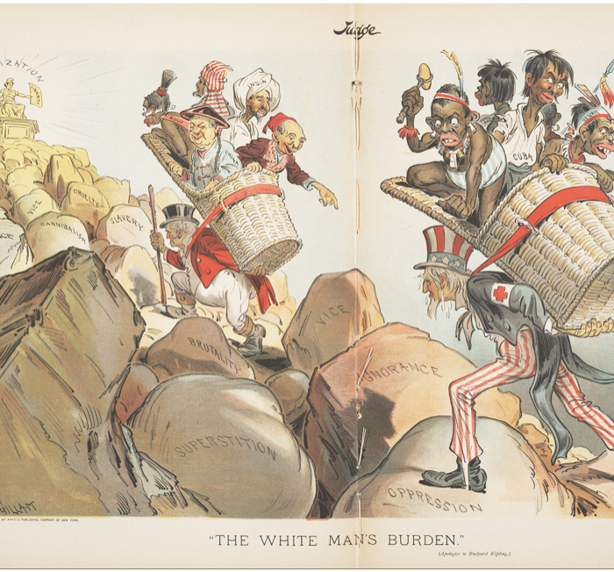
The “White Man’s Burden”
Rudyard Kipling (1864–1936)
Duty to bring order and enlightenment to distant lands
French: mission civilisatrice
Judge, 1899
Notes:
Take up the White Man's burden--
Send forth the best ye breed--
Go bind your sons to exile
To serve your captives' need;
To wait, in heavy harness,
On fluttered folk and wild--
Your new-caught, sullen peoples,
Half-devil and half-child.
Take up the White Man's burden--
In patience to abide,
To veil the threat of terror
And check the show of pride;
By open speech and simple,
An hundred times made plain,
To seek another's profit
And work another's gain.
Take up the White Man's burden--
The savage wars of peace--
Fill full the mouth of Famine,
And bid the sickness cease;
And when your goal is nearest
The end for others sought,
Watch Sloth and heathen Folly
Bring all your hope to nought.
Take up the White Man's burden--
No iron rule of kings,
But toil of serf and sweeper--
The tale of common things.
The ports ye shall not enter,
The roads ye shall not tread,
Go make them with your living,
And mark them with your dead.
Take up the White Man's burden,
And reap his old reward:
The blame of those ye better,
The hate of those ye guard--
The cry of hosts ye humor
(Ah, slowly!) toward the light;--
"Why brought ye us from bondage,
Our loved Egyptian night?"
Take up the White Man's burden--
Ye dare not stoop to less--
Nor call too loud on Freedom
To cloak your weariness;
By all ye cry or whisper,
By all ye leave or do,
The silent, sullen peoples
Shall weigh your Gods and you.
Take up the White Man's burden--
Have done with childish days--
The lightly proffered laurel,
The easy ungrudged praise.
Comes now, to search your manhood
Through all the thankless years,
Cold, edged with dear-bought wisdom,
The judgment of your peers!

Slide 7
Asian Imperialism

Slide 8
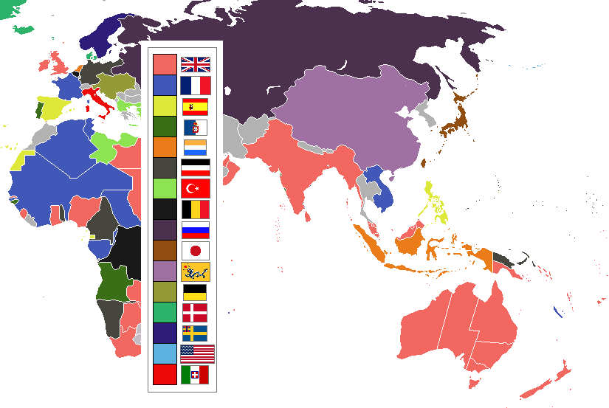
1898-
Asian
Imperialism

Slide 9
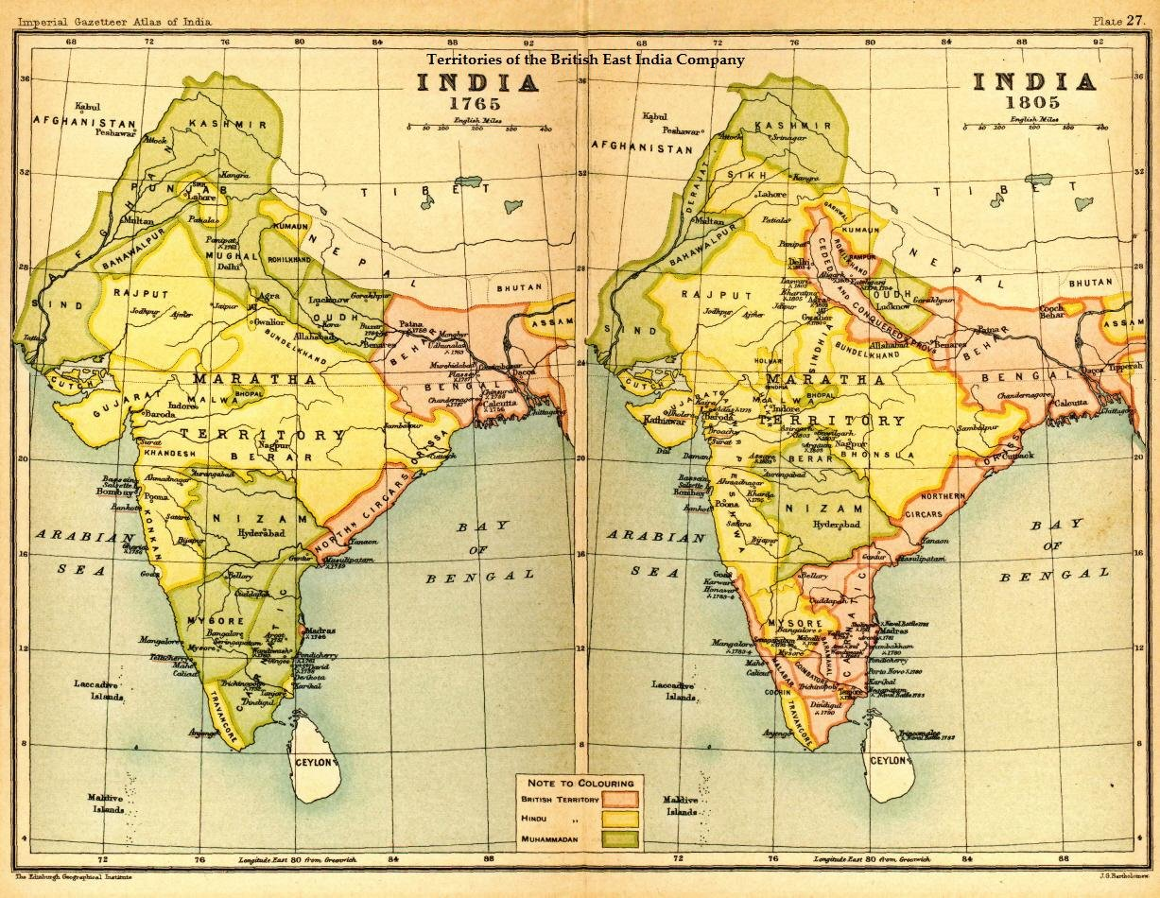

Slide 10
Indian Rebellion, 1857
Small-scale sepoy (Indian soldier serving under British authority) rebellion
Lack of respect for cultural beliefs lead to issues between British and Indian nationals. (wax paper cartridges made with animal fats)
ignited general anti-British revolution
British gained upper hand in late 1857

Slide 11
British Imperial Rule
In response to the rebellion, Britain:
Abolished Mughal empire
Exiled emperor to Burma
Abolished East India Company
Established direct rule of India by British government

Slide 12
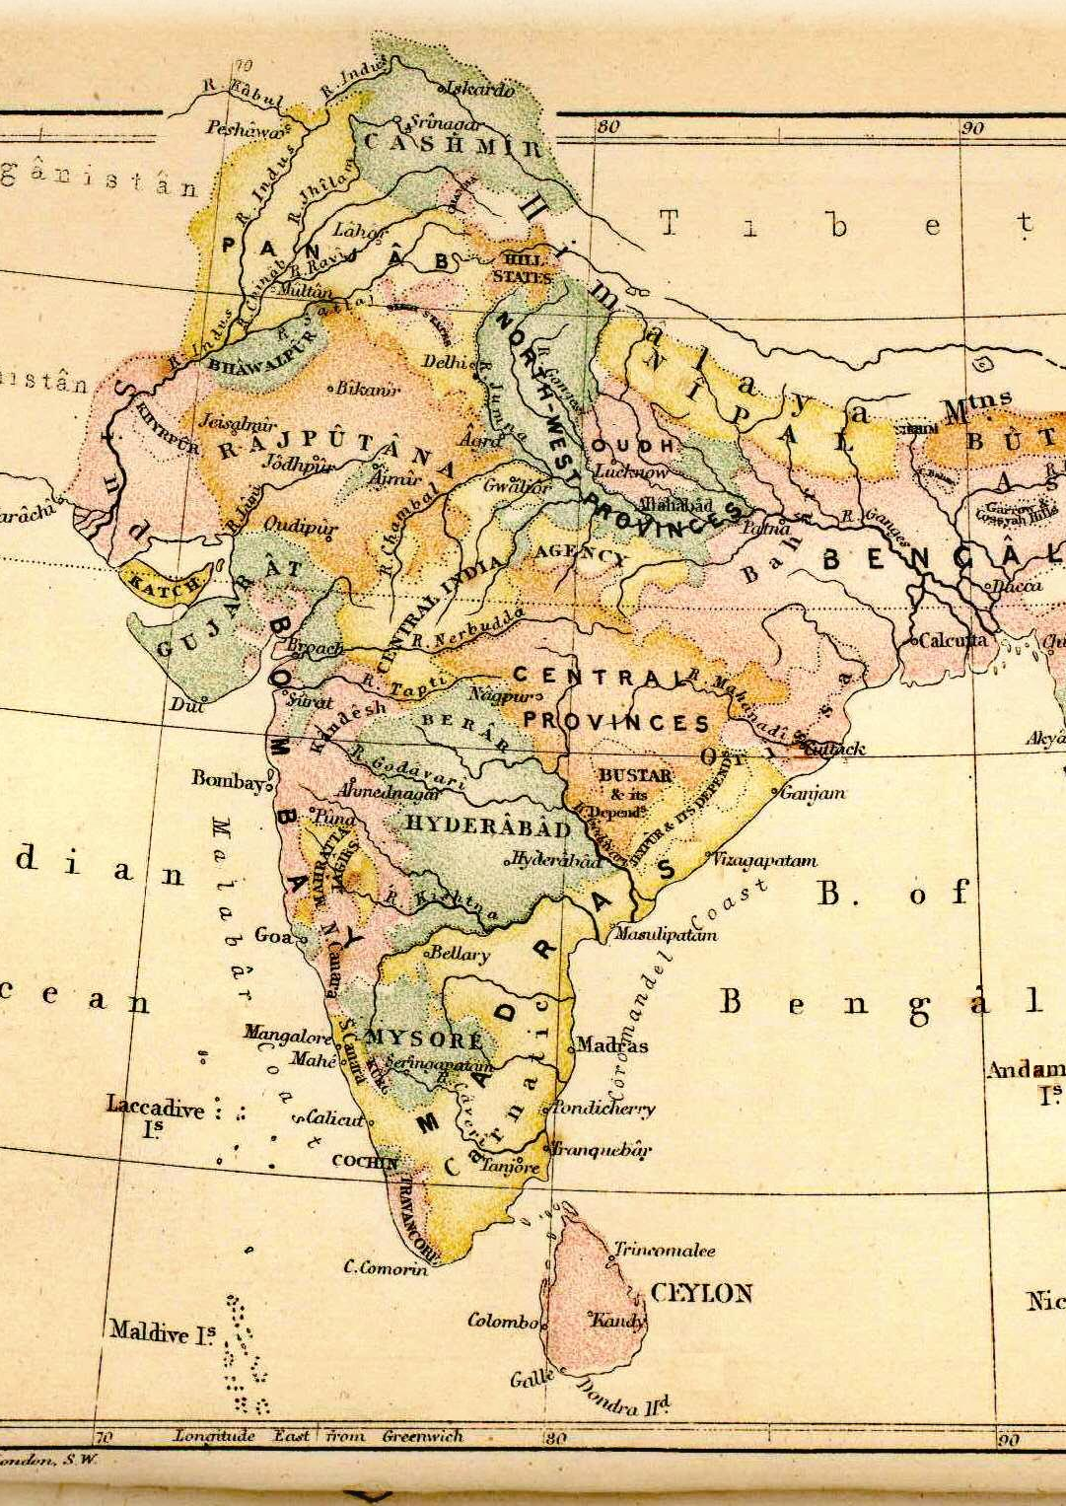
Nationalism and Anticolonial Movements
Indian National Congress formed, 1885
Operated alongside the British colonial government
1916, joined with All-India Muslim League

Slide 13
Imperialism in Central Asia
British, French, Russians in competition for central Asia
The “Great Game”: Russian vs. British intrigue in Afghanistan
Preparation for imperialist war
Russian revolution of 1917 forestalled war

Slide 14
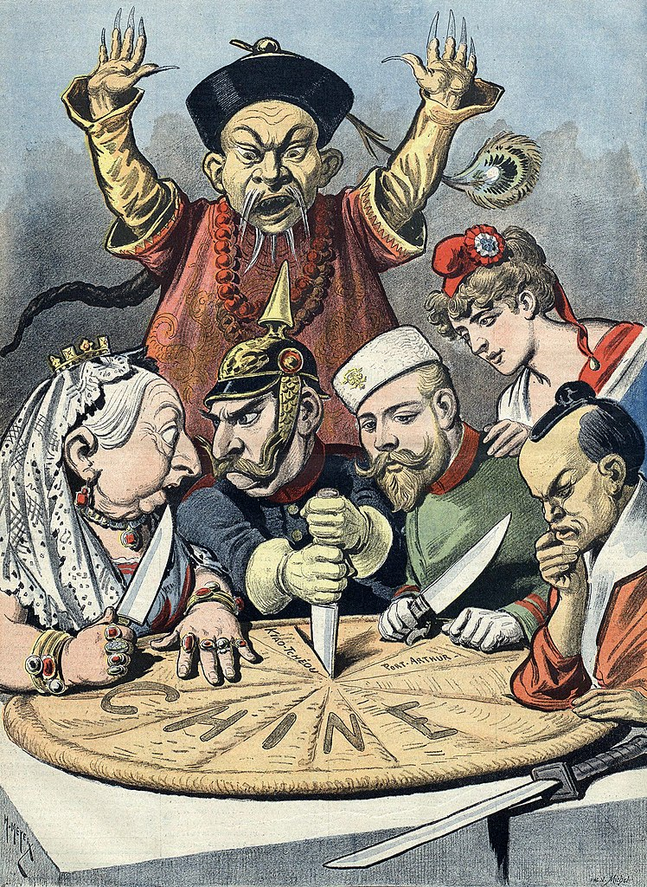
East Asia in the Long Nineteenth Century

Slide 15
Imperialism in Southeast Asia
Spanish: Philippines, maintained influence from the 1500s-1898
Dutch: Indonesia (Dutch East Indies), maintained influence from 1600s
British: Burma (established colonial authority by 1880s)
French: Vietnam, Cambodia, Laos, 1859–1893
United States: Philippines, post 1898
Other locations, such as China and Japan, suffered from economic exploitation

Slide 16
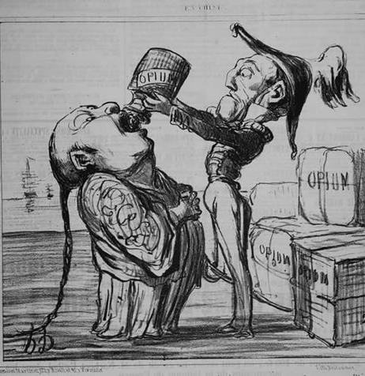
British East India Company heavily involved in opium trade
Opium grown in India, sold in China for silver; silver used to buy other Chinese products
Opium technically illegal, however, ban was poorly enforced
Chinese moved to enforce ban in the late 1830s →the Opium War (1839–1842)
Chinese defeated by British
The Chinese Empire

Slide 17
Unequal Treaties
China forced into a series of disadvantageous treaties aka “Unequal Treaties”
“Treaty Ports”
Hong Kong ceded to British in Treaty of Nanjing (1842), ports opened to British traders
Later, other countries concluded similar treaties
By the late 1800s, China is said to be “carved up like a melon” by foreign powers competing for “spheres of influence” on Chinese soil.

Slide 18
Rebellion’s Threaten the Qing
Large-scale rebellions in later reflected poverty, discontent of Chinese peasantry signaled the loss of the Mandate of Heaven
Nian rebellion (1851–1868), Muslim rebellion (1855–1873), Tungan rebellion (1862–1878)
Taiping rebellion(1850-1864); called for destruction of Qing dynasty massive in scale

Slide 19
Taiping Defeat
Nanjing captured in 1858, made into capital
Attack on Beijing with force of 1 million, but turned back
Imperial army unable to contain Taipings, so regional armies created with Manchu soldiers and outfitted with European weaponry
Hong committed suicide in 1864; Nanjing recaptured
100,000 Taipings massacred
In total 20+ million deaths associated with the Taiping Rebellion.

Slide 20
Boxer Rebellion
The well-known “Boxer Rebellion” of 1898-1900 began as an anti-Qing uprising but was redirected by the Qing Dowager Empress Cixi in opposition of Western influence in China (including anti-Christianity)
Boxers were led to believe European weapons would not harm them, crushed by coalition of European and United States troops
→China forced to accept stationing of foreign troops
In 1908, Empress Cixi died spelling the end of the Qing Dynasty

Slide 21
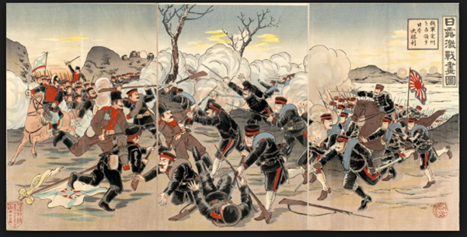
Japan

Slide 22
Foreign Pressure
Europeans, Americans attempting to establish relations
U.S. looking for Pacific ports for whalers, merchants
1853, Matthew Perry sailed gunship up to Edo (Tokyo), forced Japanese to open port
Sparked conservative Japanese reaction against shogun, rally around emperor in Kyoto
Leads to the 1868 Meiji Restoration of the emperor

Slide 23
Modern government & Imperial Ambitions
1889 constitution
Conservative; only 5% of male population allowed to vote in 1890 election
Economic reforms promoted rapid industrialization
Dramatic improvement in literacy rates and public school instituted
Growing imperial goals
Japanese victory in the Russo-Japanese War
fought (1904-1905) between the Russian Empire and the Empire of Japan over rival imperial ambitions in Manchuria and Korea

Slide 24
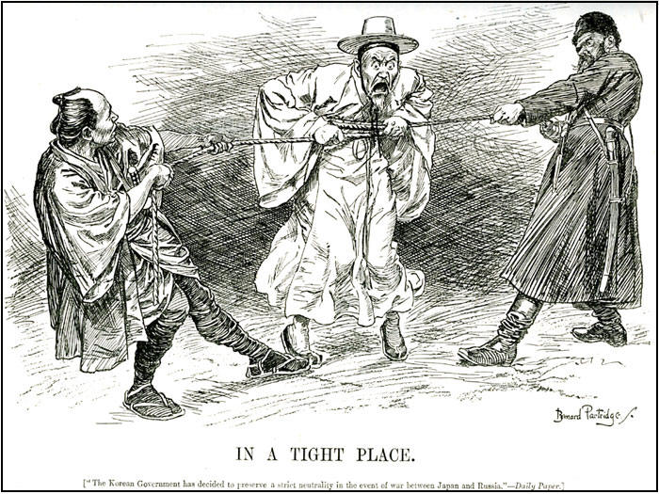

Slide 25
African Imperialism

Slide 26
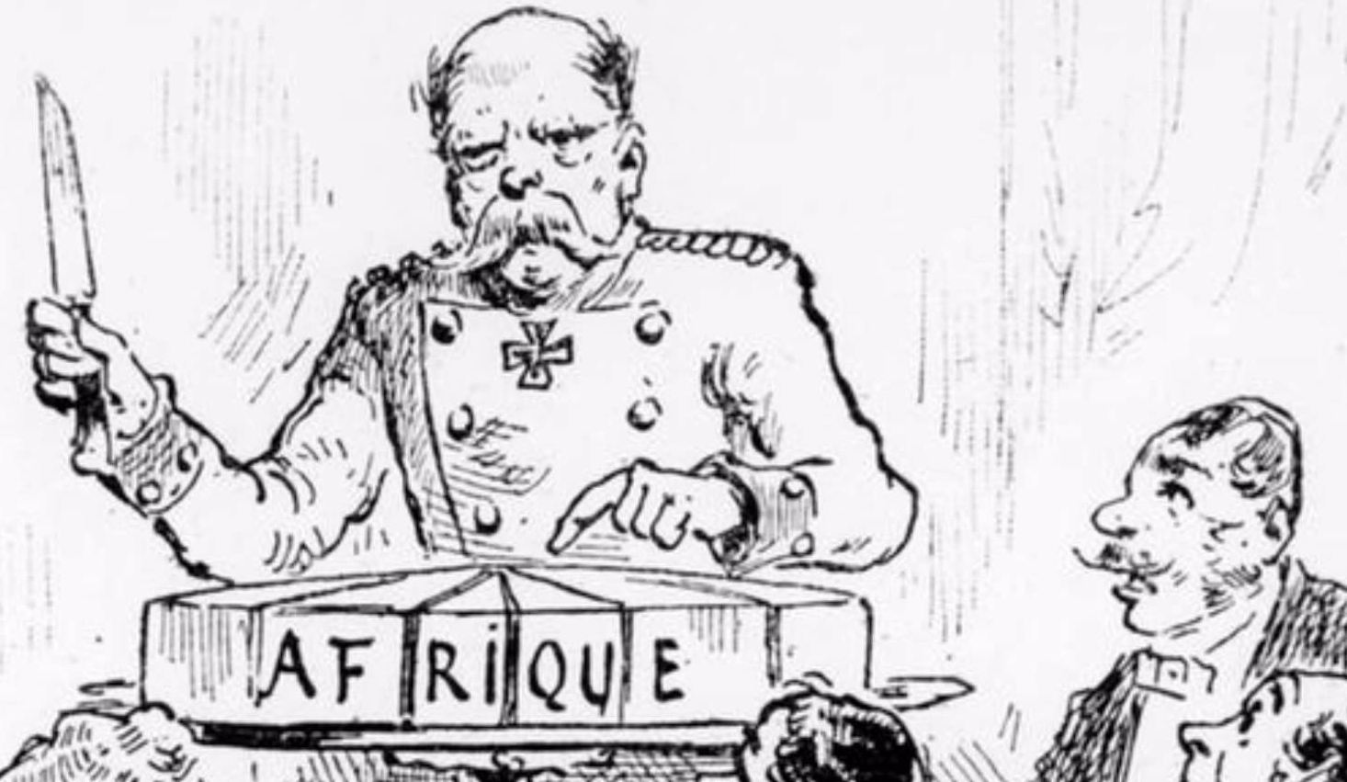
The Scramble for Africa (1875–1900)
French, Portuguese, Belgians, and British competed for Africa, later Germany and Italy make attempts
Britain established strong presence in Egypt, Rhodesia
-Egypt/Suez Canal, from waning Ottoman control
-Rhodesia for gold, diamonds

Slide 27
The Berlin West Africa Conference (1884–1885)
Fourteen European nations, United States
No African states present
Decide that any European state can take “unoccupied” territory after informing other European powers
European firepower dominated Africa, quickly the vast majority of Africa was claimed by European nations.
Exceptions: Ethiopia fought off Italy (1896); Liberia a U.S. dependency

Slide 28
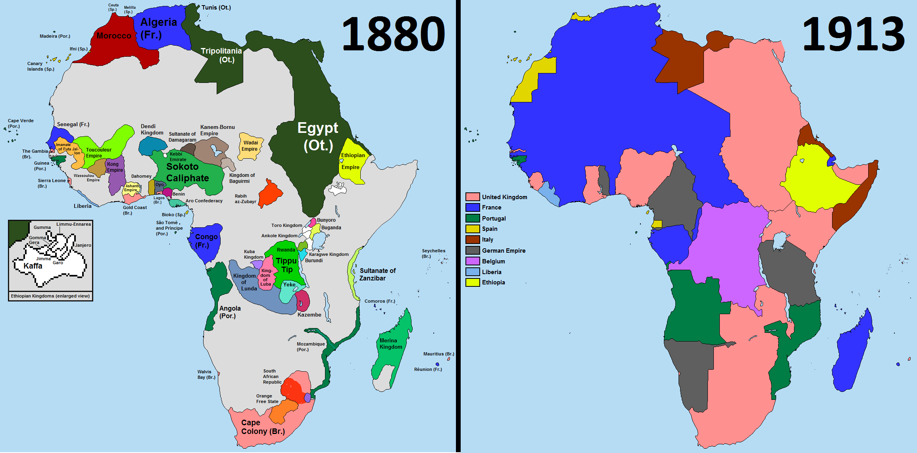

Slide 29
U.S. Imperialism
The Monroe Doctrine: President James Monroe warned Europeans not to engage in imperialism in western hemisphere (1823)
All Americas a U.S. “protectorate”
1867: purchased Alaska from Russia
1875: established “protectorate” over Hawai`i
European and American businessmen overthrew Hawaiian monarchy in 1893, persuaded U.S. to acquire islands in 1898

Slide 30
The Spanish-American War (1898–1899)
U.S. declared war on Spain after battleship Maine sunk in Havana harbor, 1898
Took possession of Cuba, Puerto Rico, Guam, Philippines
Filipinos revolted against Spanish rule, later against U.S. rule
U.S. intervened in other Caribbean and Central American lands including supporting Panamanian independence to build Canal.

Slide 31
