Slide 1
Land and Labor in the Long 19th Century

Slide 2
Outline
Industrialization and the Market Revolution
Market-based economy
Industrial capitalism
Challenging the Status Quo
Long 19th Century: Reform and Revolution
United States
Russia
Latin America

Slide 3
Industrialization and the Market Revolution

Slide 4
Market Revolution: Market-Based Economy
One in which goods are made not for personal consumption, but for sale.
Requires reliable transportation networks to move goods
Internationally (between nations)
Intranationally (within a given nation)

Slide 5
Industrial Innovation
The First Industrial Revolution (1790s-1830s)
• Coal and steam made the first Industrial Revolution possible in the United States.
• Coal-fed steam engines powered factories.
The Second Industrial Revolution (1870s-1910s)
• Bessemer Steel allows for stronger, more efficient production of steel
• Increases infrastructure (trains, bridges, buildings, etc.)

Slide 6
Industrial Capitalism
Using machines to increase production of marketable goods.
Originates in England in the 19th century
Increase productivity overall, costs for many objects/products were lowered.
→ Increased productivity meant fewer people needed to work in agriculture to sustain populations:
In 16th century, 80% of England’s population worked in agriculture
By 1850, was roughly 25% of England’s population

Slide 7
The Factory System
Early modern Europe had adopted “putting-out” system
Individuals worked at home; employers avoided wage restrictions of medieval guilds
Rising prices caused factories to replace both guilds and putting-out system
Machines too large, expensive for home use
Large buildings could house specialized laborers
Urbanization guaranteed supply of cheap labor

Slide 8
Challenging the Status Quo
The Rise of Socialism, Communism, and Labor Unions

Slide 9
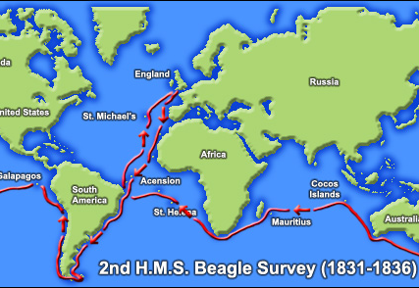
Science applied to Sociology
Origins of Species
First published in 1859
Outlines the theory of evolution.

Slide 10
Social Darwinism
Herbert Spencer, applied biological concepts of natural selection (evolution) to sociology and politics.
This logic in turn allows for the guilt-free accumulation of wealth. Rapidly increases towards the end of the long 19th century.
In 1890 the richest 9% of Americans held nearly 75% of the nation’s wealth.

Slide 11
The Socialist Challenge
Socialism first used in context of utopian socialists Charles Fourier (1772–1837) and Robert Owen (1771–1858)
Opposed competition of market system
Attempted to create small model communities
Inspirational for larger social units

Slide 12
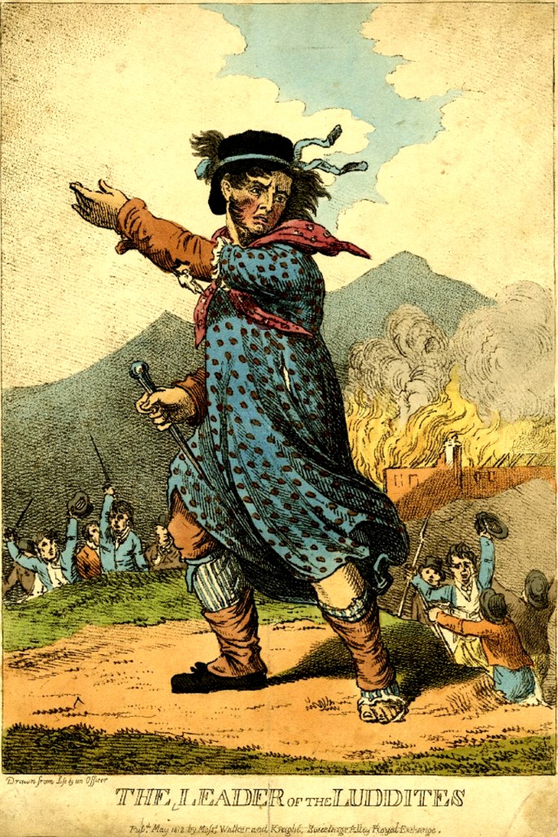
The Luddites
Group of anti-industrialists from Great Britain, attacked machines/factories
Began in 1811 and was ultimately suppressed by violence and intimidation against protestors.

Slide 13
Karl Marx (1818–1883) and Friedrich Engels (1820–1895)
Two major classes:
Capitalists, who control means of production
Proletariat, wageworkers who sell labor
Exploitative nature of capitalist system
Religion: “opiate of the masses”
The Communist Manifesto
Argued for an overthrow of capitalists in favor of a “dictatorship of the proletariat”

Slide 14
long 19th century reform and revolution
United States
Latin America
Europe

Slide 15
Reform in the US

Slide 16
The U.S. Civil War (1861–1865)
Issue of slavery highlighted principle of states’ rights, scope of federal authority
Eleven southern states withdrew from Union, 1860–1861
Southern economy: dependent on cotton as cash crop, used primarily enslaved laborers
Northern economy: developing industrialization, wage earners

Slide 17
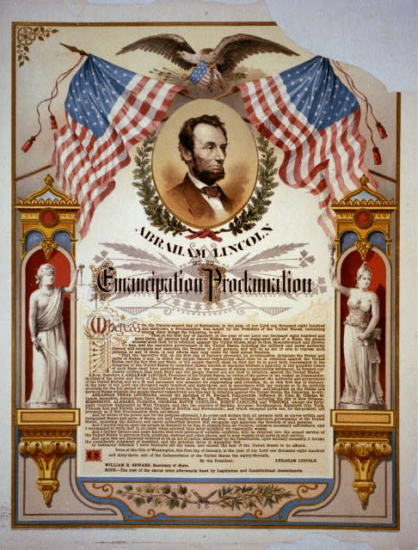
Legalizing Freedom
1863, Lincoln signed Emancipation Proclamation, making abolition of slavery explicit goal of war
1865, the Thirteenth Amendment makes slavery illegal across the nation

Slide 18
What to do with freed slaves?
Many Republicans, such as Lincoln, did not agree with the concept of equality between the races. Many Democrats supported keeping African Americans as slaves.
Reconstruction Era
The Fourteenth and Fifteenth Amendment made former slaves citizens of the US and provide the legal right to vote.
“Forty Acres and a Mule” AKA Special Field Orders No. 15, a wartime order allotted land to some freed families, in plots of land no larger than 40 acres. *This policy would be overturned after the war.*

Slide 19
By the late 19th century…
The brief period of Reconstruction ended in 1877.
De facto “Jim Crow” segregation policies became increasingly common across the US.
By the 1890s, segregation was de jure following the Plessy v. Ferguson Supreme Court decision.

Slide 20
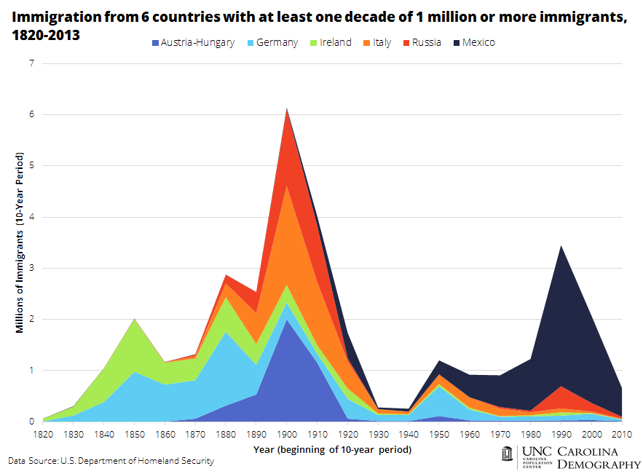
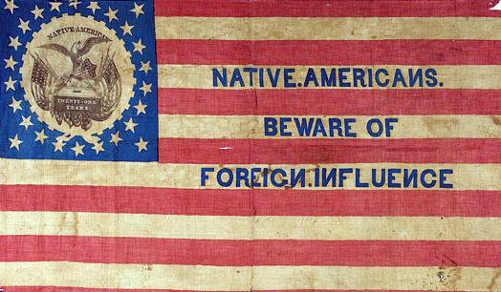
U.S. population most culturally diverse in hemisphere→ Nativism movement spreads
White Anglo-Saxon Americans felt under attack in the 19th century by high rates of immigrations which led to a rise in nativism.

Slide 21
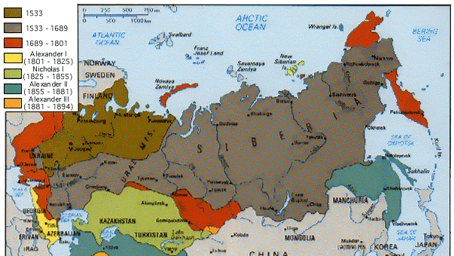
The Russian Empire,

Slide 22
The Russian Empire Under Pressure
In the 19th century, Russia was a massive, multi-cultural empire
Only approximately half spoke Russian, or observed Russian Orthodox Christianity
Romanov tsars ruled autocratic empire
Powerful class of nobles exempt from taxation, military duty
Exploitative serfdom for 20 million Russians

Slide 23
The Crimean War (1853–1856)
Russian expansion into Caucasus in attempt to establish control over weakening Ottoman empire
Threatened to upset balance of power; led Europeans to become involved
Russia driven back from Crimea in humiliating defeat
Demonstration of Russian weakness in face of western European technology and strategy
→Prompts Alexander II to reconsider societal norms

Slide 24
Attempted State Reforms
Limited attempts to reform administration, small-scale representative government
Network of elected district assemblies called zemstvos
Serfdom seen as a source of rural instability and peasant revolt
In 1861 Serfs emancipated by Tsar Alexander II. Serfs were now forced to pay for lands they had farmed for generations.
Moved towards industrialization in the late 1800s

Slide 25
Industrialization in Russia
Witte system, 1890s Industry over Agriculture
Count Sergei Witte, minister of finance 1892–1903
State subsidization of the railway industry and key industries (mining, steel, oil), put Russia on the gold standard to attract foreign investment
Witte neglected agriculture and overwhelmed an already heavily burdened peasantry by increasing taxes

Slide 26
Repression of Protestors
Intelligentsia spread radical ideas for change
Socialists, anarchists
Utilized terror tactics, assassinations
Denounced and sent into Siberian exile
Growth of nationalist sentiment in Baltic provinces, Poland, Ukraine, Georgia, central Asia
Tsarist authorities turned to censorship, secret police

Slide 27
Terrorism
1881: assassination of Tsar Alexander II by radical People’s Will movement
Prompted widespread pogrom attacks on Jews
Increased repression
Nicholas II (r. 1894–1917) entered into war with Japan (1904–1905)
Humiliating defeat exposed government weaknesses
Social discontent boiled over in revolution, 1905
Turmoil forced government to make concessions

Slide 28
Latin America in the long 19th Century

Slide 29
Latin America: Trouble after Independence
Creole elites produced republics with constitutions,
Creoles had less experience with self-rule than in British held colonies
Creoles also limited wide participation in politics
Significant political differences divided creoles (Liberal vs. Conservative)
Conflict with indigenous peoples
Caudillos (regional military leaders) came to power

Slide 30
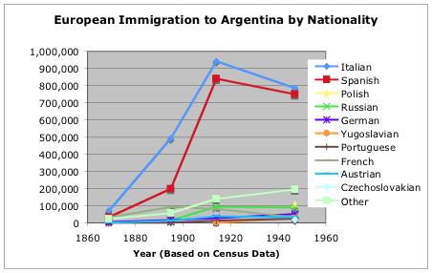
Diversity in Latin America
Complex social structure, based on racial background
Europeans, natives, African slaves, combinations thereof
Increasing migration from Asia and Europe in mid-to-late nineteenth century
Rural vs. urban divide

Slide 31
The Emergence of Political Ideologies
Conservatism
Disavowed rapid revolutionary change
Favored slow evolution of society
Liberalism
Viewed conservatives as defenders of illegitimate status quo
Manage, not stifle, social change

Slide 32
Mexico: War and Reform
Mexican war for independence lasted from 1810-1831
After Mexican-American War (1840s), reform government of Benito Juárez came to power
A “liberal,” Juárez attempted to limit power of military, church
To reshape Mexico’s financial position, postponed repayment of European loans
Juárez met powerful conservative opposition; forced out of Mexico City
Loan payments to foreign powers suspended; Europeans intervened to collect investments
Clash between French and Mexican forces, 1862

Slide 33
Porfirio Díaz, general and president
A caudillo, served as President of Mexico from 1877–80 and 1884–1911
Consolidation of power and built up a strong political machine that appealed to the more conservative classes (clergy and wealthy)
Mostly ignored the Mexican indigenous population and poorer classes
Announced his retirement in 1908 and appointed a successor. This left many people discouraged and Mexico descended into the Mexican Revolution shortly after.

Slide 34
The Mexican Revolution (1910–1920)
Middle-class Mexicans, peasants and workers joined to overthrow Porfirio Díaz’s political machine
The war went through many phases. Ultimately, the more moderate leaders took control.

Slide 35
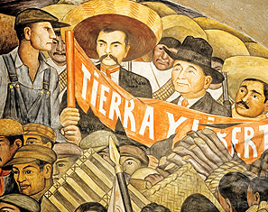
Tierra y libertad
Revolutionary leaders Emiliano Zapata (1879–1919) and Francisco (Poncho) Villa (1878–1923) led masses of landless peasants
Wanted to provide “land and freedom.” Popular, but unable to take major cities
Mexican Constitution of 1917 addressed many of the major concerns of land redistribution, this limited the more progressive factions of the Revolution.
Diego Rivera mural “Tierra y libertad” (Land and Freedom)

Slide 36
Conclusion
Concerns about changes to society as industrialization increased caused a wave of revolutions in the mid-19th century.
Internal conflict over land rights and peasants caused revolts in Russia, Mexico--and to some extent the US Civil War.
Frequently these progressive attempts at reform were constrained by societal norms and more conservative leaning politicians .

