Slide 1
The Transformation of Early Modern Europe

Slide 2
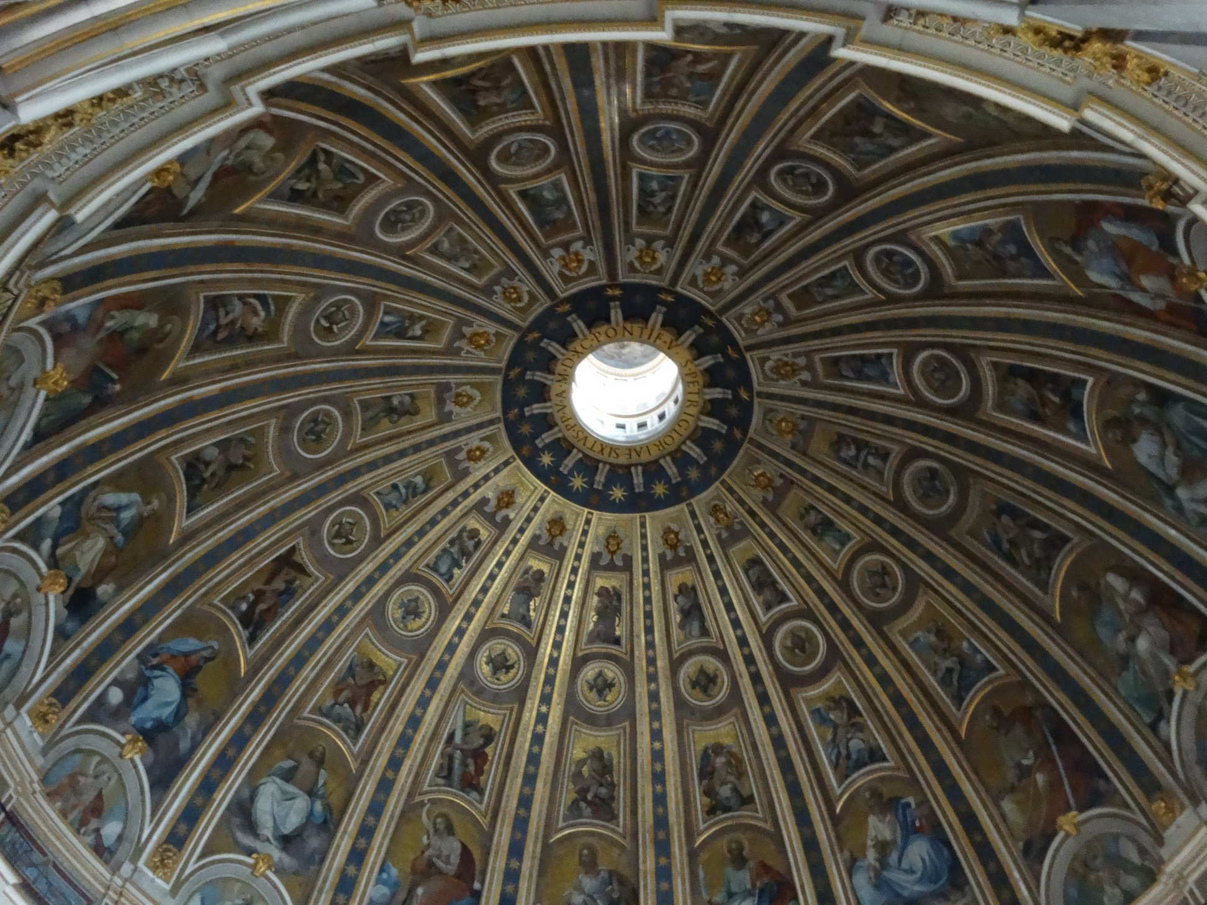
Roots of Reform-Protestant Reformation
Technological advancement:
Gutenberg’s printing press, circa 1450
Allows for faster reproduction of texts (including the bible and pamphlets)
Catholic Church corruption:
Politics
Blurred lines between clergy and wealthy families
Church involved in political issues not just theological
Economics
Selling indulgences increased to fund the construction of St. Peter’s Basilica (construction started c. 1500)
Inside view of the dome of St. Peter’s Basilica

Slide 3
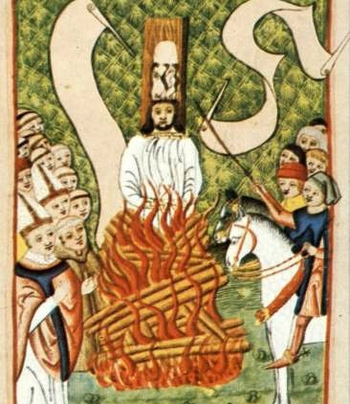
Jan Hus
Czech reformer who lectured at the University of Prague
Asserted that one should not kill for their faith and that sins were forgiven for repentance not through donation$
Hus was burned at the stake in 1415 for his unorthodox views.
→Roots of reform simmered for nearly 100 years before…

Slide 4
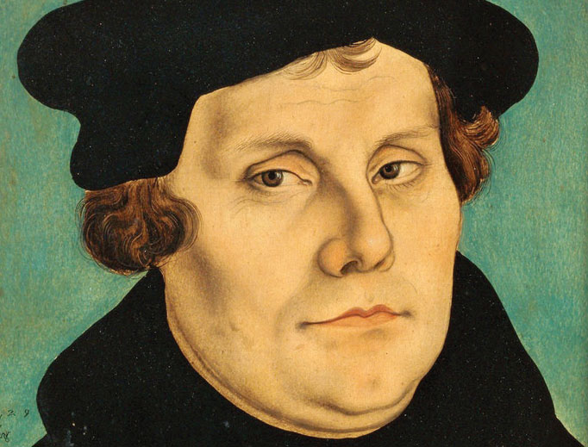
Martin Luther
95 Theses, 1517
Attacks selling of indulgences to gain salvation
Attacks notion that only clergy should be able to read the Bible and interpret God’s word
Results in the Protestant Reformation

Slide 5
Offshoots of Protestant Reformation
Calvinism
English Reformation
Catholic Reformation
Establishes the doctrine of predestination
Centered in Switzerland
Political and religious motivations
Establishes the Anglican church as the official church of England
→ transfers property from Catholic Church to nation-state
Catholic Church implemented reforms following schism
Increased support for the Society of Jesuits
Primarily missionaries
Viewed as less corrupt than the main branch of Catholicism

Slide 6
Religious Wars
Protestant and Catholic leaders vied for political power through supporting established religions and demonizing the “other”
In 1572, in France the St. Bartholomew’s Day Massacre spread and over a one-month period nearly 25,000 French Huguenots (Protestants) were killed.
Between 1550s and 1650s, religious wars were common throughout Europe
Most significant of these wars is the Thirty Years’ War

Slide 7
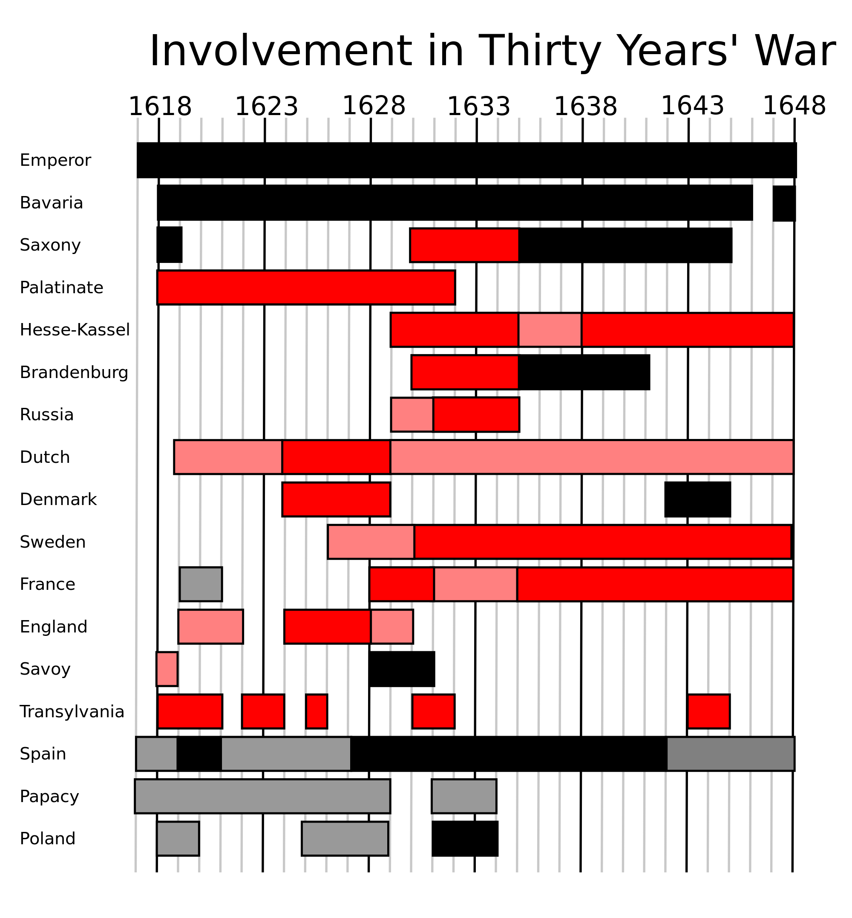
The Thirty Years’ War
Attempt by the Holy Roman Emperor to force Bohemians (CZ) back under the Catholic church
Ultimately all of Europe is involved in the conflict
Approximately ¼-1/3 of the central European population is annihilated as a result of the Thirty Years’ War (8 million fatalities)
Some areas, like northern Germany experienced over a 50% population loss.
The conflict changed the geopolitical face of Europe and the role of both religion and nation-states in society.
1618-1648

Slide 8
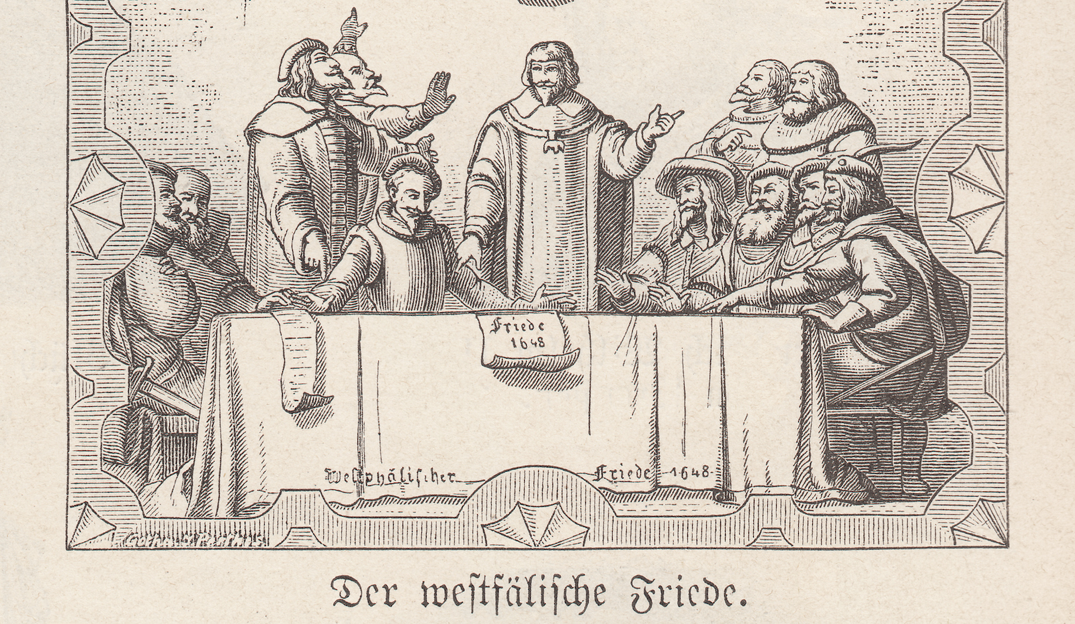
Peace of Westphalia, 1648
Ended the Thirty Years’ War
Ended the Holy Roman Empire
Recognized sovereignty and equality of European of nation-states
Protected domestic and religious decisions from foreign intervention
No longer an imperial authority to mediate intra European disputes

Slide 9
Nation-State Building
The Rise of Homogeneous States

Slide 10
Modern Europe
European States System
No European imperial authority (all sovereign and equal following 1648)
Balance of power was tenuous, warfare continued across the globe and in Europe
Rapid innovation in military technology due to concerns over neighbors/“enemies” and wanting to expand overseas empires

Slide 11
Two systems of states arise
Constitutional states
Generally shared power between monarch and representative assembly.
Theoretically more tolerant of religious and political dissenters.
Absolutist states
Monarchs claimed “absolute” power and authority over matters of the state.
Typically intolerant of religious or political dissenters.

Slide 12
Constitutional States
Netherlands
England
Religious conflict between Calvinists in the Netherlands and (Catholic) King Phillip II of Spain
Fighting Spanish for self-government in 80 Years’ War, begins in 1581
Republic government formed in 1588
Based on representative parliamentary system
Constitutional Monarchy after Glorious Revolution of 1688
Bloodless coup
William and Mary agree to shared governance between crown and parliament

Slide 13
Absolutism
codification of laws applicable to the entire realm,
organization of a professional standing army,
pursuit of ‘mercantilist’ (economic) policies designed to enrich the ruler and the state

Slide 14
Absolute Monarchies
France
Russia
King Louis XIII, 1624-1642
Attacked aristocratic conspiracies
Destroyed castles of competing nobility
In an effort to consolidate power
King Louis XIV, 1643-1715
Built Versailles, required nobility to live at Versailles to minimize uprisings
“The Sun King” evocative of divine right to rule → heavenly body
Reinstituted intolerance of protestants
Peter I, 1682-1725
Imposed new taxes on the peasants, which paid for the military
Challenged the Russian Orthodox Church
Sought to model Russia on western Europe nations (like France)
Built new capital at St. Petersburg.
Catherine II, 1762-1796
Reforms education and legal systems in Russia
Ends reformation and liberalization policies following a peasant rebellion in 1773-1774

Slide 15
Controlling Populations: The birth of the nation-state
Increasing taxes
01
Building standing armies
02
Building infrastructure
03
Suppressing non-conformists
04

Slide 16
Suppressing Non-Conformists
Spanish Inquisition
Witch Hunts
Founded by Ferdinand and Isabella, 1478
Sought to eliminate practitioners of Judaism or Islam and later Protestants
Imprisoned or executed non-Catholics
Late 1400s development in the belief of the devil and human assistants
16-17th century approximately 100,000 people put on trial of which more than 40,000 were put to death
Mostly widowed women were targeted
Held accountable for bad luck/health
Mostly occurred in areas battling between Protestantism and Catholicism
→ Aimed at establishing homogenous citizenry

Slide 17
Reforms and Revolts

Slide 18
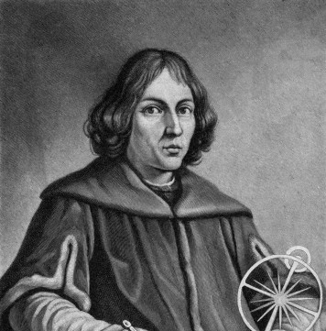
The Scientific Revolution
One of the biggest reform movements of 16th and 17th centuries
The Copernican Universe challenged Christian doctrine with the notion of the earth moving—not the sun. Galileo Galilei later provided evidence of the heliocentric universe.
Rigorous challenges to church, emphasized reason over faith.

Slide 19
The Scientific Method
The philosophy of using an inductive approach to study nature (i.e. to abandon assumption and to observe with an open mind) was a fundamental part of Scientific Method and required a planned procedure in pursuits of answering scientific questions.

Slide 20
German Peasants’ War, 1524-1525
Influenced by Martin Luther’s 95 Theses
Was an uprising by serfs desiring additional rights and resentful of nobility and fees demanded by Catholic Church
Large scale movement (largest political uprising in Europe until French Revolution), over 300,000 participants (100,000 of whom lost their lives)
→ German Peasants' War led to an overall reduction of rights and freedoms of the peasant class

Slide 21
Urbanization and Population Growth
Between 1500 and 1750 the population of Europe doubled from about 65 million to around 127.5 million.
Increased nutrition due to Columbian Exchange
Reliance on potatoes
Reliance on maize (corn)
Urbanization
As populations expanded, urban areas increased

Slide 22
The Rise of a Capitalist Economy
Banks and stock exchanges pop up in Western Europe
Joint Stock Companies evolve and assist in empire building and wealth accumulation for those who could afford to invest
Social changes due to establishment of capitalism:
Rise in crime due to increasing poverty and increasing wealth inequality
Increasingly racialized society because of transatlantic slave trade investment opportunities

Slide 23
This tumultuous period broke down previous institutions and built the foundation of modern Europe. From religious and political transformations to social and scientific movements, Europe looked very different at the dawn of the 1800s than it had in 1500.

