Slide 1
Writing & Reading History
An Introduction

Slide 2
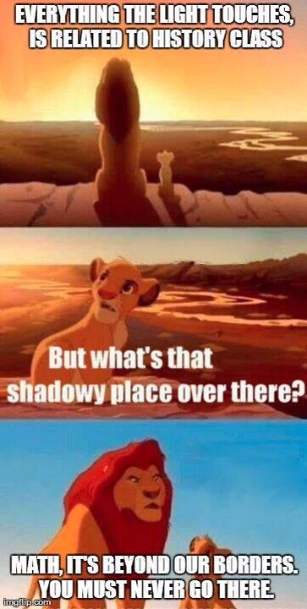
What is History?

Slide 3
What is History?
History incorporates science, art, mathematics, sociology, economics, and more!
History is based off of evidence, but historical analysis uses the evidence to create an argument or interpretation.
History is typically presented through a narrative. But how the narrative gets established is equally important.

Slide 5
Facts:
(1) The United States entered World War II following the attack on Pearl Harbor in December 1941.
(2) World War II began when Nazi Germany invaded Poland in 1939.
(3) When Japan invaded Manchuria in 1931, it start the expansionist policies that led to World War II.
Using these same facts, historians might argue for several different interpretations of when World War II “started.”

Slide 6
Interpretations:
(1) An “Americanist”—World War II lasted from 1941-1945
(2) A Eurocentric—World War II lasted from 1939-1945
(3) An Asianist—World War II began in 1931 and ended in 1945
https://history.mit.edu/subjects/world-war-ii-asia

Slide 7
Sources of Knowledge
Primary and Secondary Sources

Slide 8
Which Source is more trustworthy?
Which source can more accurately be used understand Christopher Columbus’s voyages?
Source 1: History textbook from 1950.
Source 2: Ship’s log from the Santa Maria.
Source 3: Newspaper article from Columbus Day 2017.
Source 4: Modern textbook.

Slide 9
Which Source is Better?
Which source can more accurately be used understand the causes of the World War II?
Source 1: An American history textbook from 2019.
Source 2: A German newspaper from 1939 discussing the successful invasion of Poland.
Source 3: An imperial Japanese announcement about the conquest of Manchuria from 1931.
Source 4: A world history textbook from 1950.

Slide 10
historiography
Definition: The study of historical writing.
Application: When you are reading any secondary source (our textbook included) you should be aware of how that analysis/interpretation was influenced by the time when it was written.

Slide 12
Writing History
→ When writing your papers, you should be careful of your own bias.
Just like other historians, we are also shaped by our own bias and the time period we live in. However, when writing and “doing” history, we should try to be objective.

